Slide 1
Maths – Year 1
Time
-Compare, describe and solve practical problems for time e.g. quicker, slower, earlier, later.
-Measure and begin to record time (hours, minutes, seconds).
-Sequence events in chronological order using language e.g. before and after, next, first, today, yesterday, tomorrow, morning, afternoon and evening.
-Recognise and use language relating to dates, including days of the week, weeks, months and years.
-Tell the time to the hour and half past the hour and draw the hands on a clock face to show these times.
Weight Mass and Capacity
Compare, describe and solve practical problems for mass/weight e.g. heavy/light, heavier than, lighter than.
Measure and begin to record mass/weight.
Compare, describe and solve practical problems for capacity and volume e.g. full/empty, more than, less than, half, half full, quarter.
Measure and begin to record capacity and volume.
Years 1 & 2
Term 6
On Safari
Maths – Year 2
Time
-Compare and sequence intervals of time.
-Tell and write the time to five minutes, including quarter past/to the hour and draw the hands on a clock face to show these times.
-Remember the number of minutes in an hour and the number of hours in a day.
-Read the time on a clock to the nearest 15 minutes.
Weight Mass and Capacity
-Choose and use appropriate standard units to estimate and measure length/height in any direction (m/cm); mass (kg/g); temperature (°C); capacity (litres/ml) to the nearest appropriate unit, using rulers, scales, thermometers and measuring vessels.
-Compare and order lengths, mass, volume/capacity and record the results using >, < and =.
-Read scales in divisions of ones, twos, fives and tens.
-Read scales where not all numbers on the scale are given and estimate points in between .
Writing
-Compose and write sentences independently to convey ideas.
-Write sentences, sequencing them to form short narratives (real or fictional).
-Write sentences by re-reading what he/she has written to check that it makes sense.
-Write effectively and coherently for different purposes, drawing on his/her reading to inform the vocabulary and grammar of his/her writing.
-Consider what he/she is going to write before beginning by writing down ideas and/or key words, including new vocabulary.
-Make simple additions, revisions and corrections to his/her own writing by proof-reading e.g. check for errors in spelling, grammar and punctuation or add/improve words and phrases independently or following a conversation with the teacher
Grammar, punctuation and spelling
Use capital letters and full stops to demarcate sentences in some of his/her writing
Use co-ordination (using or, and, but) and some subordination (using when, if, that, because) to join clauses
Use expanded noun phrases for description and specification e.g. the blue butterfly, plain flour, the man in the moon
Begin to punctuate work using question marks and exclamation marks
Segment spoken words into phonemes and represent them with graphemes, spelling some correctly and making phonically-plausible attempts at others.
Handwriting
-Form lower-case letters in the correct direction, starting and finishing in the right place.
-Form capital letters.
-Use the diagonal and horizontal strokes needed to join letters.
-Write capital letters and digits of the correct size, orientation and relationship to one another and to lower case letters.
English
Core texts “Big Cats” by DK (Non-fiction)
“Mama Panya’s Pancakes - A Village Tale from Kenya” by Mary and Rich Chamberlin
“We’re going on a Lion Hunt” by David Axtell
“Rumble in the Jungle” by Giles Andreae
Reading
-Show understanding of vocabulary by discussing favourite words and phrases.
-Recognise and predict rhyming words in a rhyming text.
-Re-read phonically decodable books to build up fluency and confidence in word reading.
-Predict what might happen on the basis of what has been read so far.
-Answer questions in discussion with the teacher and make simple inferences.
-Know the key plots of the stories they read.
-Understand the layout and features of a nonfiction book.
-Understand that Non-fiction books do not always need to be read from start to finish.
-Use a contents page and glossary to find information.
-Understand and use alphabetical order (to retrieve information).
-Retrieve information from a nonfiction text.
-Skim and scan for key words in a text.
-Talk about events in what is read or heard read and link them to his/her own experiences.
-Apply phonic knowledge to decode words until automatic decoding is embedded.
-Recognise alternative sounds for graphemes.
-Draw on what they already know including background information and vocabulary.
-Check that the text makes sense, correcting inaccurate reading.

Slide 2
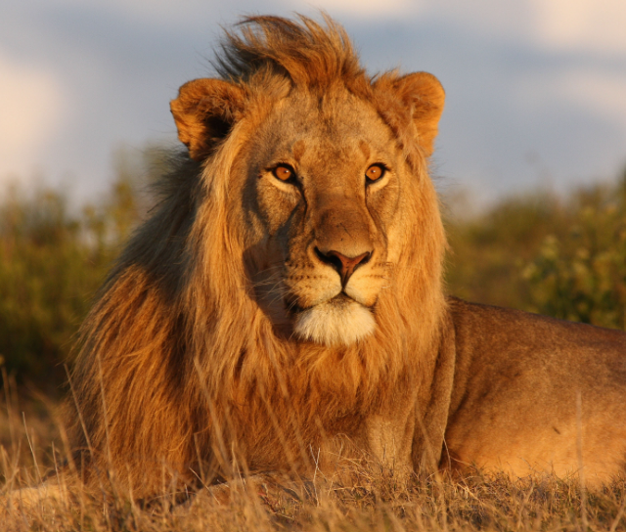
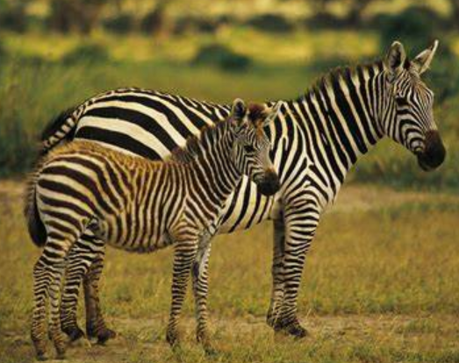
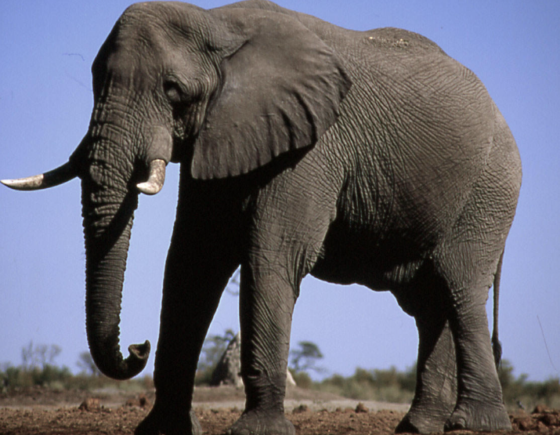
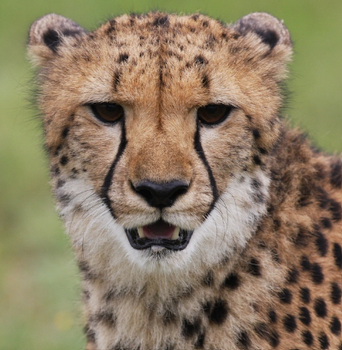
Geography – The Animal Kingdom
- Name and locate the world's seven continents and five oceans.
-Identify seasonal and daily weather patterns in the United Kingdom and the location of hot and cold areas of the world in relation to the Equator and the North and South Poles.
-Use basic geographical vocabulary to refer to key physical features, including: beach, cliff, coast, forest, hill, mountain, sea, ocean, river, soil, valley, vegetation, season and weather.
-Use world maps, atlases and globes to identify the United Kingdom and its countries, as well as the countries, continents and oceans studied at this key stage.
Computing – An Introduction to Quizzes (Scratch Jr)
-I can explain that a sequence of commands has a start.
-I can explain that a sequence of commands has an outcome.
-I can create a program using a given design.
-I can change a given design.
-I can create a program using my own design.
-I can decide how my project can be improved.
PE - Athletics and Swimming
-Master basic movements including running, jumping, throwing and catching, as well as developing balance, agility and co-ordination, and begin to apply these in a range of activities.
-Swim competently, confidently and proficiently.
-Use a range of strokes effectively.
PSHE – Changing Me
-I can start to understand the life cycles of animals
and humans.
-I can understand that changes happen as we grow and that this is OK.
-I know that changes are OK and that sometimes they will happen whether I want them to or not.
-I know how my body has changed since I was
a baby.
-I can understand that growing up is natural and
that everybody grows at different rates.
-I can identify the parts of the body that make boys different to girls and use the correct names for these.
-I can respect my body and understand which parts are private.
-I know some ways to cope with changes.
-I can tell you about changes that have happened
in my life.
-I know some ways to cope with changes.
RSHE – Asking for Help
Year 1:
-I can identify the people who look after me.
-I know how to attract their attention if needed.
Year 2:
-I know the difference between a secret and a surprise.
-I understand the importance of not keeping a secret if it is causing me to feel worried, uncomfortable or afraid.
Years 1 & 2
Term 6
On Safari
Art and Design
Exploring Africa – Patterns, sunsets and water jars
-To use a range of materials creatively to design and make products.
-To use drawing to develop and share their ideas, experiences and imagination
-To use painting to develop and share their ideas, experiences and imagination
-To develop a wide range of art and design techniques in using colour, pattern, texture, line, shape, form and space
Science - Living Things and Their Habitats
-Explore and compare the differences between things that are living, dead, and things that have never been alive.
-Identify that most living things live in habitats to which they are suited and describe how different habitats provide for the basic needs of different kinds of animals and plants, and how they depend on each other.
-Identify and name a variety of plants and animals in their habitats, including microhabitats.
-Describe how animals obtain their food from plants and other animals, using the idea of a simple food chain, and identify and name different sources of food.
Working Scientifically
-Asking simple questions and recognising that they can be answered in different ways.
-Observing closely, using simple equipment.
-Performing simple tests.
-Identifying and classifying.
-Using their observations and ideas to suggest answers to questions.
-Gathering and recording data to help in answering questions.
Music - Reflect, Rewind and Replay
-Using the voice expressively and creatively by singing songs and speaking chants and rhymes.
-Play tuned and untuned instruments musically.
-Listen with concentration and understanding to a range of high-quality live and recorded music.
-Experiment with, create select and combine sounds using the inter-related dimensions of music.
RE - Prayer and Worship
-I can explain that prayer takes place at any place or any time.
-I can discuss why Christians pray
-I can say why the Lord‘s Prayer is an important prayer for Christians.
-I can identify some aids to prayer e.g. a rosary/bible/candle.
-I can identify that there are many different prayers and that they can make up their own.
-I can discuss their own experiences of prayer.
-I can understand that prayer is a means of talking to God.

