Slide 1
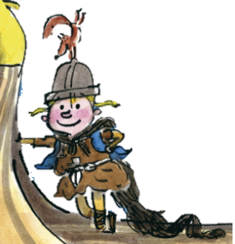
The Littlest Viking
Stories with different points of view
Wednesday 5 May 2021

Slide 2
LI: Can I draft and write stories with different points of view?
Stories with different points of view
Steps to success:
I can use the noticing lens to describe the setting
I can use the smelling lens to describe the setting
I can use the checking lens to describe the setting

Slide 3
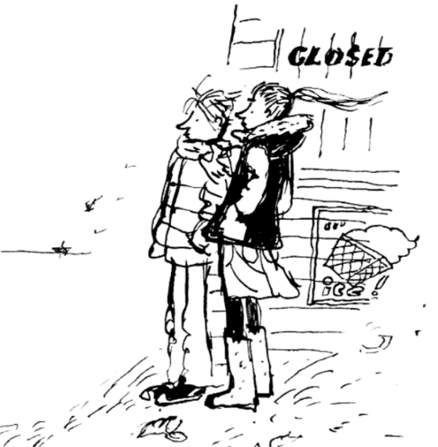
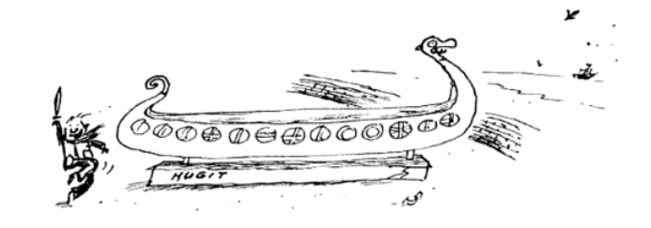
Plot point 1

Slide 4
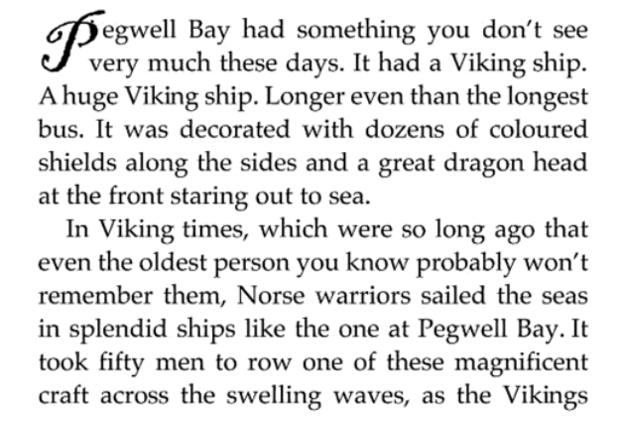
Introducing…

Slide 5
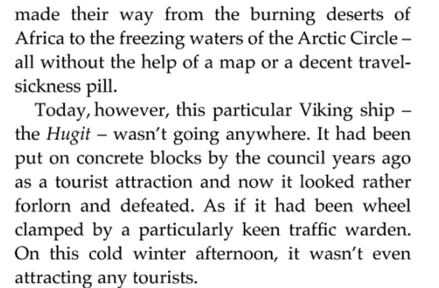
Introducing…

Slide 6
The characters
Katie, 12, the oldest and most sensible
Joshua, 6, loves Vikings but is easily scared
Gary, nearly 10, wants people to be impressed by him

Slide 7
Setting description
When we meet our characters for the first time, they are on Pegwell beach. It is a cold afternoon.
How can we make it sound cold?
Write your ideas in the first box.
1.

Slide 8
Setting description
Let’s share our ideas.
Here are some things I thought of:
Flapping of a rickety wooden sign
Wind whistling
Scolding wind
Silent beach
Creaking beach huts
Birds calling in the distance
1.

Slide 9
Setting description
Model sentence:
By Thor it was so cold! The wind was whistling around the children’s ears. Except for a bird calling in the distance it was the only sound they could hear. The beach was deserted.
Your task:
Use sounds to show the reader how empty the beach is after a storm.
Deepen the moment: Use touch to write how the cold feels or a simile to compare it to something.

Slide 10
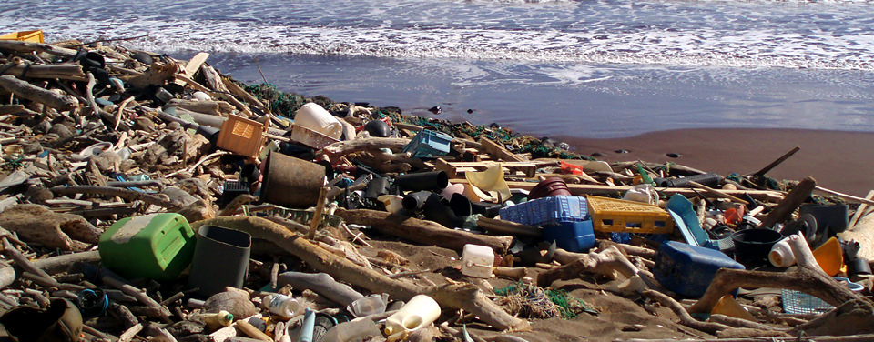
Setting description
The beach was covered in flotsam washed up from the bad weather.
2.

Slide 11
Setting description
The beach was covered in flotsam washed up from the bad weather.
What things might the children find on the beach?
Write it in the second box.
2.

Slide 12
Setting description
Let’s share our ideas.
Here are some things I thought of:
Driftwood
Rope
Razor clams
Gloves
Chain
Plastic bottle
2.

Slide 13
Setting description
Model sentence:
The beach was covered in flotsam washed up from the bad weather. Joshua, Gary and Katie looked around carefully for treasure amongst the driftwood, pieces of rope, cans and bottles.
Your task:
List pieces of flotsam.
Deepen the moment: Describe the flotsam in detail, using expanded noun phrases.

Slide 14
Setting description
Joshua picks up a bottle filled with seaweed and a dead starfish in it.
What might it smell like?
Negative or positive?
List your ideas in the third box.
3.

Slide 15
Setting description
Let’s share our ideas.
Here are some things I thought of:
Heavy thick smell of slowly decomposing plant life
Unpleasantly fishy
Briny
Rotten eggs
3.

Slide 16
Setting description
Model sentence:
Joshua picked up an interesting looking bottle. He noticed a starfish tangled in seaweed inside it. He stuck his nose in to sniff. The smell of rotten eggs washed over him.
Your task:
Describe the smell of the flotsam.
Deepen the moment: Describe how Joshua’s face and body move when he smells the unpleasant smell.

Slide 17
Share and feedback
Share your work
What sentence are your proud of?
What does the class think of the work?
How could we make it even better?

