Slide 1
Non-Chronological Reports

Slide 2
LI Can I discuss and record features of a non-chronological report?
Steps to success.
I can create a key including the main features of a non-chronological report.
I can identify the key features of a non-chronological report.
Challenge: Summarise the main points of each paragraph.

Slide 3
What does chronology/chronological mean?
Watch this link explaining non chronological reports from the BBC

Slide 4
Purpose
To give information on a topic.
Gives factual information.
It should be easy to follow and understand.

Slide 5
In pairs (where you would normally start chotting) list as many example of non chronological/factual reports as you can.
How many can you think of?
Did you get all of the ones on the next slide?

Slide 6
Examples
Did you find all of these:
Non fiction book (e.g. geography)
Catalogue
Information leaflet
Magazine article
Tourist guide book
Encyclopaedia entry
HISTORY – reports on historical figures
SCIENCE – characteristics and habitats of plants and animals
GEOGRAPHY – reports on different places and geographical features e.g. rivers, mountains

Slide 7
Examples
They can be on all sorts of topics such as:
HISTORY – reports on historical figures
SCIENCE – characteristics and habitats of plants and animals
GEOGRAPHY – reports on different places and geographical features e.g. rivers, mountains
SPACE – reports on stars, galaxys, milky ways and planets.
GARDENING – reports on types of gardens, soil, compost or plants.

Slide 8
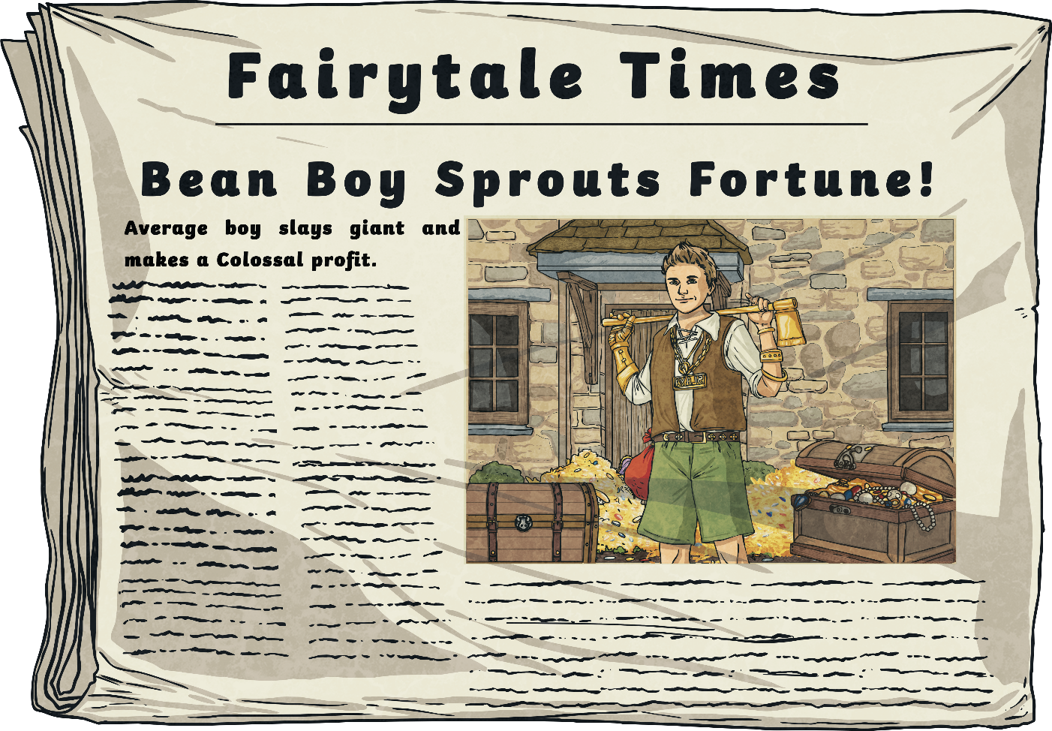
Structure
The TITLE of the report is the subject.
Each paragraph often has a SUBHEADING.
A heading is included at the top of the text. It tells the reader what the text is about.
A subheading tells the reader what information they will find in the following paragraphs before the next subheading.

Slide 9
Structure
The FIRST PARAGRAPH introduces the subject of the whole report.
NEW PARAGRAPHS are used for each fact or description, often with sub-headings.

Slide 10
Structure
It is NOT written in chronological order.
It is usually written in the present tense (except historical reports).
Ends with a paragraph summarising key points.

Slide 11
Language Features
Present tense (except historical reports)
Third person
Formal tone
Subject-specific vocabulary
Describes

Slide 12
Other Features
A non chronological report might also include these:
Pictures
Diagrams
Tables
Charts
Graphs
Glossary

Slide 13
As a class, can we label on the board the different features?
Title​
First paragraph​
Other paragraphs​
Final paragraph​
Subheadings​
Picture​
Third person example​
Present tense example

Slide 14
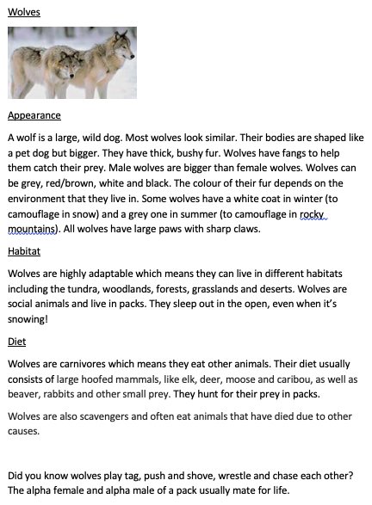
Your task is to find and label the features of this non chronological report about wolves.
Colour code each feature and create a key to show what each colour means.
(example on next slide).

Slide 15
Colour code each feature using the
following colours (or as near as possible!)
Title
First paragraph
Other paragraphs
Final paragraph
Subheadings
Picture
Third person example
Present tense example
Rhetorical question
Bonus question!
Remember to use a ruler!
Challenge: Summarise the main points of each paragraph using as few words as possible!

Slide 16
Colour code each feature using the
following colours (or as near as possible!)
Title
First paragraph
Other paragraphs
Final paragraph
Subheadings
Picture
Third person example
Present tense example
Rhetorical question
Bonus question!
Remember to use a ruler!
Challenge: Summarise the main points
of each paragraph using as few words as possible!

