Slide 2
LI Can I discuss, record and plan features of a non-chronological report? Steps to success. I can identify the key features of a non-chronological report. I can use a factfile to plan a non-chronological report. My plan includes the key features of a non-chronological report. Challenge: Research to find a funfact about my country.

Slide 3
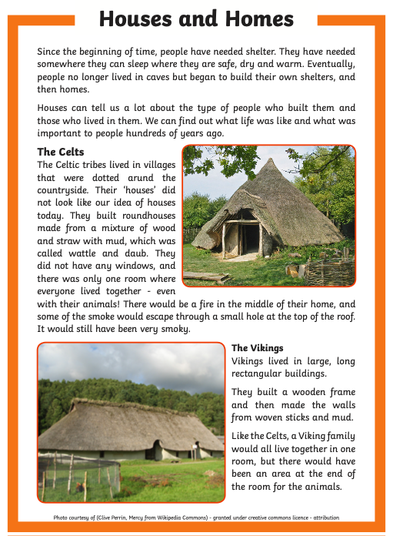
Today we are going to use research to create a plan for our non chronological report.
First, how many non chronological report features can you identify on this text in one minute?

Slide 4
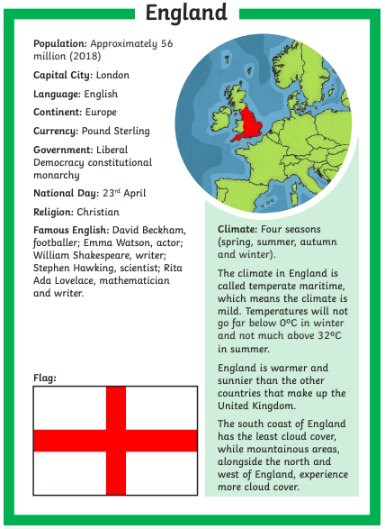
We are going to learn how to use information on this factfile to create a non chronological report plan.
You will then have your own factfile to create your own plan from.

Slide 5
As a class we will need to decide on which information goes in which paragraphs.
What will the title be?
What will the subtitles be?
How will you introduce the country?
Remember to answer ‘where,’ ‘who,’ ‘what’ and ‘when.’

Slide 6
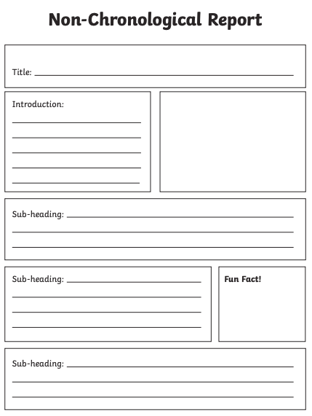
What will the title be?
What will the subtitles be?
How will you introduce the country?
Remember to answer ‘where,’ ‘who,’ ‘what’ and ‘when.’

Slide 7
Your turn! ☺
You will have a choice (maybe) between France, Germany and Spain.
Decide on your
Title,
Subtitles,
How will you introduce the country?
Which information goes in which paragraph
Remember to include ‘where,’ ‘who,’ ‘what’ and ‘when’.
Challenge: research your country to find a ‘fun fact’.

