Slide 1
Band 3
L.I – Can I add 2-digit and 3-digit numbers crossing 10 or 100?
Steps to success
I can use number bonds to add numbers mentally
I can exchange where necessary
I can use a written method
Challenge: True or false?
Band 4
L.I – Can I add two 4-digit numbers with one exchange?
Steps to success
I can use number bonds to add numbers mentally
I can exchange where necessary
I can use a written method

Slide 2
In Focus Task
How do you know?

Slide 3
Talk Task
When adding large numbers, what happens when we have more than 10 counters in a column?

Slide 4
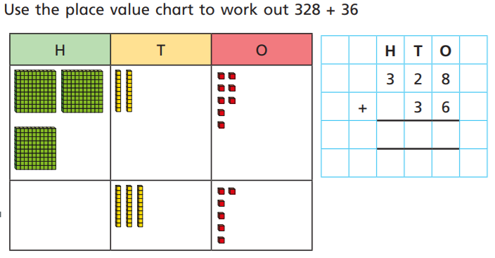
New Learning
Stem sentence
Start on the right to get it right.
Re-group when crossing 10 or 100.

Slide 5
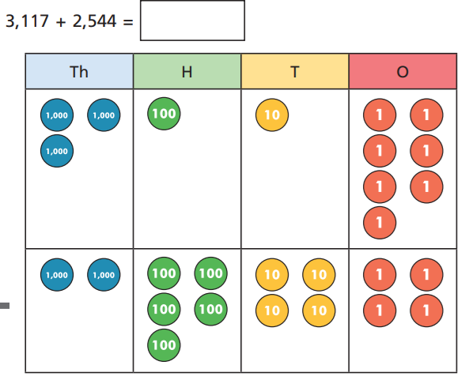
New Learning
Year 3: try 235+74=
Stem sentence
Start on the right to get it right.
Re-group when crossing 10 or 100.

Slide 6
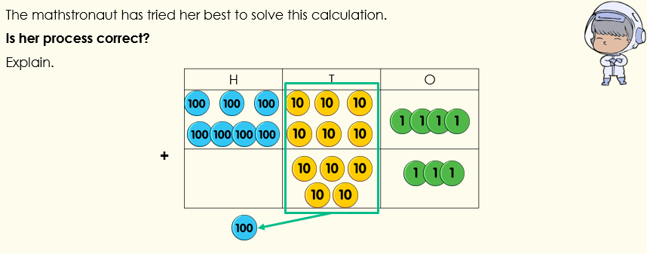
Develop learning
Hint – she is wrong

Slide 7
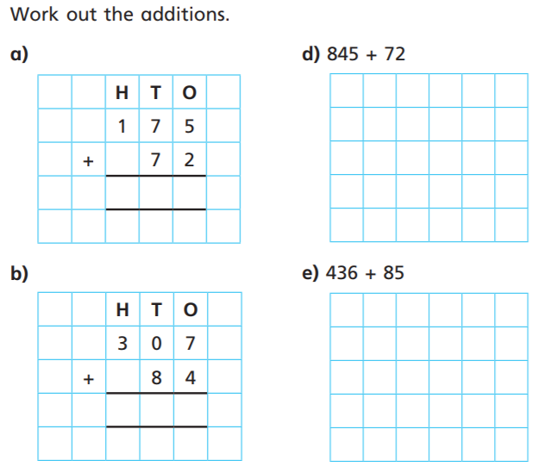
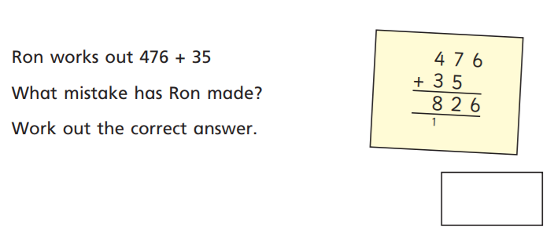
Independent Task Band 3
1
2

Slide 8
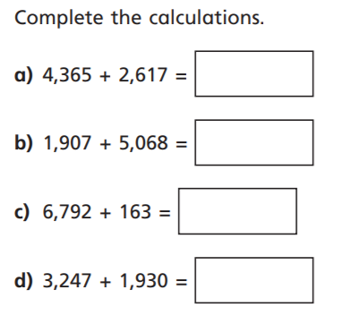
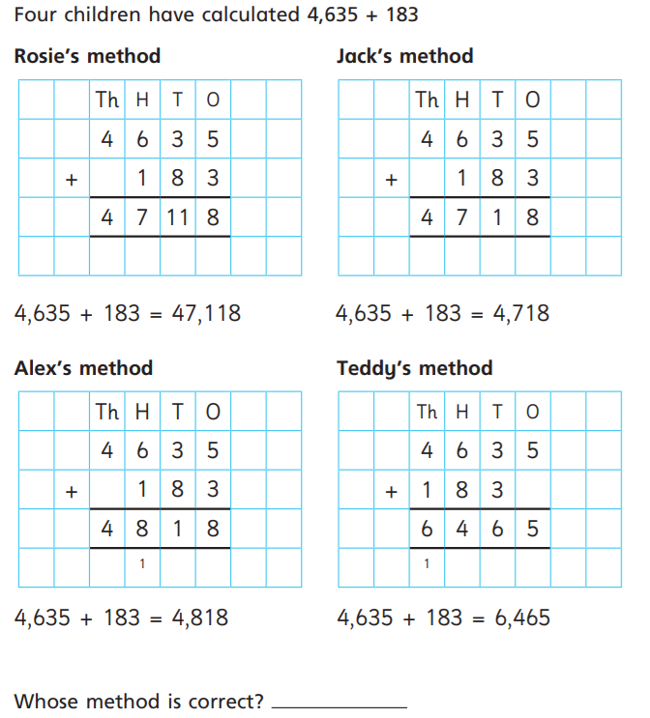
Independent Task Band 4
1
2

Slide 9
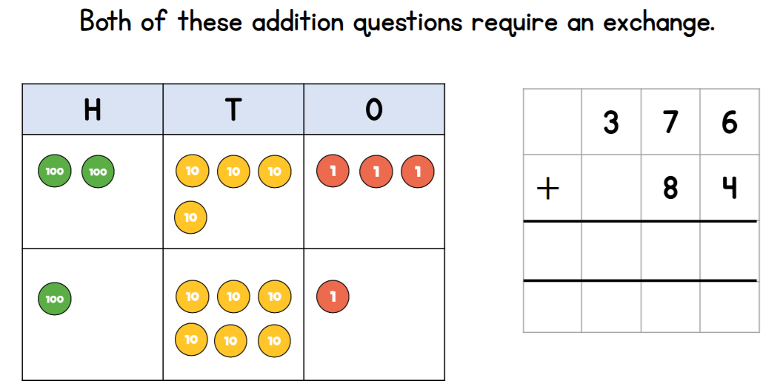
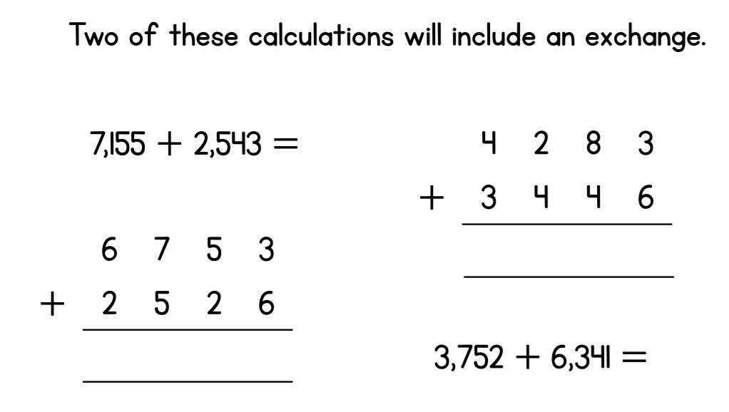
Lightbulb challenge
True or false – explain your answer
Band 3
Band 4

Slide 10
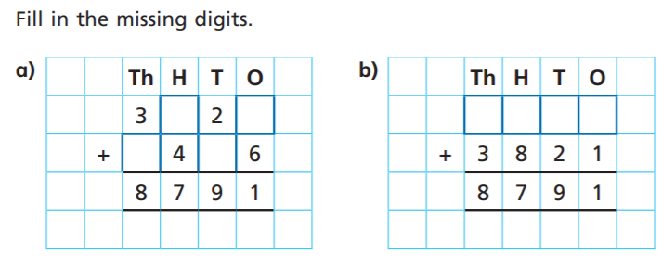
Extend and challenge
Band 3
Band 4

