Slide 1
Lesson 4 – Edit ad revise

Slide 2
LI – Can I edit my work? Steps to success: - I can improve spelling errors - I can improve punctuation errors - I can make changes to make my work better

Slide 4
Other punctuation
Commas (after fronted adverbials);
Capital letters for names;
Commas in a list;
? for questions;
Full stops.

Slide 5
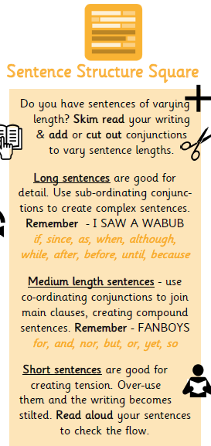
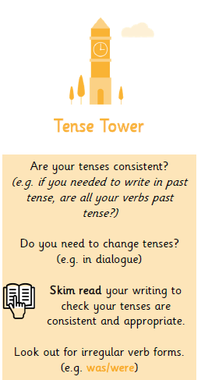
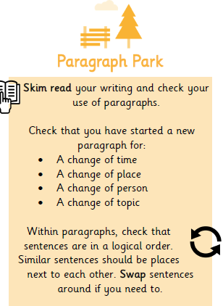
Missing words
Does it all make sense?
Have you repeated a word too many times?

Slide 6
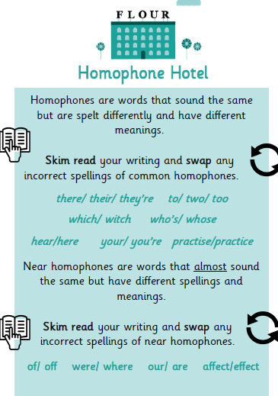
Names
Iron Man
Hoghart
Longer descriptive words
*Use a dictionary*

Slide 7
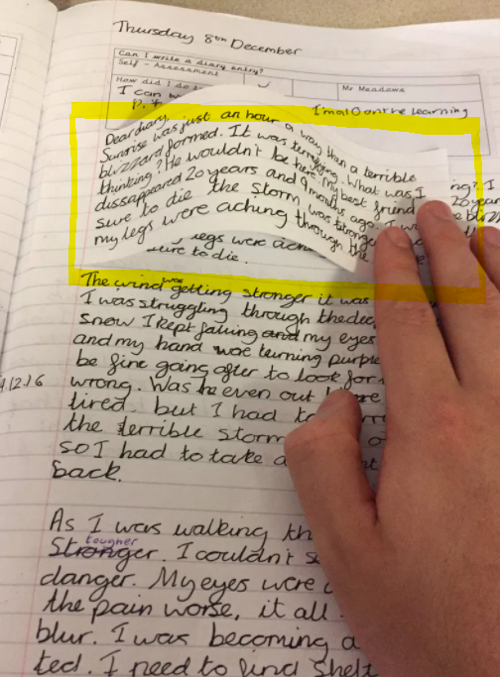
Editing flap
Using editing flaps, pick a sentence to rewrite.
Choose a sentence where you have had to make a lot of edits or one you want to change.
Make sure it makes sense, you have kept the tense correct and that your presentation is neat.

