Slide 1
Timetable for the week:
Groups | Session 1 | Session 2 | Session 3 | Session 4
Roald Dahl | Guided reading with T Initiate and Model The Tunnel | Follow-up task from guided reading Enable | Independent Comprehension ‘The Tunnel’ | Independent reading for pleasure
Jacqueline Wilson | Independent reading for pleasure | Guided reading with T Initiate and Model The Tunnel | Follow-up task from guided reading Enable | Independent Comprehension ‘The Tunnel’
Julia Donaldson | Independent Comprehension ‘The Queen’s Elephant’ | Independent reading for pleasure | Guided reading with T Initiate and Model | Follow-up task from guided reading Enable
Michael Morpurgo | Finish reading The Tunnel | Independent Comprehension ‘The Tunnel’ | Independent reading for pleasure | Guided reading with T Initiate and Model Greek Myths

Slide 2
Independent reading for pleasure
5 minutes before the end of BookTalk, you need to complete a post-it review of the book you have read.
Draw the emoji, then write down your opinion of the book, explaining why.

Slide 3
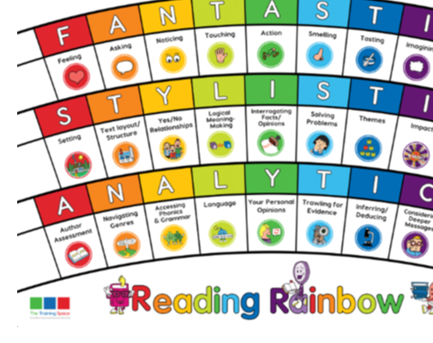
Our LI’s for the week: Band 2 - Show understanding of vocabulary by discussing favourite words and phrases Band 3/4 - Begin to identify authors familiar patterns of language Band 2 - Answers questions and make links between other books that have been read. Band 3/4 - Discuss and compare texts from a wider variety of genres and writers referring to authorial style, themes and features
Initiate/Model write this in your margin.

Slide 4
Lenses:
Language
Author assessment
Sentence Starters:
Language:
To engage the reader the writer has deployed the technique …
Author assessment:
If we were to review this book we would give it ____ stars and the comment …

Slide 5
Language
Language:
To engage the reader the writer has deployed the technique …
How does the author use language to keep the reader engaged?
Together find and chot down evidence in the text of words and phrases that grab your attention.
Can you explain why this stands out?

Slide 6
Author assessment
How would you rate this book?
Author assessment:
If we were to review this book we would give it ____ stars and the comment …
Together: find and note down things you liked and disliked about the book.

Slide 7
ENABLE –
please write this in the margin.

Slide 8
Session – Enable (Independent follow-up task)
1) In your opinion, what element of the story or character has been described well. Quote from the text.
Description is strong in the part of the story when …
2) Compare the two books read. State which one you preferred. Note similarities and differences.
Zoo and Tunnel are similar/different because …
Bonus question:
Describe the style of the author. How would you recognise and describe a typical ‘Anthony Browne’ book?
Books by Anthony Browne are …

