Slide 1
L.I – Can I divide 100 into 2, 4, 5, and 10 equal parts?
Steps to success
I know what equal means
I can create different groups
- I can explain my thought processes
Challenge: True or false

Slide 2
In Focus Task
What does two equal parts mean?
What does 5 equal parts mean?
What doe 10 equal parts mean?

Slide 3
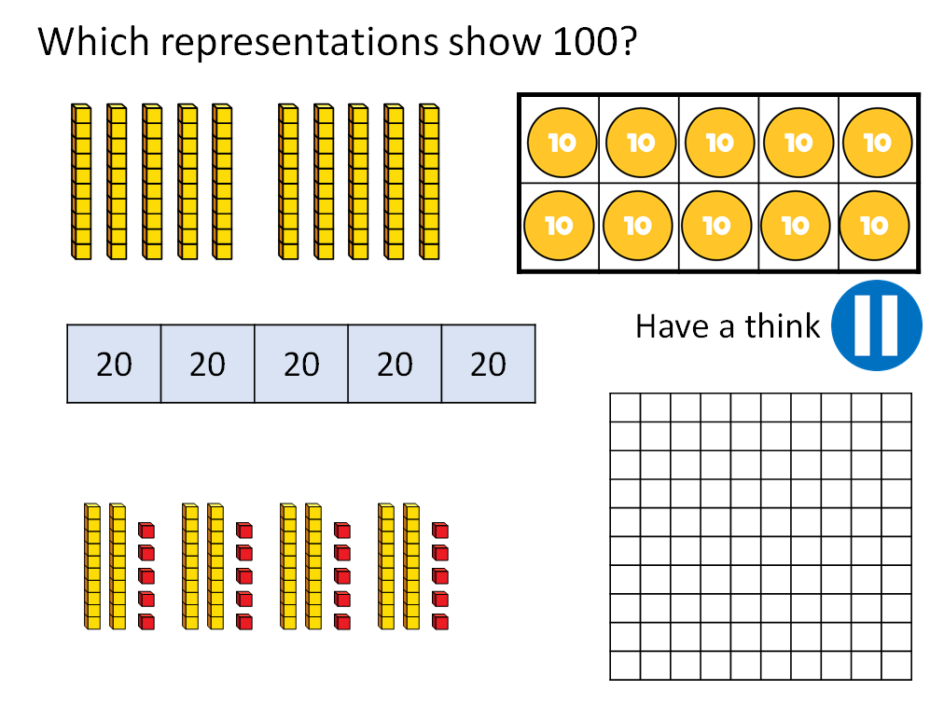
Talk Task

Slide 4
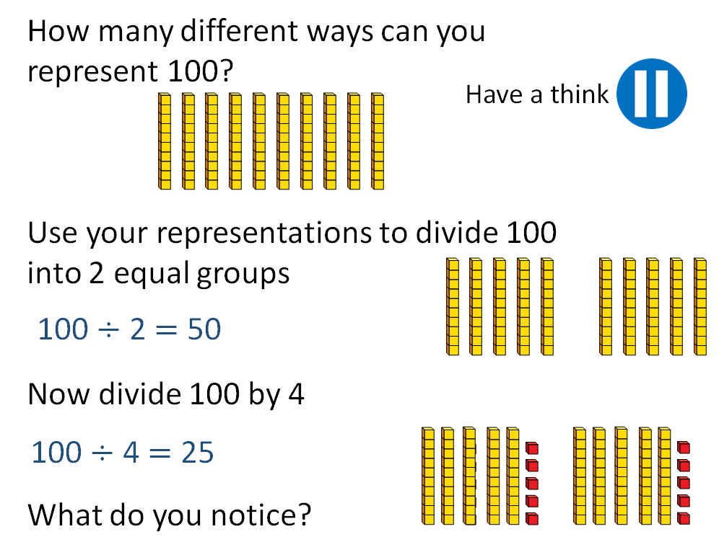
Talk Task

Slide 5
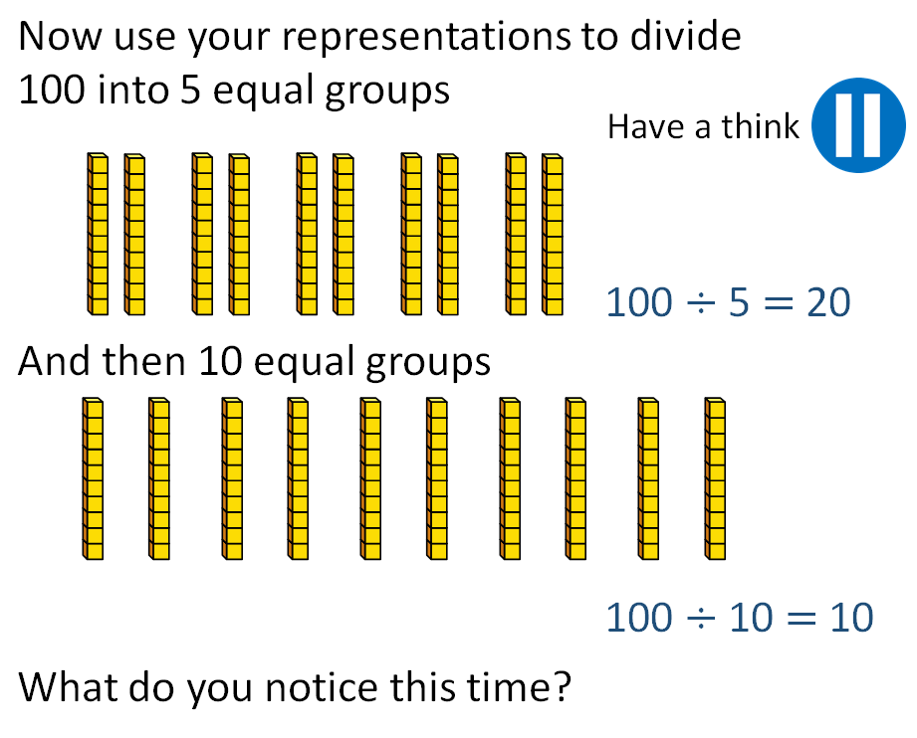
Talk Task

Slide 6
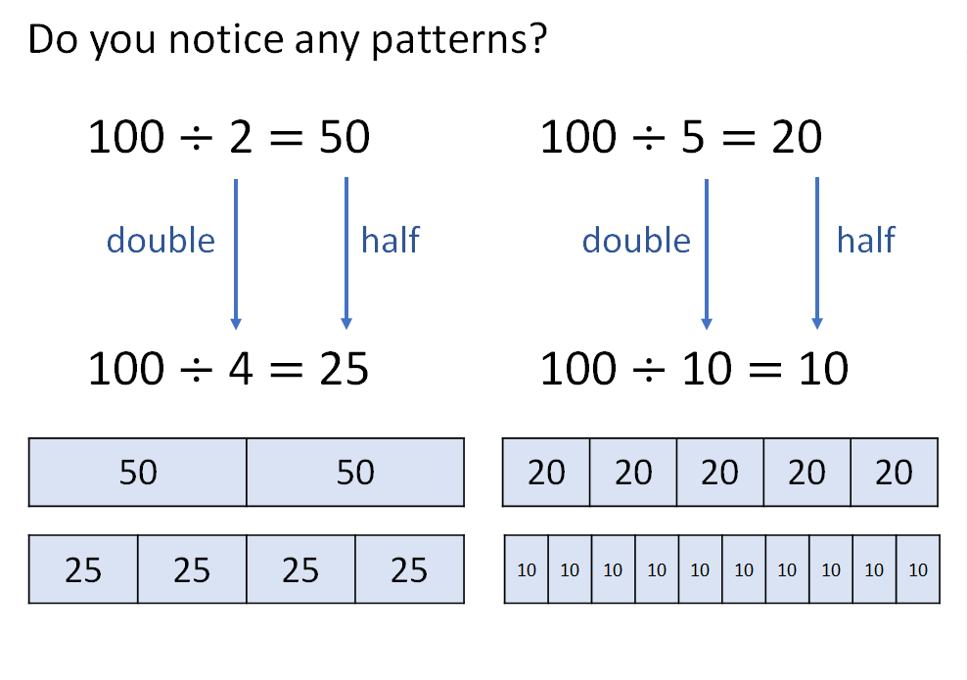
We do
Develop Learning

Slide 7
We do
Develop Learning
Which is your preferred method?

Slide 8
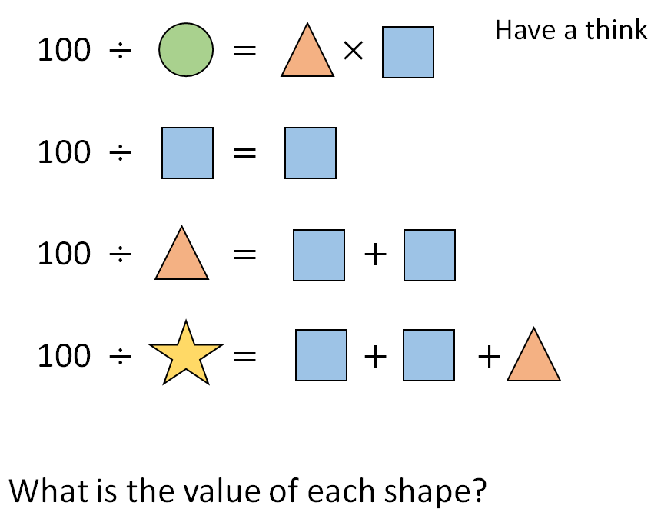
We do
Independent Learning:
Can you work out the puzzle?
Work with a partner. Discuss each step.

Slide 9
$\text{100} ÷$ $=$ $×$
2
5
10
$\text{100} ÷$ $=$
10
10
$\text{100} ÷$ $= +$
5
10
10
4
$\text{100} ÷$ $= + +$
10
10
5
$=$ 2 $=$ 10 $=$ 5 $=$4

Slide 10
We do
Develop Learning
How many solutions can we find?
Work with a partner. Discuss each step.
How can we start?
What do we know?
What can be our next step?
What do you notice?

Slide 11
Lightbulb challenge

Slide 12
L.I – Can I divide 100 into 2, 4, 5, and 10 equal parts?
Steps to success
I know what equal means
I can create different groups
- I can explain my thought processes
Challenge: True or false

Slide 13
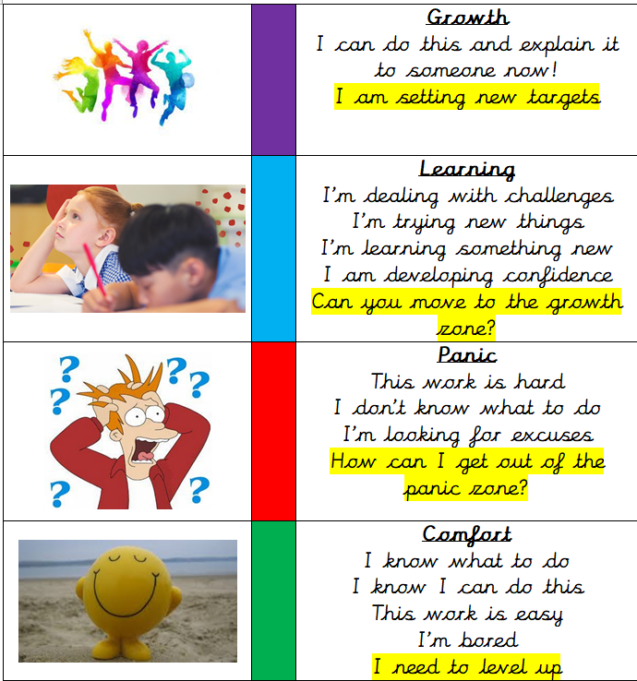
Write a reflection sentence.
Reflection:
I felt I was successful using…
I found it difficult using…
Today, it really helped me to use…
I really understood ____ this lesson…
I struggled to understand ___ this lesson…
Make sure there is a ‘zone of learning’ on the LI.
(Growth/Learning/Panic/
Comfort)

Slide 14
Write a reflection sentence. Here are some examples.
Reflection
I felt I was successful using …..
I found it difficult using ….
An effective strategy I used today was ….
Today, it really helped me to use ….
Perhaps it would have been easier if I had used/asked ….
I asked for help with question 2 because …
A top tip for (adding fractions) is …..

