Slide 1
Timetable for the week:
Groups | Session 1 | Session 2 | Session 3 | Session 4
Julia Donaldson | Guided reading with T Initiate and Model | Follow-up task from guided reading Enable | Independent Comprehension | Independent reading for pleasure
Jacqueline Wilson | Independent reading for pleasure | Guided reading with T Initiate and Model Greek Myths | Follow-up task from guided reading Enable | Independent Comprehension
Roald Dahl | Independent Comprehension | Independent reading for pleasure | Guided reading with T Initiate and Model | Follow-up task from guided reading Enable
Michael Morpurgo | Follow-up task from guided reading Enable | Independent Comprehension | Independent reading for pleasure | Guided reading with T Initiate and Model Greek Myths

Slide 2
Independent reading for pleasure
5 minutes before the end of BookTalk, you need to complete a post-it review of the book you have read.
Draw the emoji, then write down your opinion of the book, explaining why.

Slide 3
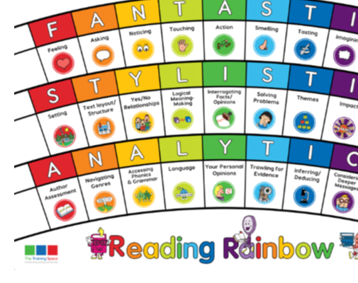
Our LI’s for the week: Band 2 - Show understanding of vocabulary by discussing favourite words and phrases Band 3/4 - Begin to identify authors familiar patterns of language Band 2 - Answers questions and make links between other books that have been read. Band 3/4 - Discuss and compare texts from a wider variety of genres and writers referring to authorial style, themes and features
Initiate/Model write this in your margin.

Slide 4
Lenses:
Action
Stating predictions
Sentence Starters:
Action:
At the moment, the actions in the story are …
Stating predictions:
At this stage in the story we believe that …

Slide 5
Action
Action:
At the moment, the actions in the story are …
How does the author use actions and events to keep the reader engaged?
Together find and chot down events that have happened so far in the correct order.

Slide 6
Stating predictions
What could happen next?
Stating predictions:
At this stage in the story we believe that …
Together: find and note down clues that may tell you what could happen in the future of the story.

Slide 7
ENABLE –
please write this in the margin.

Slide 8
Session – Enable (Independent follow-up task)
1) Are the actions in the story a slowly revealing the characters like in The Iron Man or are they revealing a series of events? ​
At the moment the actions in the story are …
2) Predict what will happen next. Use evidence from the text to explain why you think this.
At this stage in the story we believe that …
Bonus question:
Explain in your own words why King Minos is angry with the Athenians and wants war. ​

