Slide 1
L.I Y3 – Can I compare fractions?
LI Y4 – Can I position fractions on a numberline?
Steps to success
Compare two wholes (equal)
Which part is greater? Smaller?
Order fractions
Challenge: True or False

Slide 2






In focus task
Notes:
Emma looks at these two diagrams.
She says that they prove that $\frac{1}{4}$ > $\frac{1}{2}$.
Do you agree or disagree with Emma?

Slide 3

New learning
When we compare fractions, the whole has to be__________
Notes:
Zainab says that these two diagrams prove that $\frac{1}{4}$ = $\frac{1}{2}$.
Do you agree or disagree with Zainab?

Slide 4

New Learning
When we compare fractions, the whole has to be__________
Notes:
Note that although Femi’s statement that $\frac{1}{4}$ < $\frac{1}{2}$ is true, these diagrams do not prove the statement as the wholes are not the same.
When we compare fractions, the whole has to be the same.

Slide 5
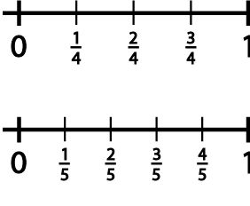
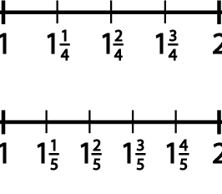
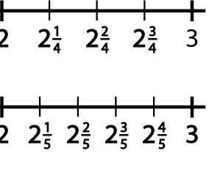
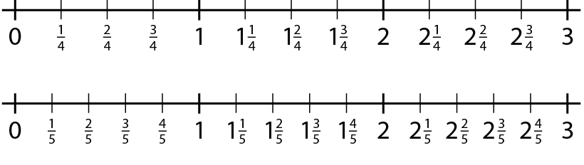
Year 3 Independent work, Year 4 stay on carpet
Tell me a number between two and three.
Tell me a number very close to three.
Tell me a number even closer to three than the previous number.
Notes:
Tell me any number between two and three.
Tell me a number very close to three.
Tell me any number even closer to three than the previous number.
Tell me a number greater than two that is very close to two.
Tell me a number smaller than two that is very close to two.

Slide 6
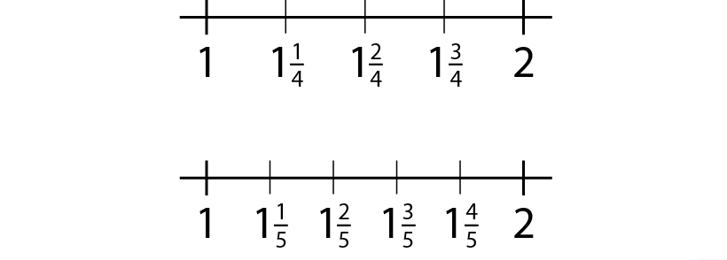
New learning
What other questions can we ask?

Slide 7
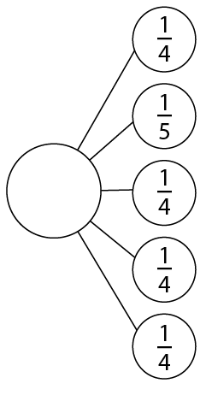
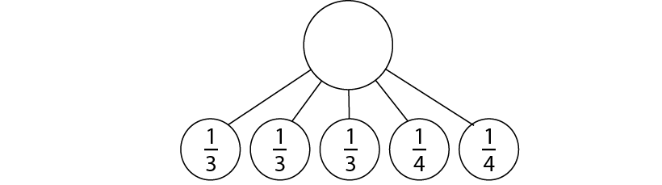


New learning
What mixed number can be written from the following fractional parts?
Notes:
What mixed number can be written from the following fractional parts?

Slide 8

Position the numbers on the numberline
Notes:
Position these numbers on the number line.

Slide 9
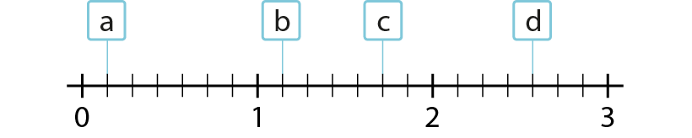

Develop learning
Now try these
Notes:
The line is divided into ___ equal parts. This allows us to count in ­­­­­­___.

Slide 10

Y4 Independent learning
2
3
4
1
How many intervals between zero and 1?
What fractional steps are there between each whole number?
What fraction is marked by the arrow? Can you explain your thinking?
Repeat by pointing to a different place on the line.

Slide 11





Y4 independent learning
How many intervals between each whole number?
What fractional steps are there between each whole number?
Can you label each interval correctly?

Slide 12
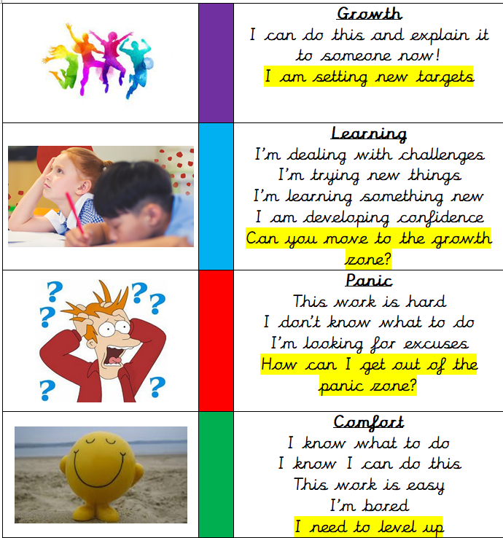
Write a reflection sentence.
Reflection:
I felt I was successful using…
I found it difficult using…
Today, it really helped me to use…
I really understood ____ this lesson…
I struggled to understand ___ this lesson…
Make sure there is a ‘zone of learning’ on the LI.
(Growth/Learning/Panic/
Comfort)

Slide 13
Write a reflection sentence. Here are some examples.
Reflection
I felt I was successful using …..
I found it difficult using ….
An effective strategy I used today was ….
Today, it really helped me to use ….
Perhaps it would have been easier if I had used/asked ….
I asked for help with question 2 because …
A top tip for (adding fractions) is …..

