Slide 1
LI - I can draw a flower in the style of Georgia O’Keeffe
Steps to success:
Plan a close-up view of a flower
Use chalk to create a smooth finish.

Slide 2
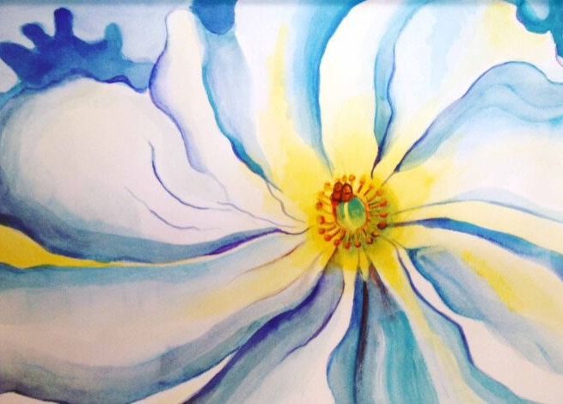
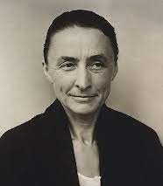
Georgia O’Keeffe (1887 – 1986)
American painter who was best known for her large-format paintings of natural subjects, especially flowers and bones, and for her depictions of New York City skyscrapers and architectural and landscape forms unique to northern Mexico.

Slide 3
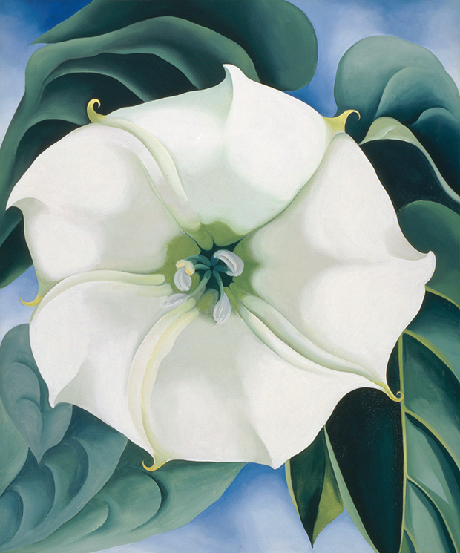
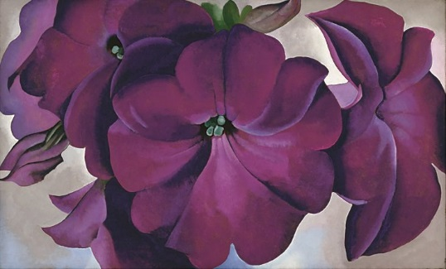
Her paint appears very smooth with no brushstrokes visible – how do you think she achieved this?
Georgia O’Keeffe painted flowers a lot, why?
“I hate flowers – I paint them because they’re cheaper than models, and they don’t move!”
– G. O’Keeffe

Slide 4
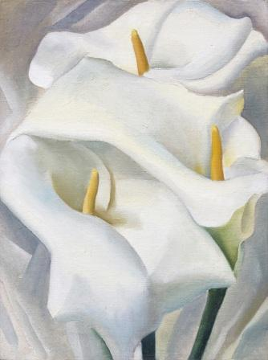
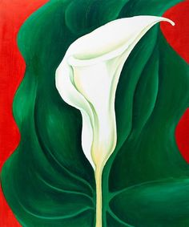
Lilies…

Slide 5
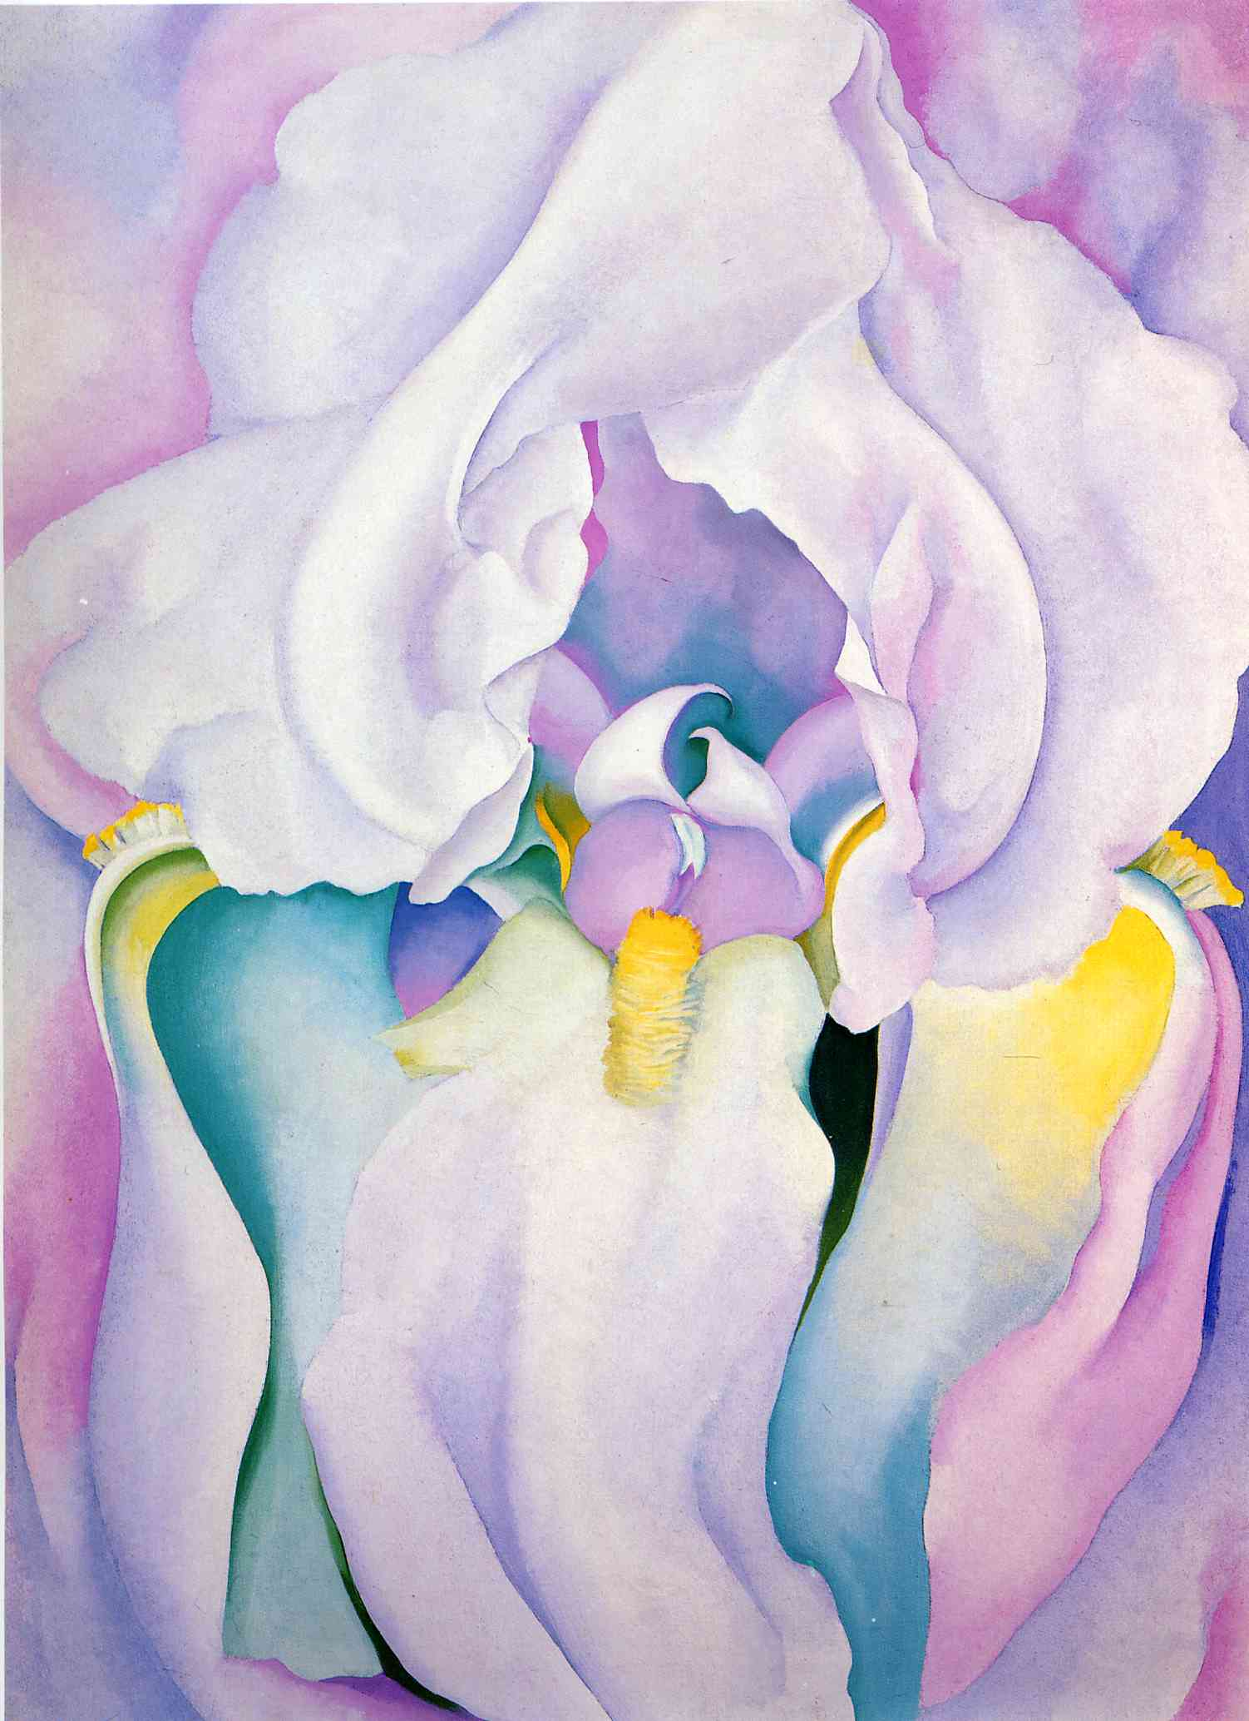
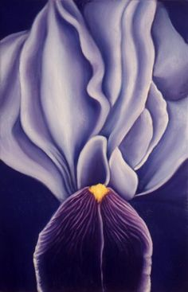
Iris…

Slide 6
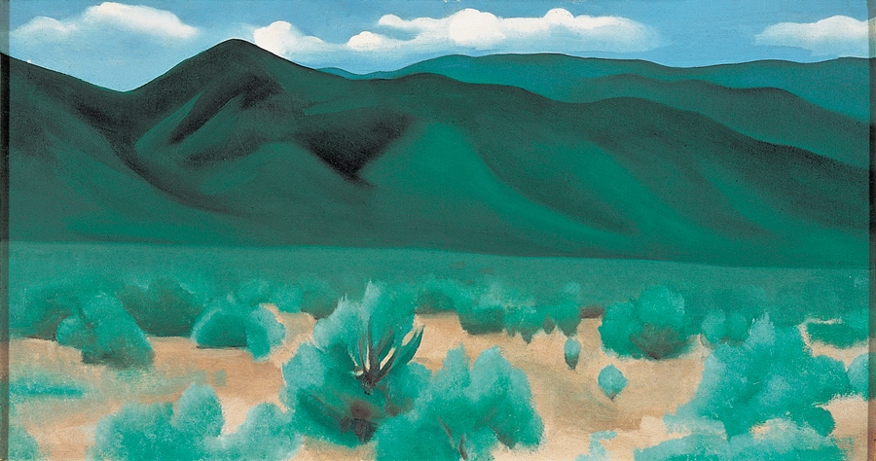
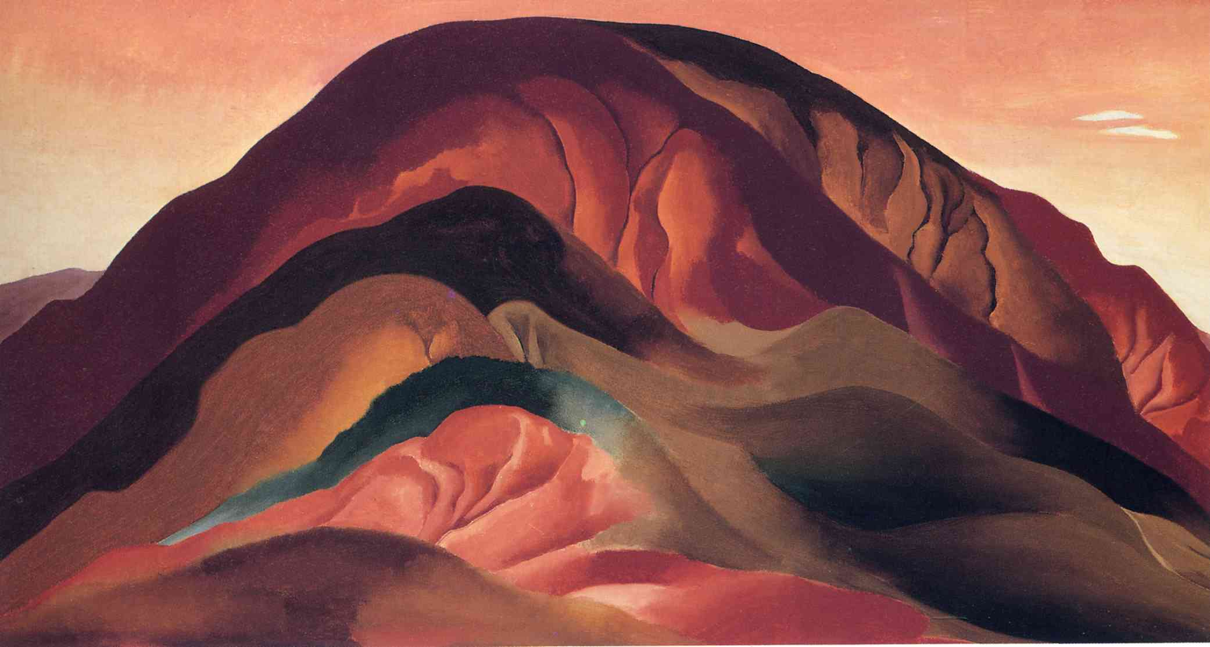
Georgia lived in New Mexico in America, She painted flowers mostly, but was also inspired by landscapes.
What do you notice about the colours?
How does O’Keeffe communicate form/shape?

Slide 7
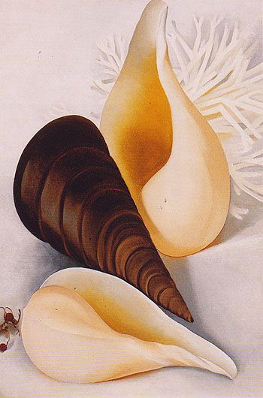
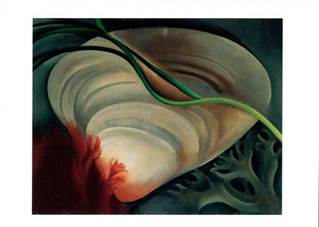
O’Keeffe’s smooth style, and use of colour and shading, emphasised the form and shape, in what she painted.

Slide 8
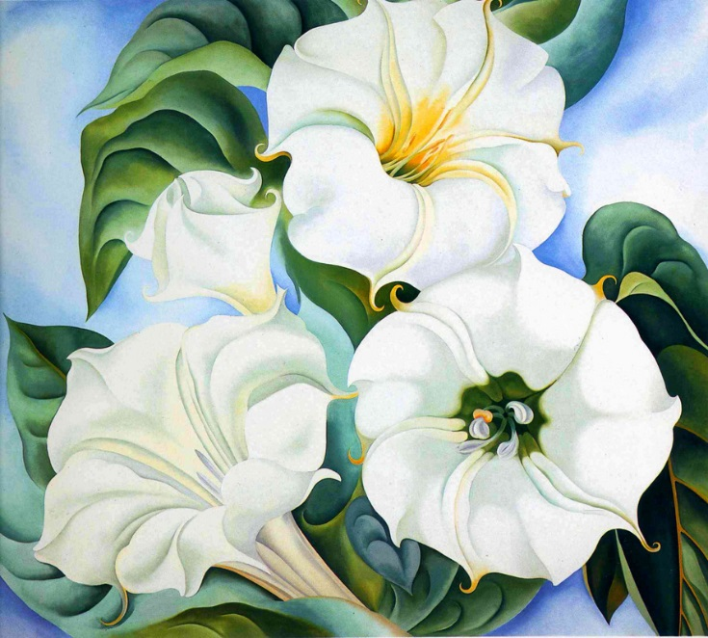
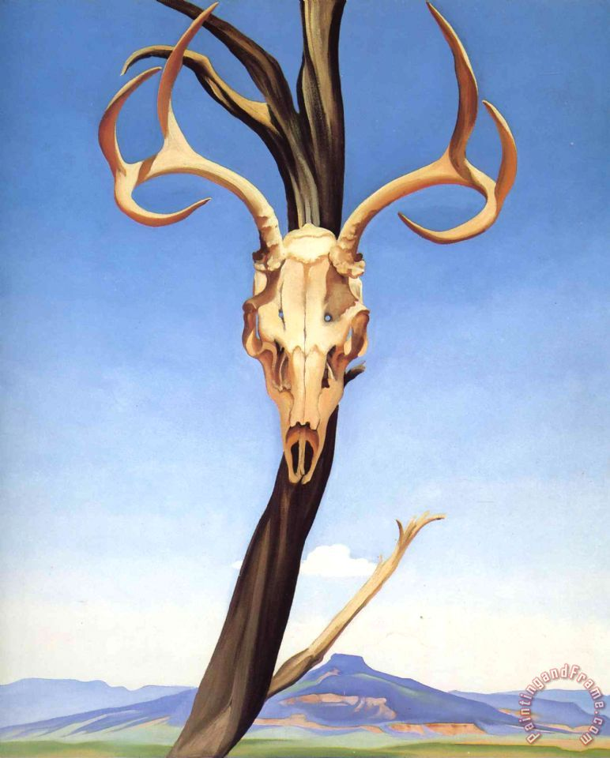
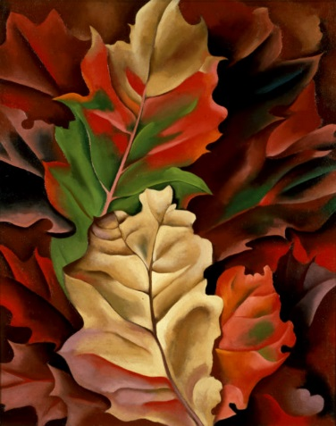
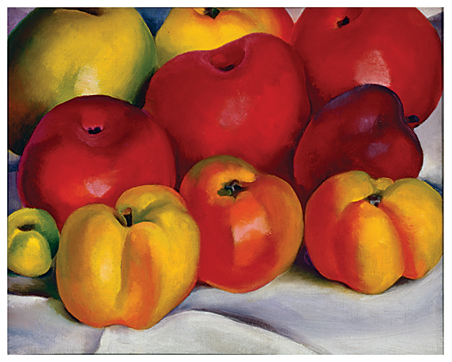
Georgia O’Keeffe painted flowers, skulls, shells; natural items, what style of composition might you call this?
Still life

Slide 9
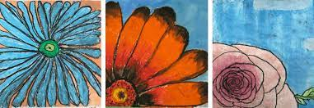
Discussion
What might you include if you were to create your own Georgia O’Keeffe inspired still life?

Slide 10
Using chalk pastels
https://www.youtube.com/watch?v=7qVNXeCSesY

