Slide 1
Timetable for the week:
Groups | Session 1 | Session 2 | Session 3 | Session 4
Julia Donaldson | Guided reading with T Initiate and Model drip, splash | Follow-up task from guided reading Enable | Independent Comprehension Look down, look up | Independent reading for pleasure
Jacqueline Wilson | Independent reading for pleasure | Guided reading with T Initiate and Model Mouse, bird, snake, wolf | Follow-up task from guided reading Enable | Independent Comprehension
Roald Dahl | Independent Comprehension | Independent reading for pleasure | Guided reading with T Initiate and Model Mouse, bird, snake, wolf | Follow-up task from guided reading Enable
Michael Morpurgo | Follow-up task from guided reading Enable | Independent Comprehension | Independent reading for pleasure | Guided reading with T Initiate and Model Mouse, bird, snake, wolf

Slide 2
Independent reading for pleasure
5 minutes before the end of BookTalk, you need to complete a post-it review of the book you have read.
Draw the emoji, then write down your opinion of the book, explaining why.

Slide 3
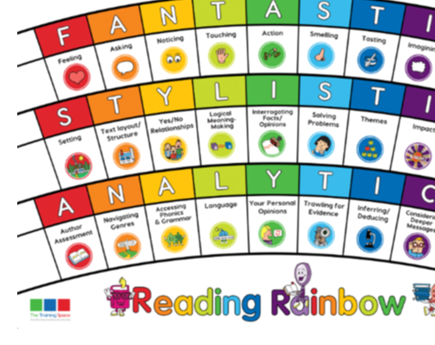
Our LI’s for the week: Band 2 - Show understanding of vocabulary by discussing favourite words and phrases. Band 3/4 - Identify vocabulary within the text that gives the best description of the setting or character. Band 3/4 - Identify word classes taught and discuss the meaning of these words
Initiate/Model write this in your margin.

Slide 4
Mouse, Bird, Snake and Wolf – David Almond
Lenses:
Character
Accessing phonics and grammar
Sentence Starters:
Character:
The author creates a believable setting by …
Assessing phonics and grammar:
The most arresting word/phrase used by the writer is …

Slide 5
Character
Have you learned much about Ben’s personality so far?
Character
The main character is well developed/under developed by the author because…
Together: find evidence of descriptions of Ben’s personality. You may need your inference skills!

Slide 6
Accessing phonics and grammar
Grammar:
The most arresting word/phrase used by the writer is …
Can you identify adjectives, nouns, verbs, prepositions… ? Fastest finger.
Which is your favourite word or phrase? Explain why.

Slide 7
ENABLE –
please write this in the margin.

Slide 8
Session – Enable (Independent follow-up task)
1) Ben creates a mouse in the text. Harry and Sue say it is just like him. What do you think?
Ben’s character is like / not like a mouse because
2) What is your favourite word or phrase in the text. Explain how the writer has used this word of phrase for effect.
The most arresting word/phrase used by the writer is …
I think he has used this to create/show …
Predict what may happen next. Write a paragraph explaining what will happen and why you think that. Use evidence from the text to help you with your explanation.

