Slide 1
Monday 22nd February
English
Learning Intentions:
4: Draw inferences such as inferring characters' feelings, thoughts and motives from their actions, and justifying inferences with evidence clearly taken from the text.
5: Understand what he/she reads by drawing inferences, such as inferring characters’ feelings, thoughts and motives from their actions, and justifying inferences with evidence.

Slide 2
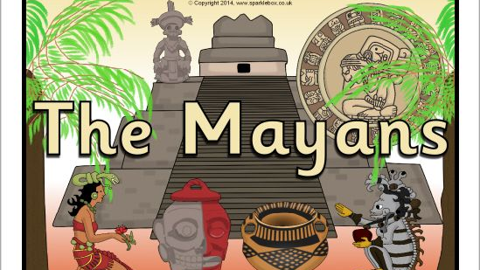

Introducing:
The Mayans
The Maya civilisation began long ago in a place called 'Mesoamerica'. This huge area is made up of Mexico and part of Central America.
The Mayas built amazing cities like Tikal (which they called 'Yax Mutal') and Palenque. Even though they lived in different cities, ruled by different kings and queens, the Mayas shared a lot of common beliefs and traditions.
They were experts at reading the stars and even built their cities as a map of the sky! They were also inspired by the creatures of the forest and shared many legends about animals, plants and nature spirits.
Watch the video to find out more! An introduction to the ancient Maya - BBC Bitesize

Slide 3
Our aim: we are building up to writing our own character descriptions of a Mayan God.
Over the weeks, we will look at different Mayan Gods and aspects of their life.
We’ll take notes and collect vocabulary on some of the Gods with a different focus each day.
Like before, there will be lessons where we collect vocabulary and super sentences.
This will help you when the time comes to write up your own character description.

Slide 4
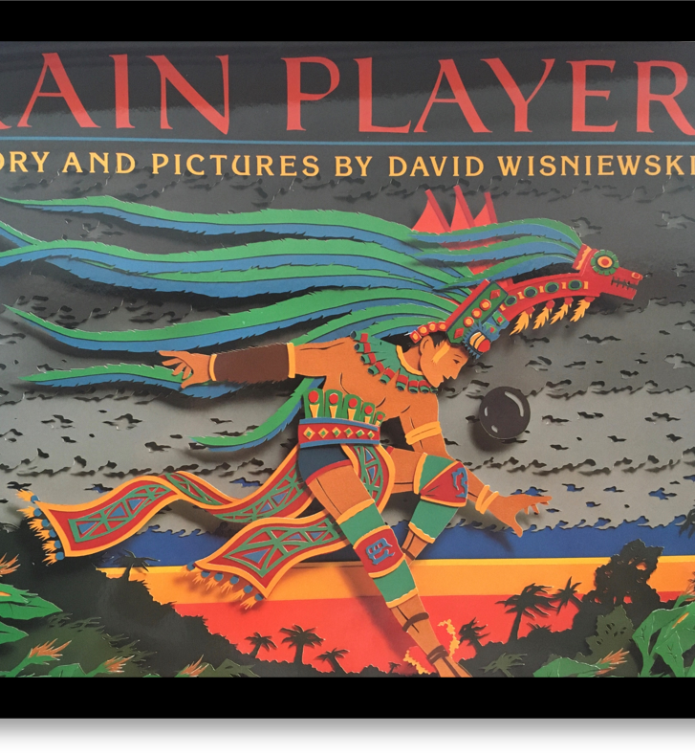
RAIN PLAYER
This book will be our focus for our writing sessions.
Written by David Wisniewski, this beautiful book tells the tale of an interesting ancient Mayan belief, that the future had already been decided and could not be changed.
Read up to page 8 – this is the page where you meet the Rain God, named Chac.
Make any notes on things we find out about Pik and Chac.
The page you need to stop at is on the next slide.
*A powerpoint and PDF copy of the book can be found on the timetable. You do not need to print this.*

Slide 5
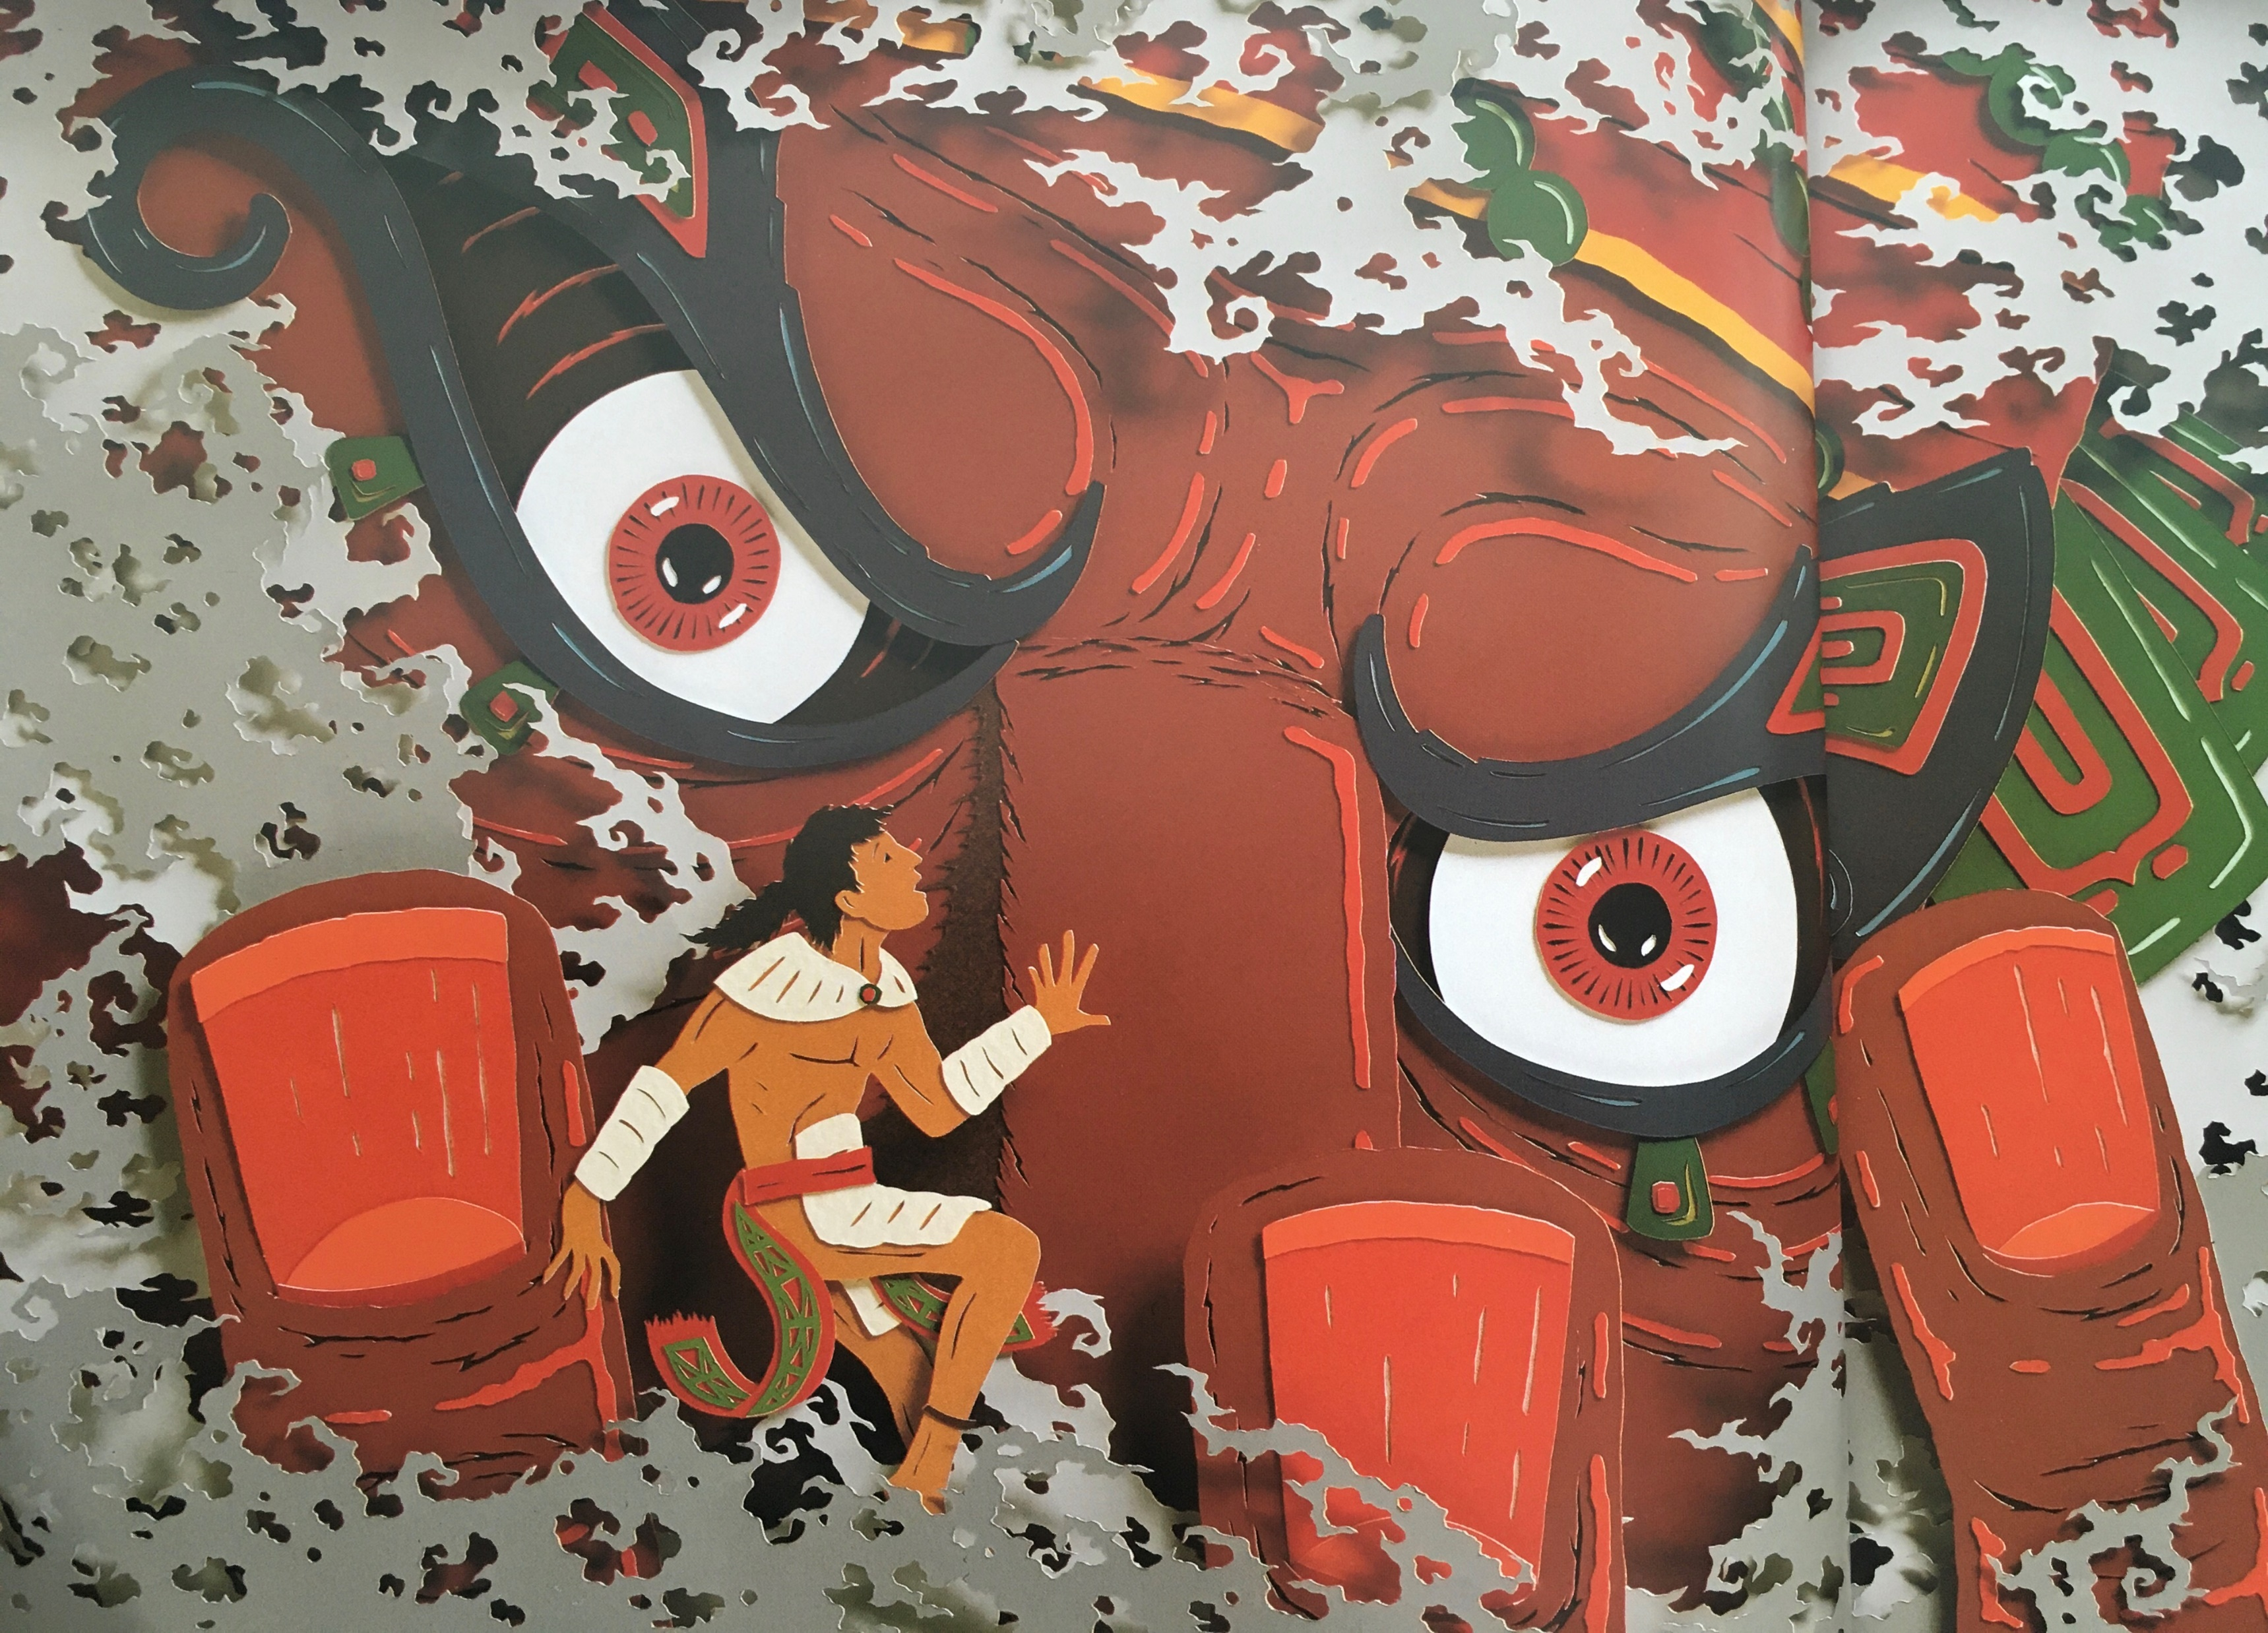

Slide 6
Task 1: Find the Meaning
Using an online dictionary or a paper copy if you have one, look up the meaning of the following tricky words.
These could be described as technical/topic words as they would be used when talking about Mayan life.
Click on the link for the online dictionary: Dictionary.com | Meanings and Definitions of Words at Dictionary.com
Devour Perish
Mercy Fate
Prophecy Torment
Heralds

Slide 7



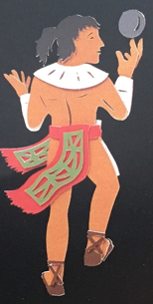
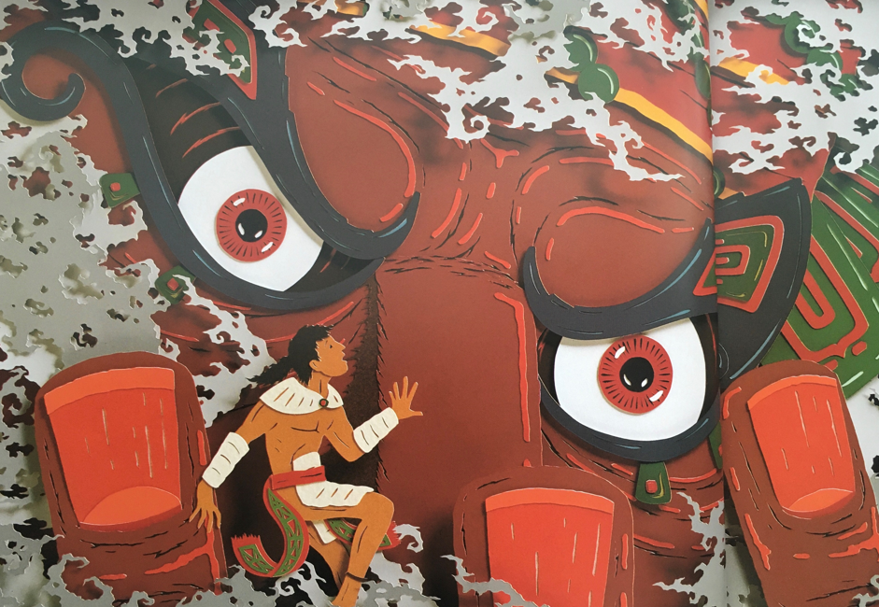
Task 2: Character Study
Lenses:
We need to think about what we already know about both characters, Pik and Chac.
Set your book/paper out like I have below.
What I know about Pik | What I know about Chac
Example: Pik was skilled at playing the game ‘pok a tok’. | Example: he is the God of Rain.

Slide 8
Task 2: Character Study
When you have collected ideas on what you know about Pik and Chac, your task is to write a point of view paragraph on what your impression is of both these characters.
You can write this as two separate small paragraphs, or one.
Use your table of facts to help you and my sentence starters below.
*There are some extra help questions on the next slide to guide you.*
The impression I get of Pik/Chac is that…
We can see that Pik/Chac likes to… which makes me think that…
It is obvious that Pik is…
It is clear that Chac is… we know this because in the book it says…

Slide 9
Help questions
To help you write your point of view paragraph, you could find the answers to these questions.
Who were Pik and Chac?
What did Pik like doing?
What did he do when they thought they heard the call of the Ah Kin Mai?
How does Pik act when he listening to the Gods?
How does he act around his friends?
How do the children feel about the God of Rain?

Slide 10
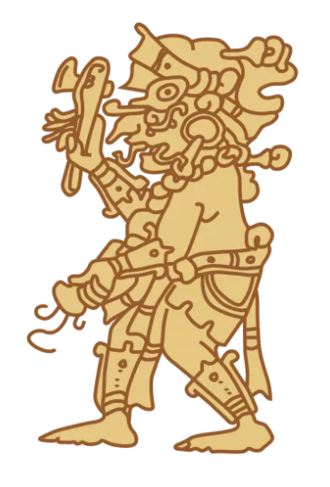
Plenary
Mayan gods and goddesses for Kids / The Maya: history, culture & religion (the-maya.eu)
Mayan Gods For Kids | Mayan God Names | DK Find Out
Pick one fact about a Mayan God. Make it the one that you find most interesting! Share it with us on Class Dojo.

