Slide 1
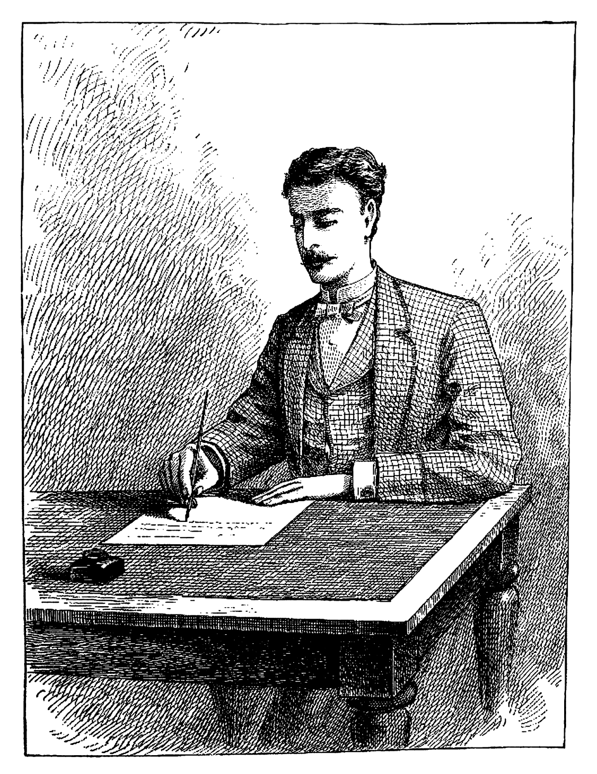
L.I.:
Year 5: I can use different verb forms in my writing with consideration for the audience and purpose.
Year 6: I can use grammar and vocabulary which is suited to the purpose of my writing.

Slide 2
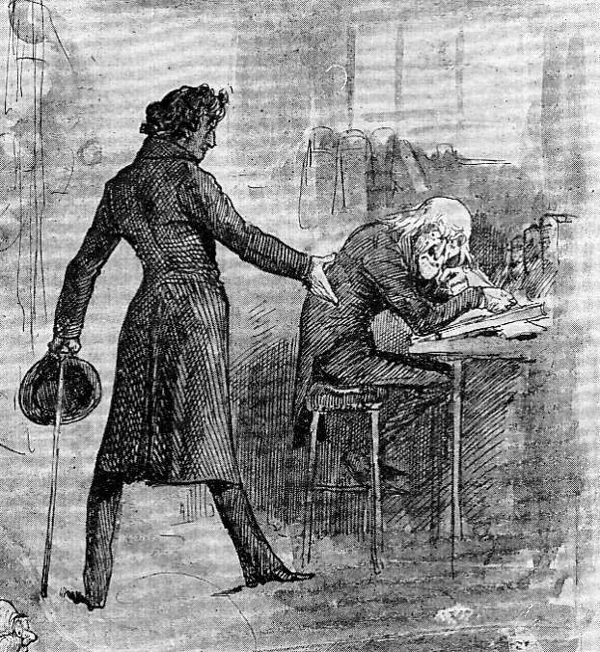
Scrooge thinks he shouldn’t celebrate Christmas. How can we convince him otherwise?

Slide 3
Firstly, CHOT some generalisers. Examples: many, most, some, a few

Slide 4
Now write down these conjunctions. “As you may well know…’’ “As you might be aware…” “As you may recall…” Use one to open your argument.

Slide 5
As you might be aware, many people don’t celebrate Christmas in the Victorian era.

Slide 6
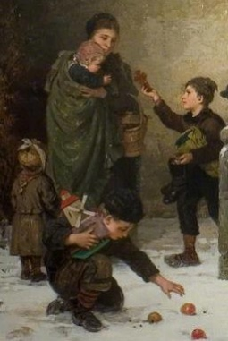
Now elaborate your point. Why don’t some people in the Victorian era celebrate Christmas? Example: They’re too poor, they have to work

Slide 7
Now CHOT conjunctions to emphasise your point. Example: Actually, as a matter of fact

Slide 8
In actual fact, many people are far too poor to think about Christmas at all, with many of them being forced to work in workhouses on Christmas Day.

Slide 9
In 1834, the Poor Law Amendment Act was passed. It stated that no able-bodied was to receive money or any other help from the Poor Law authorities except in a workhouse and that conditions in workhouses were to be made very harsh to discourage people from wanting to receive help.

Slide 10
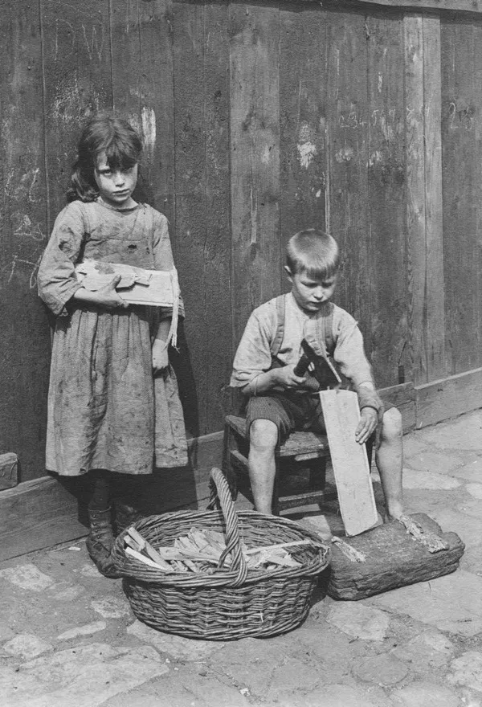
CHOT negative verbs that describe the way in which people in work.
Examples: they toil, they struggle

Slide 11
Now CHOT adverbs to describe these verbs.
Examples: tirelessly, endlessly

Slide 12
CHOT conjunctions similar to the word “since”.
Examples: following, as a result of

Slide 13
Since the Poor Law Amendment Act in 1843, poor, elderly, sick and disabled adults, along with abandoned children, are made to slog tirelessly in the workhouse.

Slide 14
Challenge: Can you add a parenthesis to your sentence?

