Slide 1
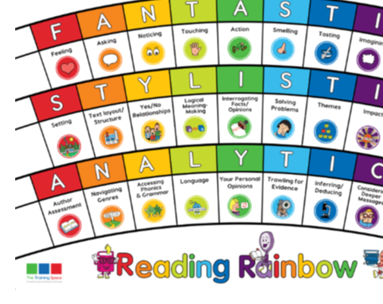
Our LI for the week: Band 4: Can I secure my knowledge of non-fiction features by discussing and identifying how the writer sets out their text and the impact it has on the reader? Band 5: Can I identify and discuss themes and impact of layout, paragraphing, grammar -usage, punctuation, and spelling. Band 6: Can I read books that are structured in different ways; read for a range of purposes?

Slide 2
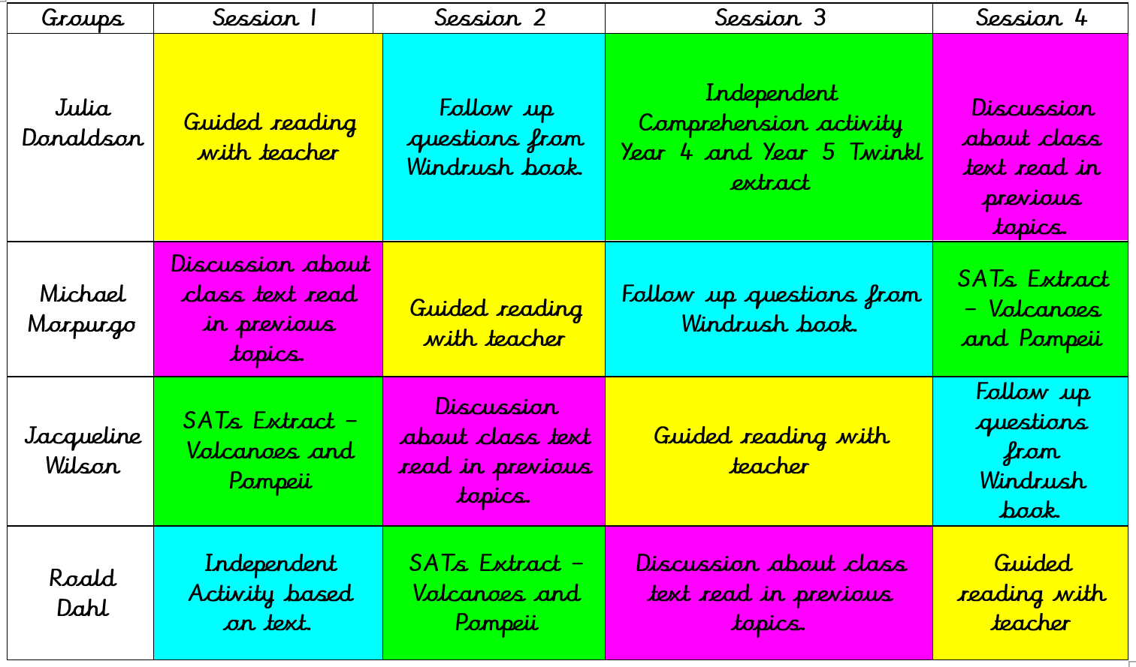

Slide 3
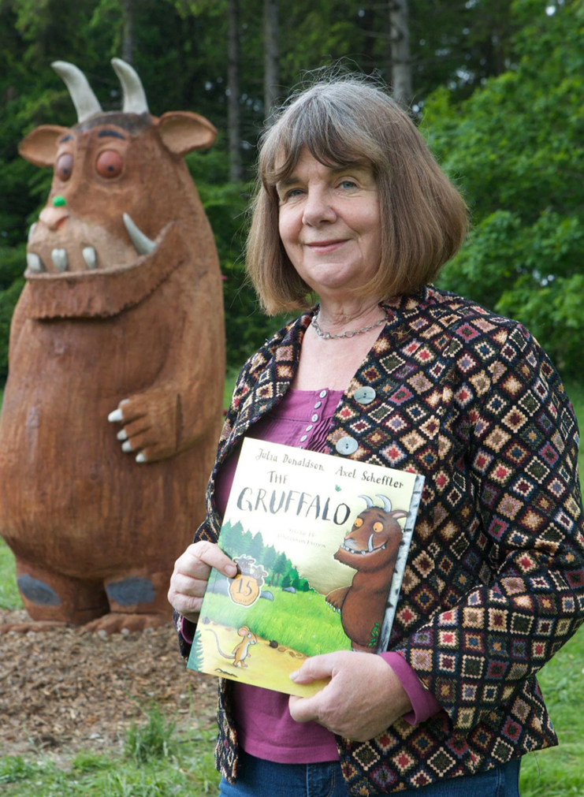
Lenses:
Text Layout/Structure
Impact
Sentence Starters:
Text Layout/Structure
The feature… has been used to…
Impact
The feature has been used to have an impact on the reader by…

Slide 4
Julia Donaldson Group – Enable
Read pages 2 – 7 in ‘All aboard the Empire Windrush’.
Why has the author used a map to show where the West Indies are?
Why are the words ‘West Indies’ and ‘guardian’ in bold?
Why do you think information about the British Empire has been put in its own text box?
Why has the author used real photographs and cartoon pictures in the text?

Slide 6
Roald Dahl Group – Enable (Independent follow-up task)
To be discussed verbally as a group led by the teacher.
1. Which hospital is Grandad staying in?
2. What does Lil mean when she proclaims she's going to do some digging of her own?
3. Who does Lil meet at the museum/ What are your first impressions of them?

Slide 8
Michael Morpurgo Group – Enable (Independent follow-up task)
To be discussed verbally as a group led by the teacher.
1. Which hospital is Grandad staying in?
2. What does Lil mean when she proclaims she's going to do some digging of her own?
3. Who does Lil meet at the museum/ What are your first impressions of them?

Slide 10
Lenses:
Trawling for Evidence
Language
Sentence Starters:
Trawling for Evidence
There is clear evidence of… where it states…
Language
The use of the word/phrase… demonstrates that…

Slide 11
Jacqueline Wilson Group – Enable (Independent follow-up task)
To be discussed verbally as a group led by the teacher.
1. Which hospital is Grandad staying in?
2. What does Lil mean when she proclaims she's going to do some digging of her own?
3. Who does Lil meet at the museum/ What are your first impressions of them?

