Slide 1
2 3 .2 . 2 2
6: Can I draw lines and angles accurately?
I can use a ruler to draw and measure lines.
I can use a protractor to draw and measure angles.
In focus task

Slide 2
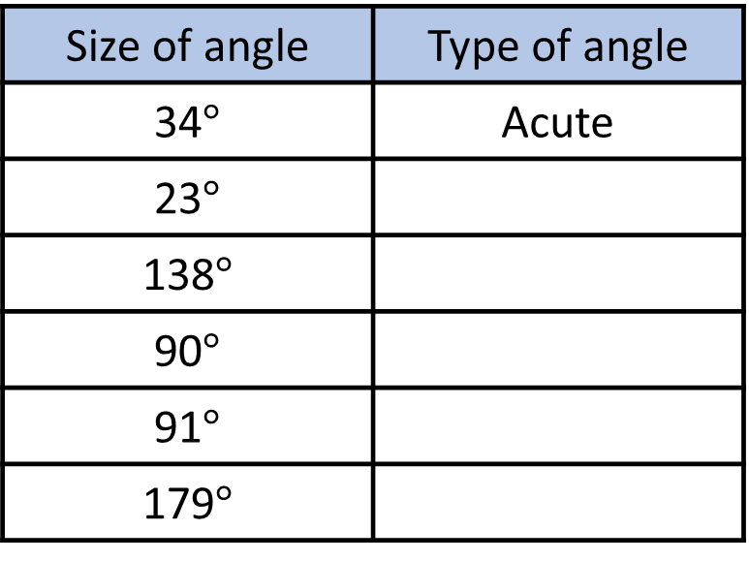
In focus
Complete the table.
What is the size of angle $x$?
Size of angle | Type of angle
34$°$ | Acute
23$°$
138$°$
90$°$
91$°$
179$°$
$$x$$

Slide 3
In focus
Complete the table.
What is the size of angle $x$?
Size of angle | Type of angle
34$°$ | Acute
23$°$
138$°$
90$°$
91$°$
179$°$
Acute
Obtuse
Right
Obtuse
Obtuse
180$°$
$$x$$

Slide 4
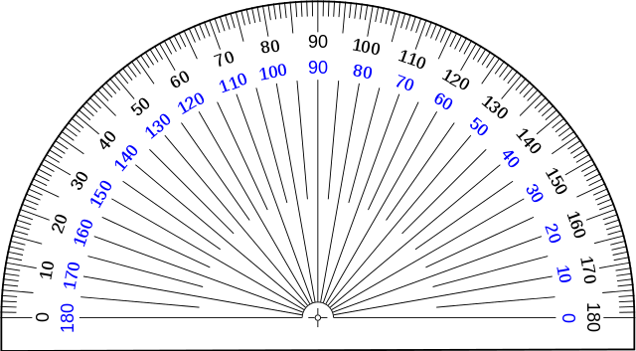
New learning
Ruler
Protractor

Slide 5
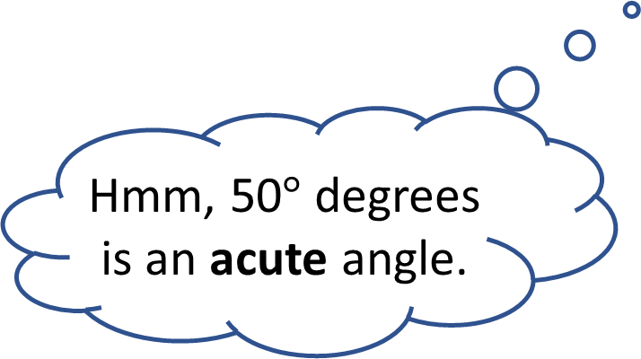
New learning
Draw an angle of 50$°$
Hmm, 50$°$ degrees is an acute angle.
I think it would look like this

Slide 6
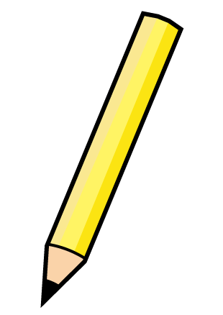
New learning
Draw an angle of 50$°$

Slide 7
New learning
This the origin, we place this on the vertex where two lines meet.

Slide 8
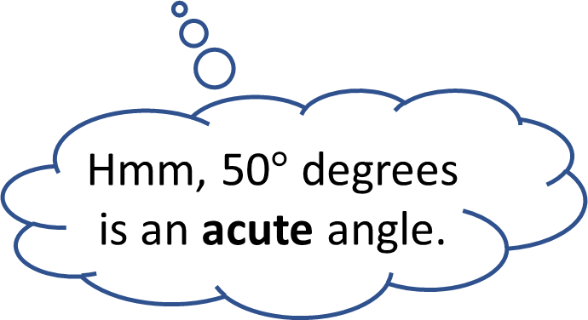
New learning
Have a think
Draw an angle of 50$°$
Hmm, 50$°$ degrees is an acute angle.
Which of the two angles is acute?
Blue or Grey

Slide 9
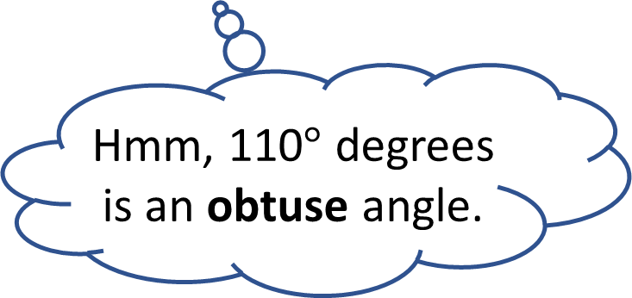
New learning
Have a think
Draw an angle of 110$°$
Hmm, 110$°$ degrees is an obtuse angle.

Slide 10
New learning
Have a think
Draw an angle of 110$°$

Slide 11
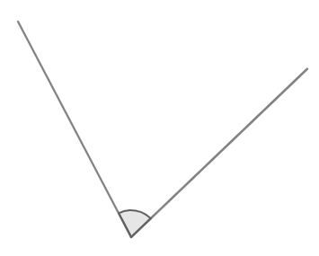
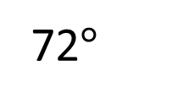
Develop learning
Draw these lines and angle accurately.
7 cm
72$°$
8 cm

Slide 12
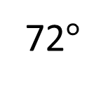
Develop learning
Draw these lines and angle accurately.
7 cm
72$°$
8 cm

Slide 13
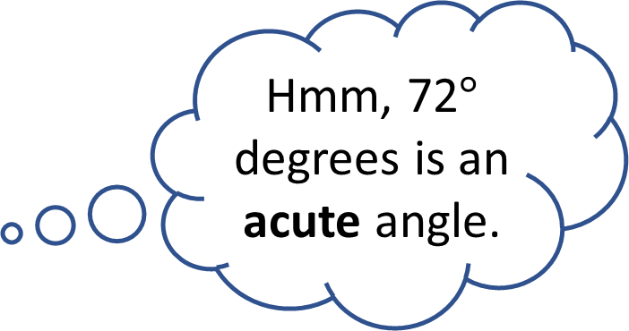
Develop learning
Draw these lines and angle accurately.
Hmm, 72$°$ degrees is an acute angle.
7 cm
72$°$
8 cm

Slide 14
Light bulb challenge

