Slide 1
Monday 28th February
English
Learning Intentions:
3 and 4: I can identify features of a text using a similar model.
5 and 6: I can select the appropriate form and features of a text I am planning to write.
LI: To identify the audience and purpose of a text. (Context: an information text)

Slide 2
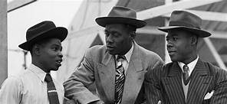
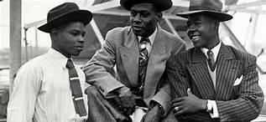
Lesson Guide:
Today’s lesson will be split into three parts.
Firstly, you will have a grammar starter.
Part 2: Features of an information text.
Part 3: Gathering facts on the Windrush – we will need as many as possible!

Slide 3
GPS Starter: Word classes - Adverbs
Complete underneath your LI.
Write the heading, ‘GPS starter: Word classes – Verbs’
Different words can be grouped together based on what job they ‘do’ in a sentence.
We will be continuing to look at different word classes each day.
Today we are focusing on VERBS.
A verb is an action/doing word.
E.G. He ate his lunch.
The word ‘ate’ is the action in this sentence.
How do we make them more interesting?
We can use powerful verbs to add more interesting detail to our sentences.
E.G. He gobbled up his lunch.
E.G. 2 He devoured his lunch.
Hands-up: can you think of any other verbs for ate?

Slide 4
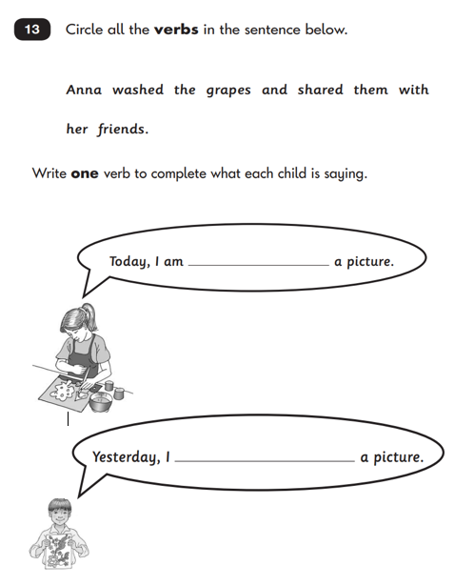
Some of you may have a task which looks like this.
Please complete it on the sheet and make you have glued it in neatly underneath your heading.
*Freya, Ely, Alsie, Joey, Jack L*

Slide 5
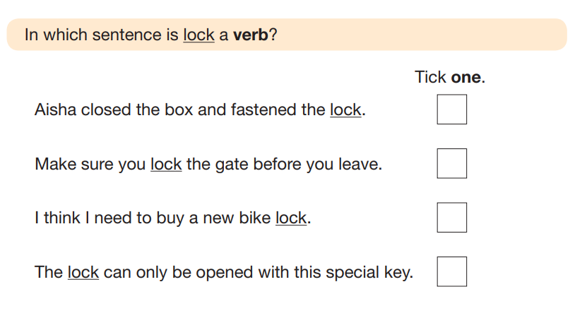
Answer the SATs questions as a whole class.
Afterwards:
Write the sentences and underline the verb/s.
I opened the door slowly.
Charlie demolished his breakfast.
Stretching slowly, Lenny trotted towards the back door.
Challenge (if you’re finished):
Create your own sentences using INTERESTING verbs. Underline the ones you have used.

Slide 6
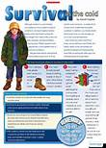
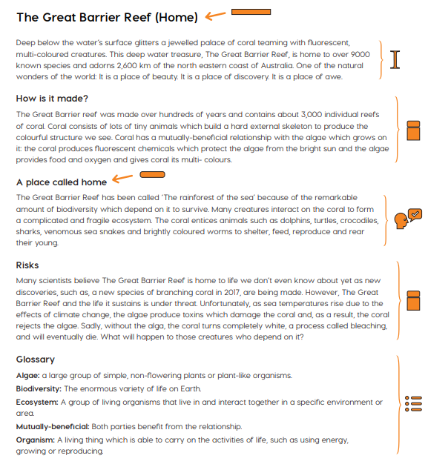
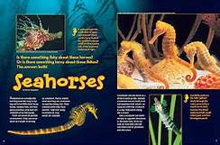
Information texts: what are they?
We are going to write our own information text based on The Windrush.
An information text is a piece of non-fiction writing which gives information about a particular thing (for example: Cleopatra, Ancient Egypt, recycling or volcanoes).
Information texts are sometimes called non-chronological reports, because they are giving information about something without mentioning the order in which it happened.

Slide 7
Heading
Fascinating Facts
Sub-heading and topic information
Introduction
Before we begin writing our information texts, we need to understand what features it is made up from, and what a complete one looks like.
To help us with that, we can use non-fiction shapes. Here are the shapes that make up an information text.
TASK: Look through the information text example (1 between 2). Can you label the features on the side? You may write on the information text.
*See how many shapes you can identify the meaning of.*
Labelled photograph with caption
Glossary

Slide 8
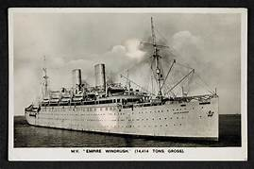
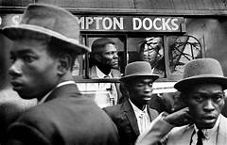
Part 3
It is now time to begin your research! Stick in your picture neatly.
There will be 4 different postcards to get your facts from.
Write down the name at the top of the postcard and underline it (do this for each one).
Your facts can go underneath.
Take the facts only from the postcards, and write them down using bullet points.
Spend 5-10 minutes using each one.

Slide 9
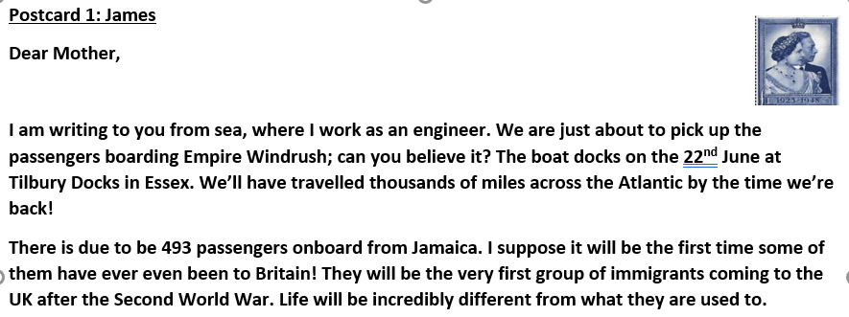
Example
James:
The boat docked on 22nd June at Tilbury Docks, Essex.
Travelled across the Atlantic.
493 passengers from Jamaica.
They were the first immigrants who came to the UK after WW2.

