Slide 1
Tuesday 8th March
English
Learning Intentions:
4: Can I draft and write by:
building an increasing range of sentence structures?
5 and 6: Can I draft and write by:
selecting appropriate grammar and vocabulary, understanding how such choices can change and enhance meaning?
Lenses:
Fronted adverbials
Colon

Slide 2
GPS Starter: Word classes - Pronouns
Complete underneath your LI.
Write the heading, ‘GPS starter: Word classes – Pronouns’
Freya, Ely, Alsie, Joey, Jack L, Ivy – please write ‘GPS starter: Word Classes’
Pronouns take the place of nouns in a sentence.
If we didn't have pronouns, we'd have to keep repeating our nouns and that would make our sentences boring!
For example, if we didn't use pronouns a sentence might look like this:
Tom went upstairs to the bedroom. Tom opened the door and Tom sat on the bed.
Pronouns are short words like it, she, he, you, we, they, us and them.
They are used to describe either individuals or groups of people, rather than using their name or names.
E.G. Lottie dressed up as Hermione Granger because Lottie loved Harry Potter!
Hands-up: can you think of a pronoun instead of repeating the word ‘table’ in a sentence?

Slide 3
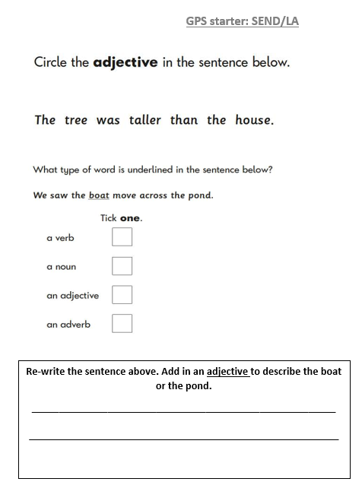
Some of you may have a task which looks like this.
Please complete it on the sheet and make you have glued it in neatly underneath your heading.
*Freya, Ely, Alsie, Joey, Jack L, Ivy*

Slide 4
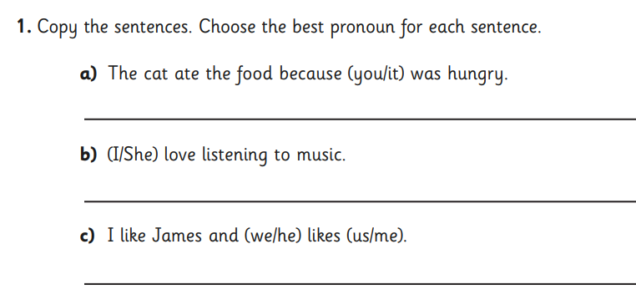
Complete these tasks in your books.
Remember, a noun is a person, place, animal or thing! This is different to a pronoun.

Slide 5
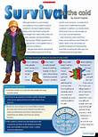
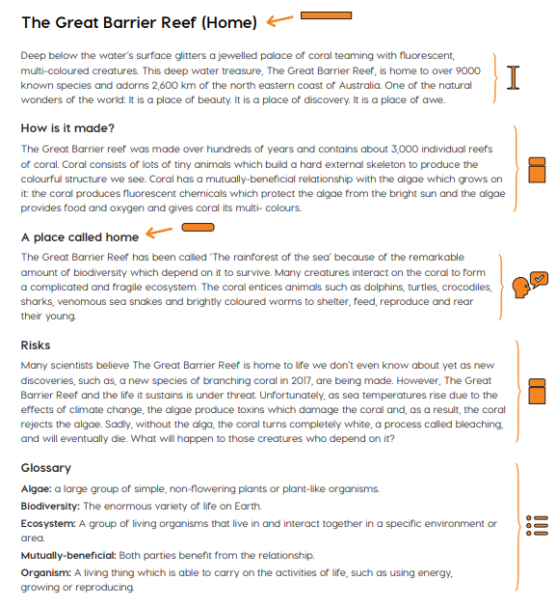
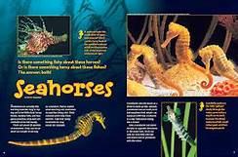
RECAP: Information texts: what are they?
We are going to write our own information text based on The Windrush.
An information text is a piece of non-fiction writing which gives information about a particular thing (for example: Cleopatra, Ancient Egypt, recycling or volcanoes).
Information texts are sometimes called non-chronological reports, because they are giving information about something without mentioning the order in which it happened.

Slide 6
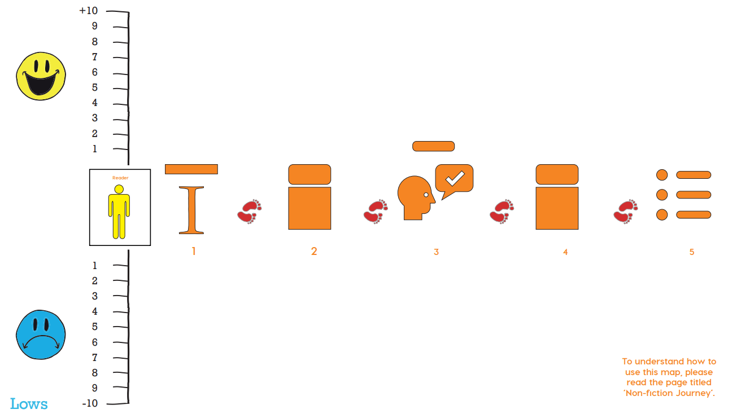
Your information text will be made up of 5 plot points.
We will work on one plot point per lesson.
Today: we are looking at the introduction.
Learning buddies: what do you think should go in the introduction of your information text?

Slide 7
Heading
Fascinating Facts
Sub-heading and topic information
Introduction
Shapes for an Information Text
Before we begin our sentence stacking lessons, we need to understand what an information text is made up of.
To help us with that, we can use non-fiction shapes. Here are the shapes that make up an information text.
We have used some of these shapes before, so today we’ll focus on those that are new to us.
*See how many shapes you can identify the meaning of.*
Labelled photograph with caption
Glossary

Slide 8
Lens:
Fronted adverbials
Sub-heading and topic information
Your next paragraph is going to be about life in the Caribbean for those before they boarded the Windrush.
Your first sub-heading of your information text needs to introduce this.
Use your notes from last Monday’s lesson to help you. Read through the extracts about life there.

Slide 9
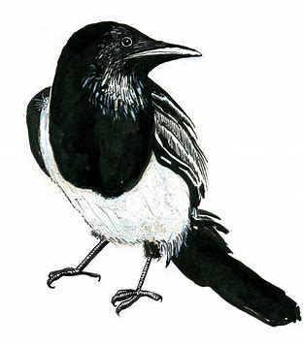
Fronted adverbials
‘In August 1944,…’
In the summer of 1944,…
In the middle of a heatwave in 1944,…
Whilst in the middle of a hot summer season in 1944,…
During the end of the summer in 1944,…
Destroyed
demolished, devastated, annihilated, wrecked, savaged, ruined, wiped out
Chot down fronted adverbials for ‘In August 1944,…’
Chot down dramatic verbs for destroyed.
Sub-heading and topic information

Slide 10
Fronted adverbials
Sub-heading and topic information
Now when you see this symbol, you know that your teacher will now model a sentence on the flipchart.
Remember, you do not copy this. This is to help you!
Write your subheading (mine is ‘Life in the Caribbean).
This first sentence will be using fronted adverbials.
You will continue this sentence on using information about Jamaica from the next two slides/your notes.
This part should be one paragraph.

Slide 11
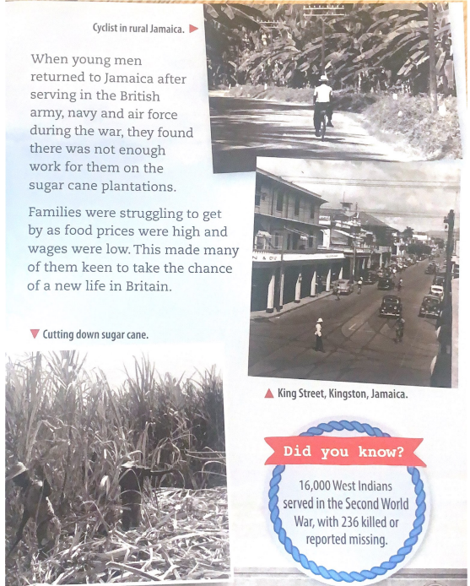
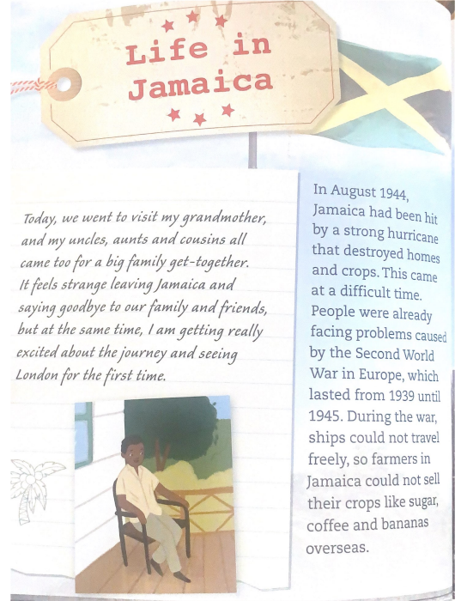

Slide 12
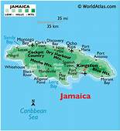
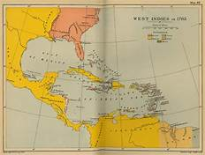
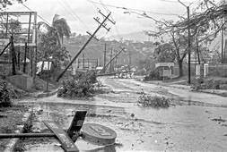
Lens:
Colon
Sub-heading and topic information
In this next section of our life in the Caribbean paragraph, we will talk about seeing the advert, inviting them to travel over.
Look through the info on the next slide, the advert picture, and your own notes, too.
Brainstorm/share any facts you have about the advert.

Slide 13
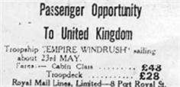
Extract taken from a book of first accounts from Windrush passengers:
Thirty-five-year-old Jamaican Oswald M Denniston explained to the reporter, "Most of us are job-seekers, but others are here to finish their trades and education.
"The very poor can't leave Jamaica. They must have £28 for their passage and another £5 on them when they sail," he said, adding, "It wasn't poverty that brought me here.“
“The streets were lined with devastation from Storm Gilbert. This made us want to leave even more, as we saw the adverts in the papers and stuck to shop windows. Broken shop windows.”
Think about how this would make people feel, seeing this advert at a time when their homes were destroyed.

Slide 14
Colon and Commas
Advert:
plastered onto windows, pinned to trees, tucked into letterboxes, displayed in the newspapers, handed out on the streets.
Exciting opportunity:
Once-in-a-lifetime chance, not-to-be-missed opportunity, unbelievable opportunity, ticket to freedom, invitation for a new life
Chot down three ways the advert was displayed (you can add your own!).
Chot down another way of saying ‘exciting opportunity’.
You must add your own.

Slide 15
Colons and Commas
Sub-heading and topic information
Now when you see this symbol, you know that your teacher will now model a sentence on the flipchart.
Remember, you do not copy this. This is to help you!
This first sentence will be using the power of 3 (and commas) to describe how the advert was shown, and a semi colon.

Slide 16
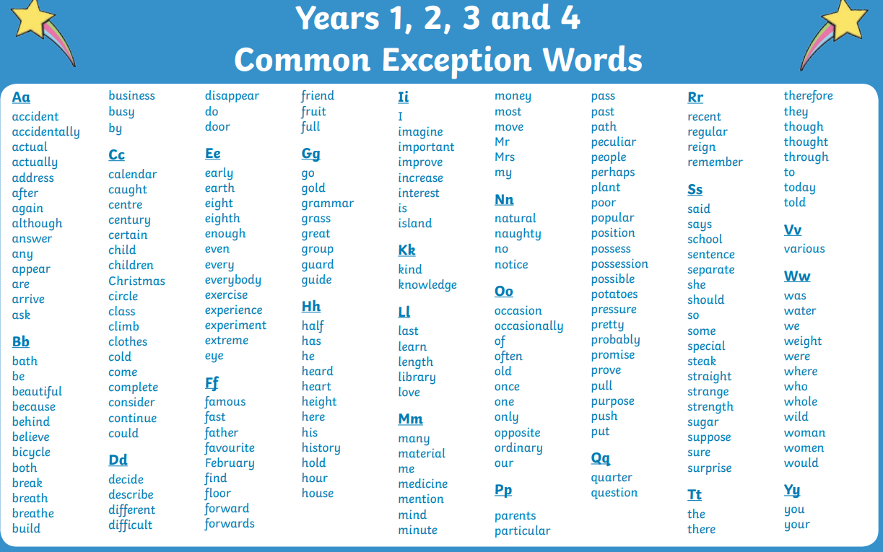
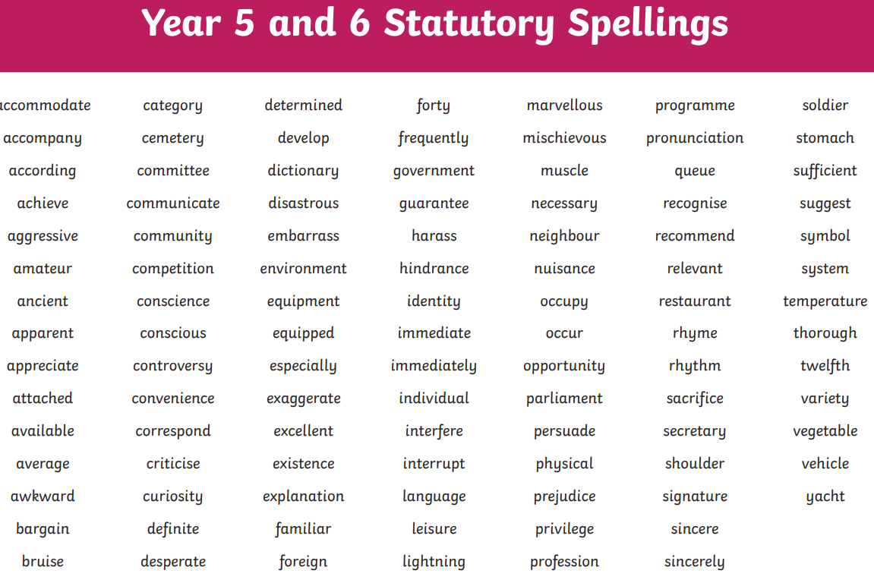
Plenary
There will be no independent writing challenge today as it is our first sentence stacking.
Use this time to read back through your writing, using our spelling help sheets.
Take a C.E.W (3 and 4) mat and a Year 5 and 6 Statutory Word Mat. Check through your blog and your work from today.

