Slide 1
WORLD BOOK WEEK 2022
Tuesday 22nd February 2022

Slide 2
WORLD BOOK WEEK 2022
Learning intentions:
LI 4: Can I identify themes in texts by the same authors?
LI 5/6: Can I make links to other books by the same author using evidence from the text?

Slide 3
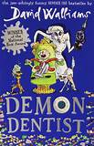
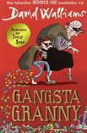
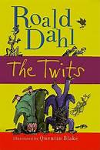
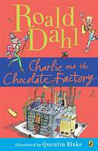
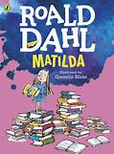
This week:
Remember:
We will be focusing on the following objectives throughout the week:
Identifying authors familiar patterns of language.
Recognising different forms of poetry.
Making links to other books either by the same author or similar in genre, explaining our thinking using evidence from the texts.
Make comparisons within and across books we are reading.

Slide 4
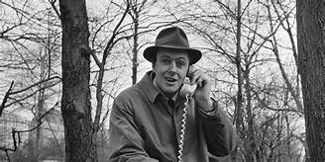
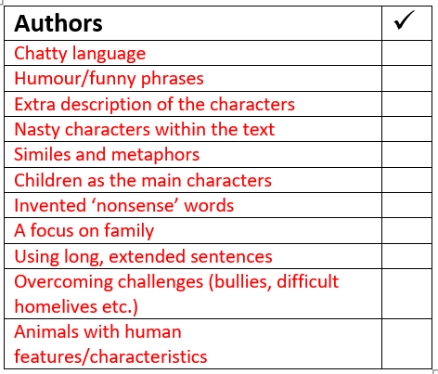
Task 1: VENN DIAGRAM
Today we will be focusing on texts written by Roald Dahl.
Read through the extracts from the texts on your table.
We will go through the features that we can find, using our checklist from yesterday.
As a whole class, write on the flipchart paper the features you can spot.

Slide 5
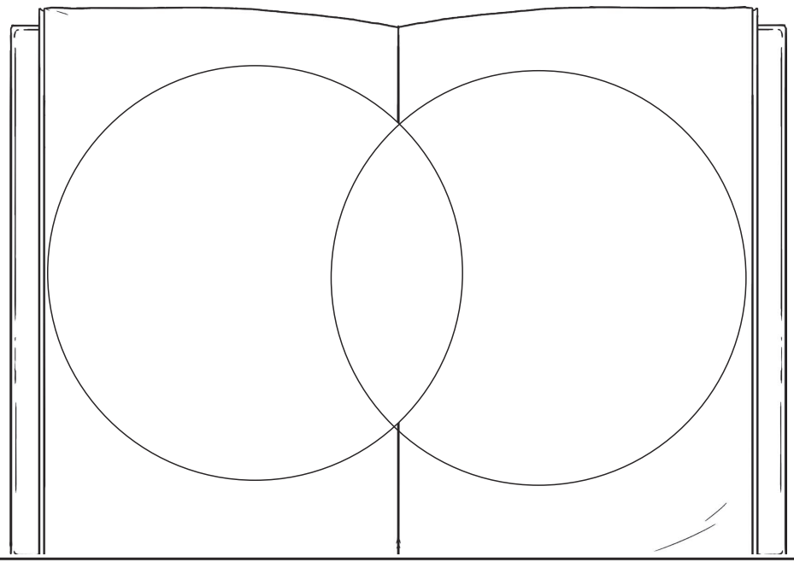
Task
Pick two texts by Roald Dahl out of the extracts.
Label the two extracts on either side of the Venn.
On each side you will put examples on the features which only belong in one of the texts.
In the middle, put the features which you can find in BOTH texts.
Use my example to help!

Slide 6
Matilda
BFG
A focus on family
Nasty characters within the text
Nonsense words – moocheling
Extra description of the surroundings e.g. ‘shining fiery hot over the wasteland’.
Children as a main character – Matilda/Sophie
Lots of speech
Long sentences
What other features can you identify which aren’t on the checklist?

Slide 7
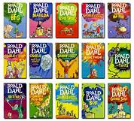
Task 2:
In your paragraph, include:
Examples of things you like about Roald Dahl’s writing.
Your favourite parts of the texts we have read (make sure you name the book).
One thing you don’t like (if there is nothing, don’t include this part!) and explain why.
Which age group you think would enjoy his texts the most, and WHY.
Something you think makes Roald Dahl’s books different.
Once you have finished your venn, make sure this is glued in NEATLY into your book under your LI.
At the end of the week we will be writing letters to our authors, and part of what we’ll include are our likes/dislikes about their writing.
To help with this, your task 2 is to write a paragraph about your opinions on some of the texts we have read so far.
Use the list to help you.
Remember – you MUST support your answer with EVIDENCE from the text!
Example: One thing I particularly enjoy in the BFG is where Roald Dahl uses nonsense words to be humorous/funny, such as ‘footcheling’.

Slide 8
Sentence starters:
Something I specifically enjoy within Roald Dahl’s books are…
Another feature I like is…
In my opinion, what makes Roald Dahl’s books stand out is… because…
I feel that his books would be best for children aged… and I think this because…
Although he is a brilliant author, one thing I don’t like about ______ is… for the reason that…

