Slide 1
Wednesday 6th January
English
Learning Intentions:
4:To understand and learn from a texts structure, vocabulary and grammar.
5:To understand what he/she reads by identifying and discussing themes and conventions in writing.
6: To understand what he/she reads by identifying and discussing themes and conventions in and across a wide range of writing.

Slide 2


Starter
Using Shackleton’s Journey and other setting examples, we will be building up to writing our own setting descriptions.
Read through the extract.
Does it answer the following questions?
What could you hear?
How were the crew feeling?
Which sound did the ship make?
How could the ice be described?
What were the crew members doing?

Slide 3
“Soon after entering the sea, Endurance (the ship) started to face pack ice, which resembled something close to a giant jigsaw puzzle of ice stretching for over 700 miles. The ship carved a deep ‘V’ into the frozen edge, creaking and groaning as it tried to break free from the grip of the ice. Overhead, seabirds squawked their shrill cries as they swooped and soared through the crisp air. The exhausted crew took deep, steady breaths as they continued to chisel and chip away at the ice with any sturdy tool that could be found.”
Do you think this is a good setting description? Why?

Slide 4
An effective setting description allows you to picture the scene exactly in your mind.
Which of these descriptions is more effective? Why? What language techniques are in A, but not in B?
A
The ship carved a deep ‘V’ into the frozen edge, creaking and groaning as it tried to break free from the grip of the ice. Overhead, seabirds squawked their shrill cries as they swooped and soared through the crisp air. The exhausted crew took deep, steady breaths as they continued to chisel and chip away at the ice with any sturdy tool that could be found.
B
The ship made a noise as it hit the ice. Birds flew above the ice. They made loud noises. The crew were really tired because they were working hard and chipping at the ice. They used different tools that they found on the boat.

Slide 5
Finding Features
Setting descriptions should include the following features:
Describe what can be seen.
Describe what can be heard.
Describe what can be smelt.
Describe what can be felt.
Describe the atmosphere and mood.
Challenge: using figurative language.

Slide 6
Atmosphere and Mood:
The atmosphere is a feeling coming from the environment or the setting. The mood is the feeling of the reader.
Gentle waves bubbled over the smooth sand as the sun made a lazy start to the morning, stretching its fingers of light in stunning streams across the shore. A small group of birds softly touched down near the shoreline.
This description gives off a calm atmosphere.

Slide 7
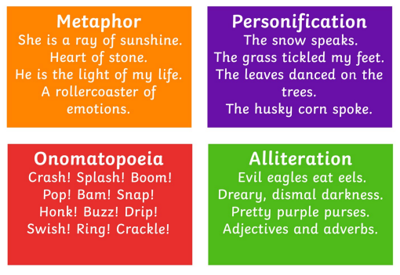
Challenge: figurative language
Here are some different types of figurative language:

Slide 8
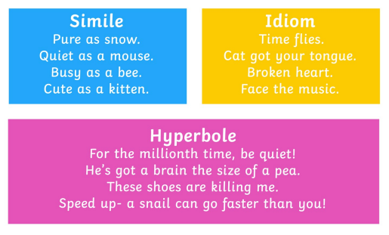
Challenge: figurative language
Here are some different types of figurative language:

Slide 9
Your task:
Read through the setting description.
Create a key using different colours (if you have them) on the features worksheet.
Underline the feature in its matching colour.
Give an example of that feature.

Slide 10

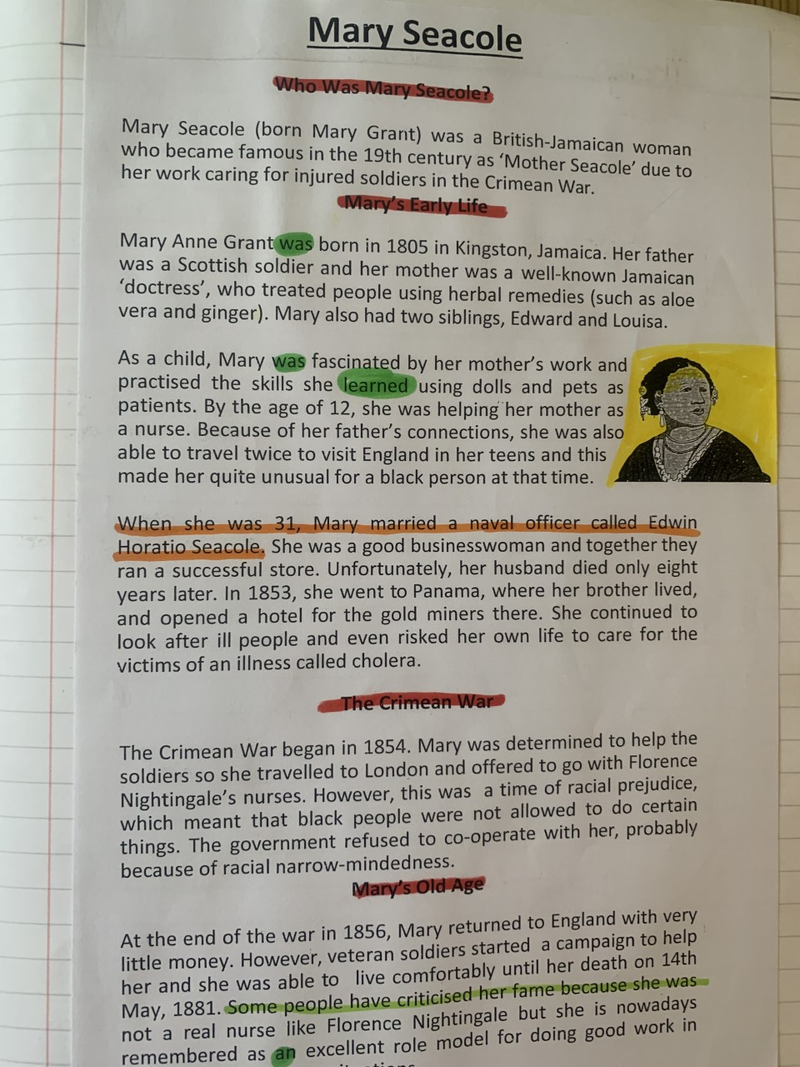
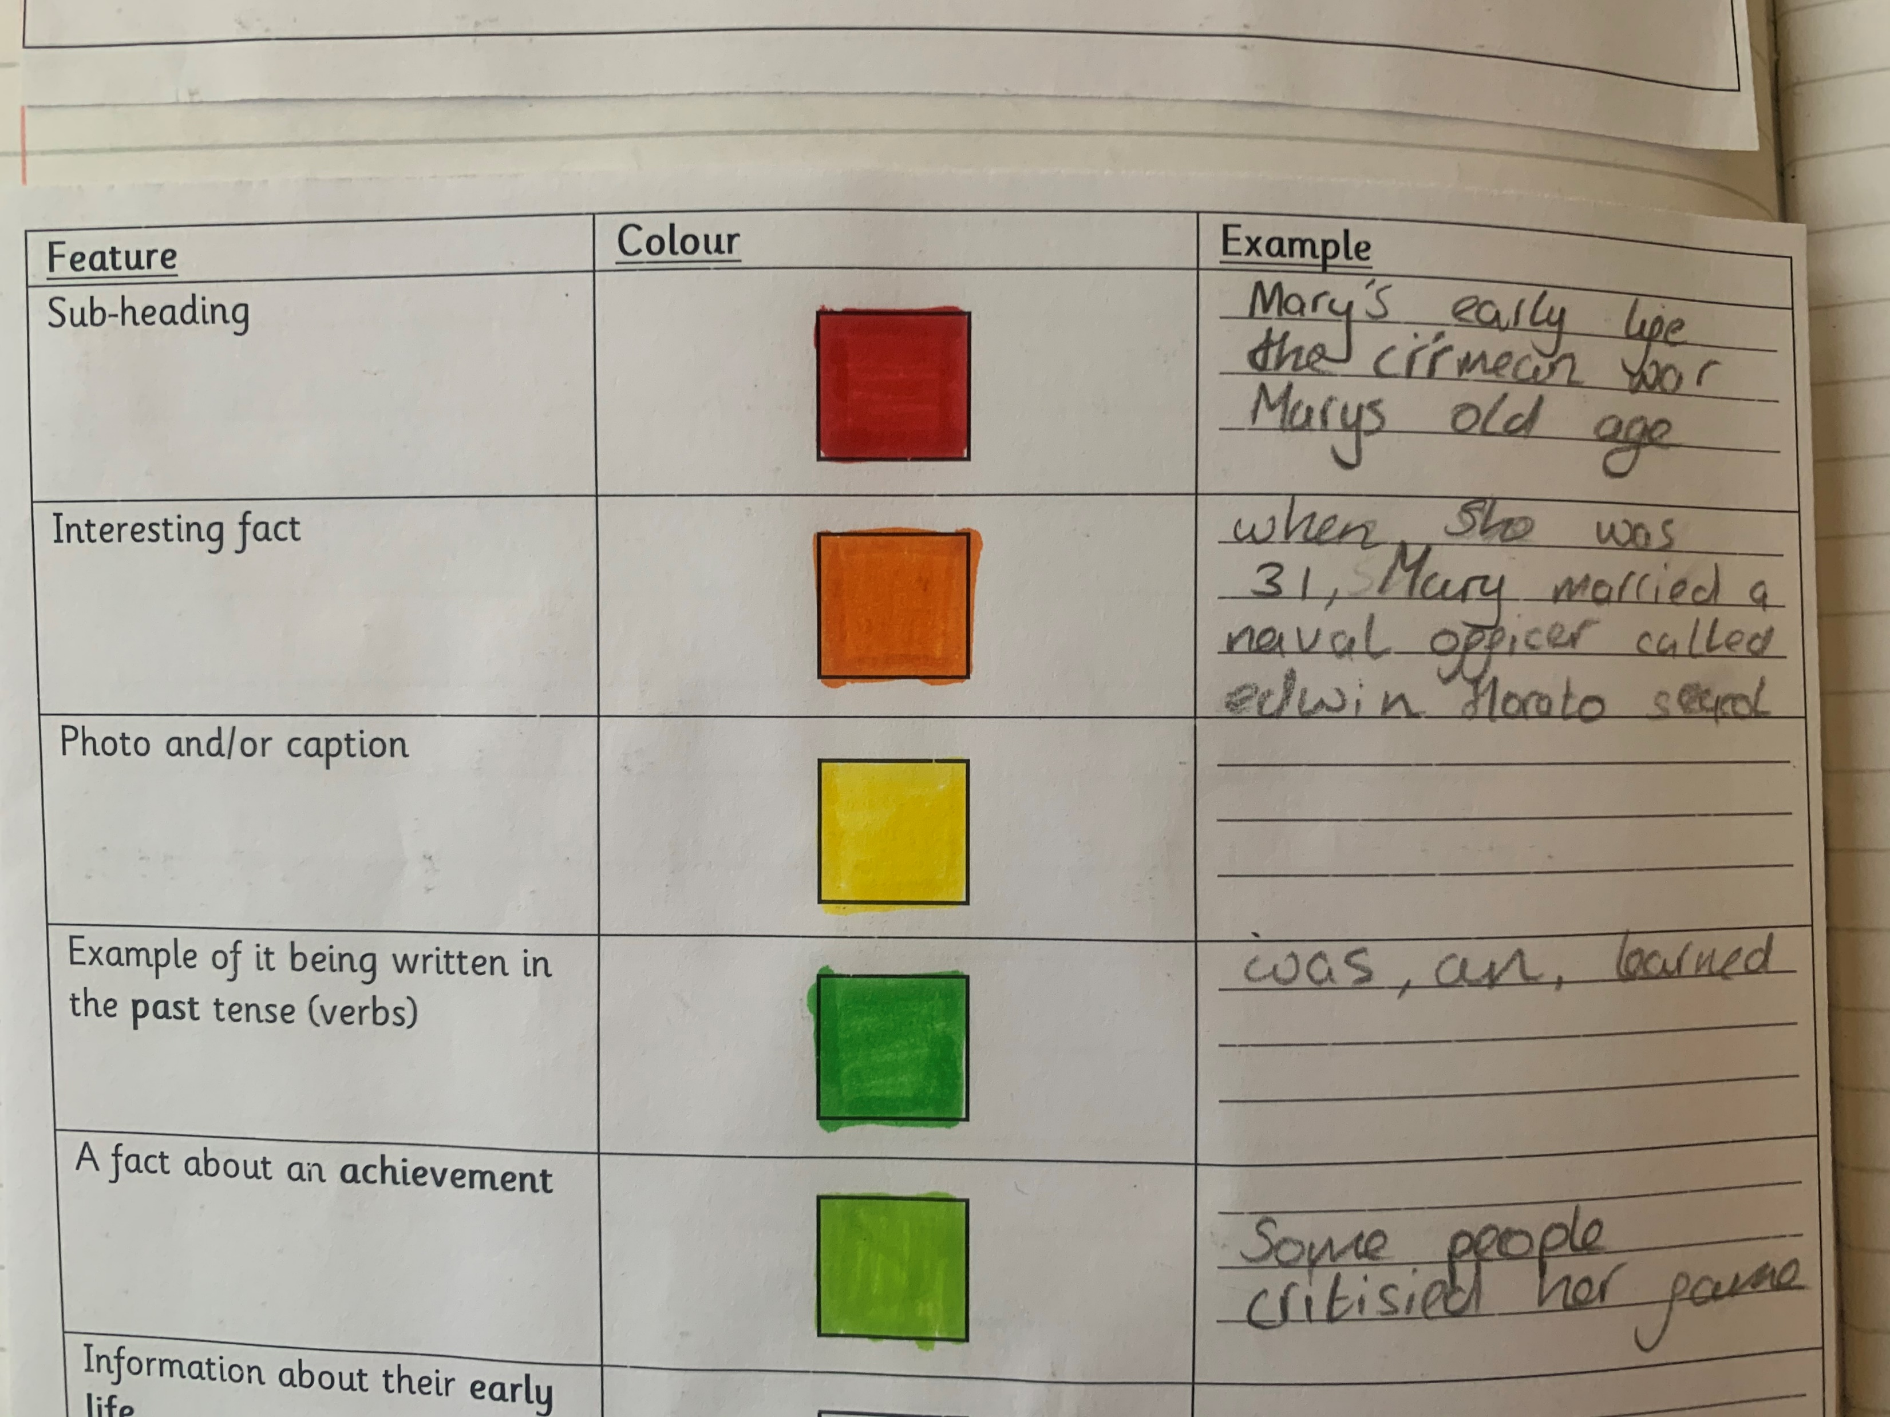
Here is an example of a similar task which we completed last term:

