Slide 1
Year 3: Can I count in 50s? Year 4: Can I count in 25s?

Slide 2
Friday 25.9.20

Slide 3
Focus task: make 3-digit and 4-digit numbers
2
1
5
6
Year 3: Use any 3 of these
Year 4: Any 4 of these
What is the smallest odd number you can make?
What is the highest even number you can make?
Want more?
What is the smallest even number you can make?
What is the highest odd number you can make?
0
9
7
6
4

Slide 4
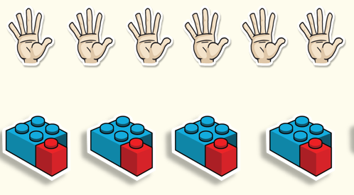
Fluency – do and talk
Let’s count in 5s

Slide 5
Fluency – nothing new
If we can count in 5s, we can count in 50s.
50
150
250
350
450
0
100
200
300
400
500

Slide 6
Fluency – nothing new
If we can count in 5s, we can count in 50s.
Write on your whiteboards what number the arrow is pointing to.

Slide 7
Year 3 – Fluency work
Copy and complete the sequences.

Slide 8
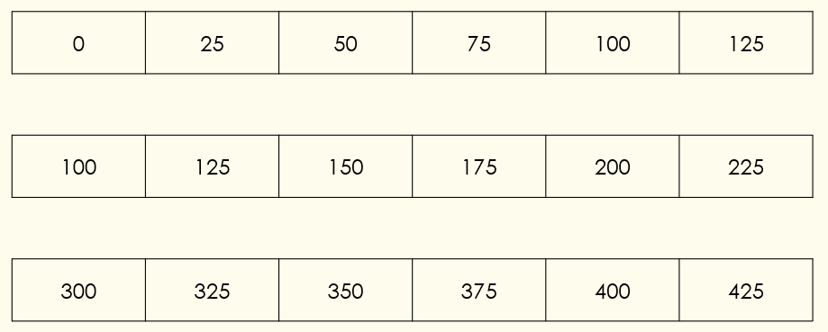
Fluency – do and talk Year 4
What do you notice about these sequences?

Slide 9
Let’s practise
Complete the missing numbers on the number tracks, explain your answers.
 | 25 | 50 |  |  | 125 |  | 175 | 200
0
75
100
150
225
375
500 | 475 | 450 |  | 400 |  |  | 325 | 300
425
350
275
175 | 150 | 125 |  | 75 |  |  | 0
100
50
25
Answers
Notes:
Concrete resources – Number tracks
Key Questions – What would you expect the numbers to end with? Is the sequence increasing or decreasing? How do you know?
Misconceptions/ Common Errors – Pupils may confuse increasing/ decreasing sequences
Further Practice – Give each pupil a number (multiples of 25). Tell them to order themselves (increasing or decreasing order) without talking.
Extension – 460 is a multiple of 5, is it also a multiple of 25 (or would 460 fit in the pattern)?

Slide 10
Year 4 – Fluency work
Copy and complete the sequences.

Slide 11
Fluency - variation
Year 3: explain the mistake in each sequence
Year 4: explain the mistake in each sequence

Slide 12
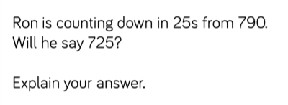
Lightbulb challenge
Year 3
Year 4

