Slide 1
Can I find 1, 10, 100 more or less?

Slide 2
Monday 21.9.20

Slide 3
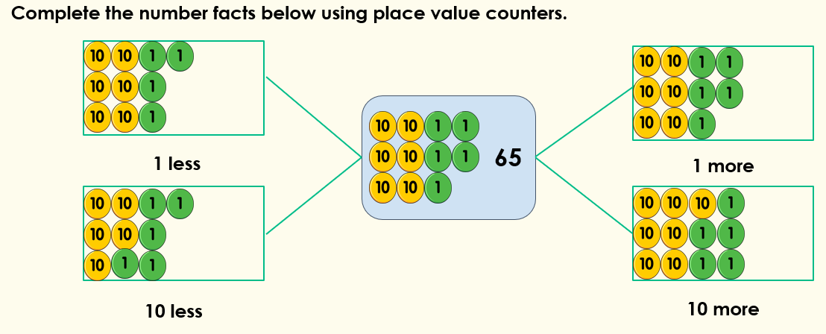
Focus task
1 less than 65 is ______________
10 less than 65 is _____________
1 more than 65 is _______________
10 more than 65 is _______________

Slide 4
Fluency – do and talk
How can we find 1, 10, or 100 more or less than this number?
Use counters or base 10 to show me the answers.
Which column changes?
Can more than 1 column change?
You do:
234
550
684
207

Slide 5
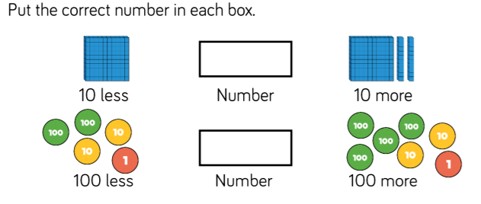
Fluency - variation
I do
We do

Slide 6
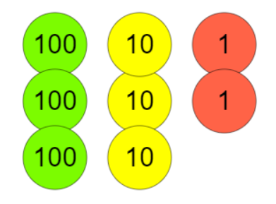
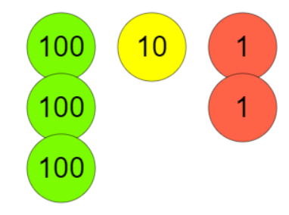
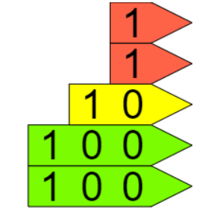
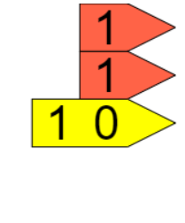
Fluency - variation
You do
10 more
10 less
100 more
100 less

Slide 7
Reasoning – we do
Sophie says, “I add 100, subtract 10, add 1 and subtract 100. My number is 315.
What number did Sophie start with?
Holly thinks 10 more than Sophie’s number is 415. Is she correct?

Slide 8
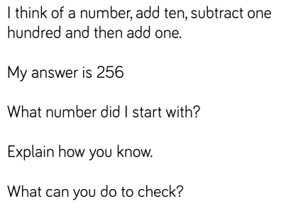
Reasoning – you do

Slide 9
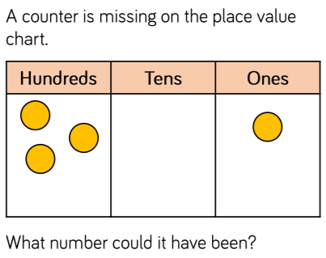
Lightbulb challenge
Show me all the possibilities

