Slide 1
Can I use basic punctuation correctly?
- I can use capital letters at the start of a sentence and for proper nouns.
- I can use full stops at the end of a sentence.
- I can use commas in lists, speech (Y4) and after fronted adverbials (Y4).

Slide 2
Sentences
A sentence is a string of words, which must make sense and must include a verb.
Which of these strings of words really are sentences? Think about whether anything happens.

Slide 3
Sentence punctuation
A sentence ALWAYS starts with a capital letter. We also need a capital letter for proper nouns (names of people, places, days and months).
A sentence ends with a full stop, question mark or exclamation mark.
When does a sentence end?
When the action linked to the verb is finished.
There is usually a pause.

Slide 4
Sentence punctuation
How many sentences can you count?
Cats sleep a lot. They can sleep anywhere. They sleep on newspapers, on windowsills and even in baskets. When they wake up they have a good stretch. Sometimes they go straight back to sleep again.
Cats sleep a lot they can sleep anywhere they sleep on newspapers, on windowsills and even in baskets when they wake up they have a good stretch sometimes they go straight back to sleep again

Slide 5
Sentence punctuation
Exclamation Marks
Used for exclamations, possibly sudden, or strong emotions such as shock, disgust, anger or happiness.
e.g. What a mess!
Full stops
Used for general sentences which state something.
e.g. Apples can be green or red.
Question Marks
Used when a sentence is asking something and has an answer.
e.g. Can I have some pudding?
.
!
?

Slide 6
Sentence punctuation
Do these sentences need a full stop, exclamation mark or question mark?
What time is it
Broccoli is disgusting
We will meet you there
Why are you lying down
I can't believe we won
Archery is my hobby
Do the independent activity before we move on to commas.

Slide 7
Commas
We use commas in:
Lists
After fronted adverbials (Y4)
In speech (Y4)
(Sentences with clauses)

Slide 8
Commas
Commas can change the meaning of a sentence.
How did the comma change this sentence?
Let’s eat Grandma. Let’s eat, Grandma.
Can you turn this negative sentence into a positive sentence using commas?
I like cooking my family and my pets.

Slide 9
Commas (year 4)
Year 3, you can start your task.
Year 4, we continue…
Fronted adverbials tell us how, when or where the action is. Fronted adverbials are always at the start of a sentence and need a comma before you continue the rest of the sentence.

Slide 10
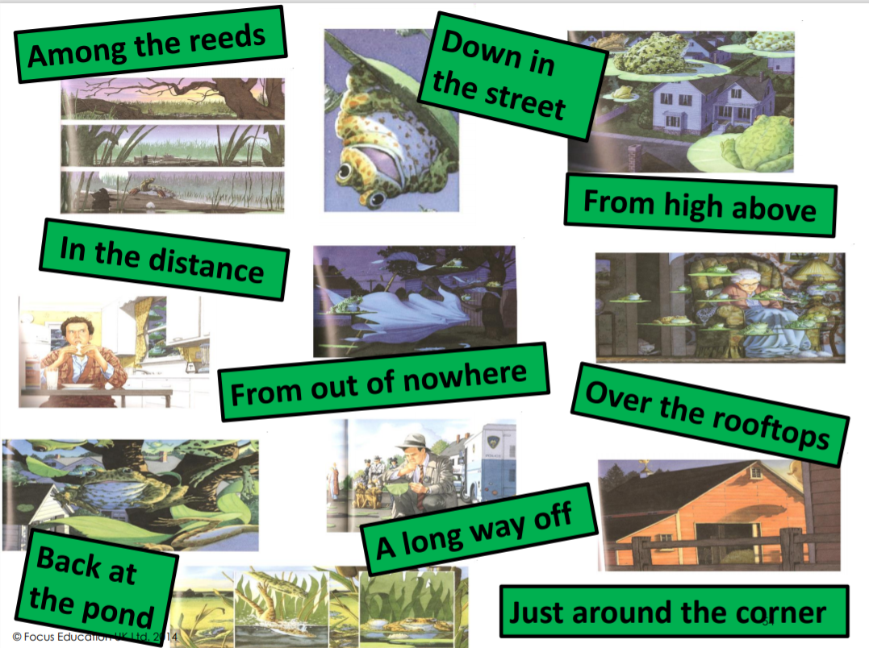
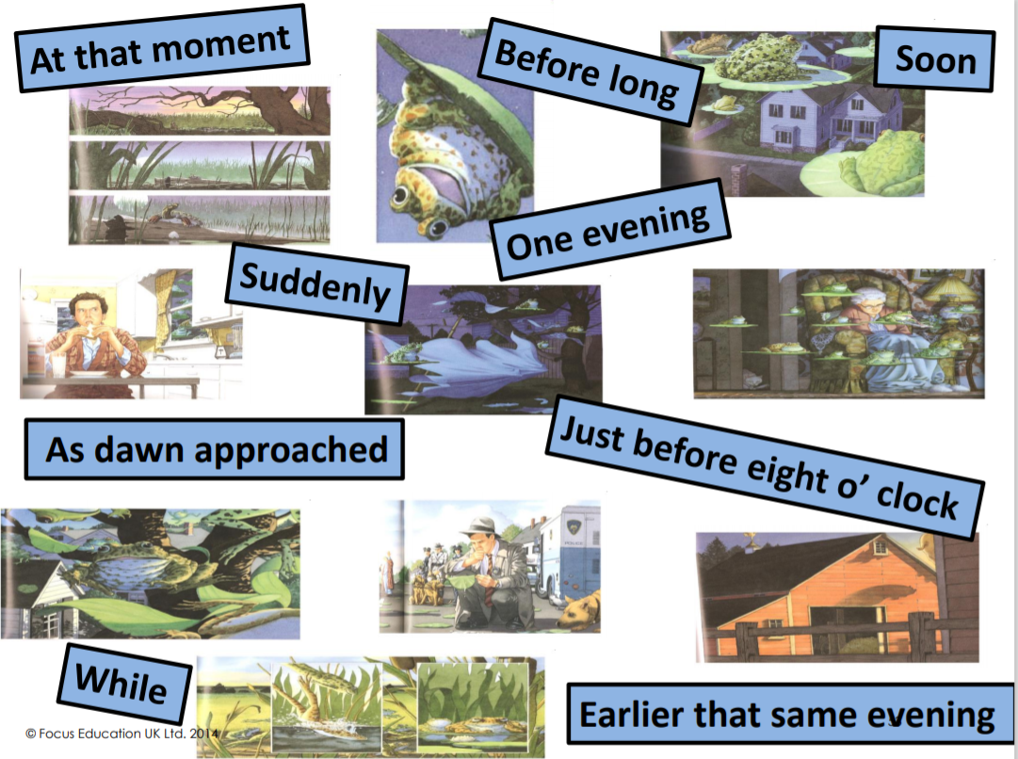
Fronted adverbial,
Here are some examples
Loudly, slowly, joyfully, wildly, softly

