Slide 1
Biographies
A biography is a non-fiction text about a person’s life. It only contains facts.
Over the next few weeks we are going to learn to write a biography.
You will then write a biography about William the Conqueror.

Slide 2
A Sporting Biography
Wilma Rudolph 1940-1994
Resilient, Rapid Runner
Can you imagine being paralysed then going on to win an Olympic medal?
Wilma is one of America’s most famous sprinters. When she was growing up she contracted polio and had to wear a metal leg brace when she was four because the disease paralysed her left leg. Once she started physical therapy she was walking without a brace by the age of twelve and was as free as a bird soaring across the sky. In school, Wilma was teased for being different, this made her unhappy. By the age of thirteen, she was running faster than all of the boys and girls in her class, this made her heart fly. During school, Wilma was starting to get noticed for her speed and strength. As Wilma grew up, she began to break into the Olympic scene and won her first medal in 1956 in Melbourne, Australia. Wilma, most noticeably, went on to win three golds in 1960 in Rome. Wilma’s legacy that she left behind her for other children was The Wilma Rudolph Foundation to support young athletes during their careers. Her message we can feel through how she lived her life is, everyone is equal and should have equal access to the same opportunities.
Wilma Rudolph campaigned for equality on civil rights.
Wilma was one brave voice that showed others you can make a difference if you speak up.
Wilma fought against segregation in her home of Clarksville, Tennessee.

Slide 3
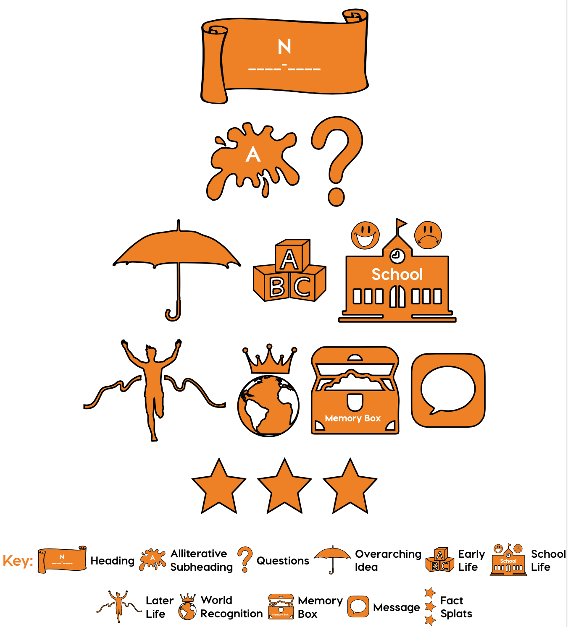
Find the shape
Your job is to match these pictures with the purpose of the sentences or paragraphs in the text.
You will glue the shapes next to the relevant part of the text.

Slide 4
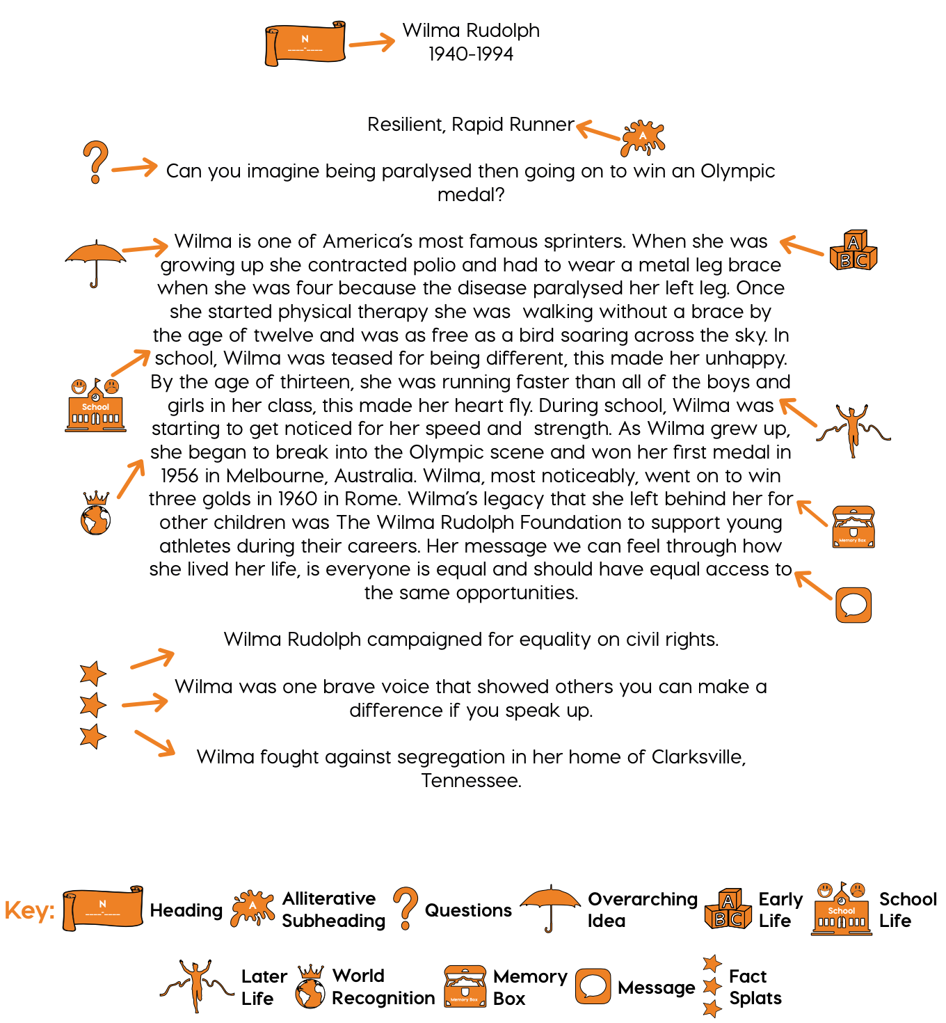
Mark your work.
Did you do your task correctly?
If not, what mistake did you make and why?

Slide 5
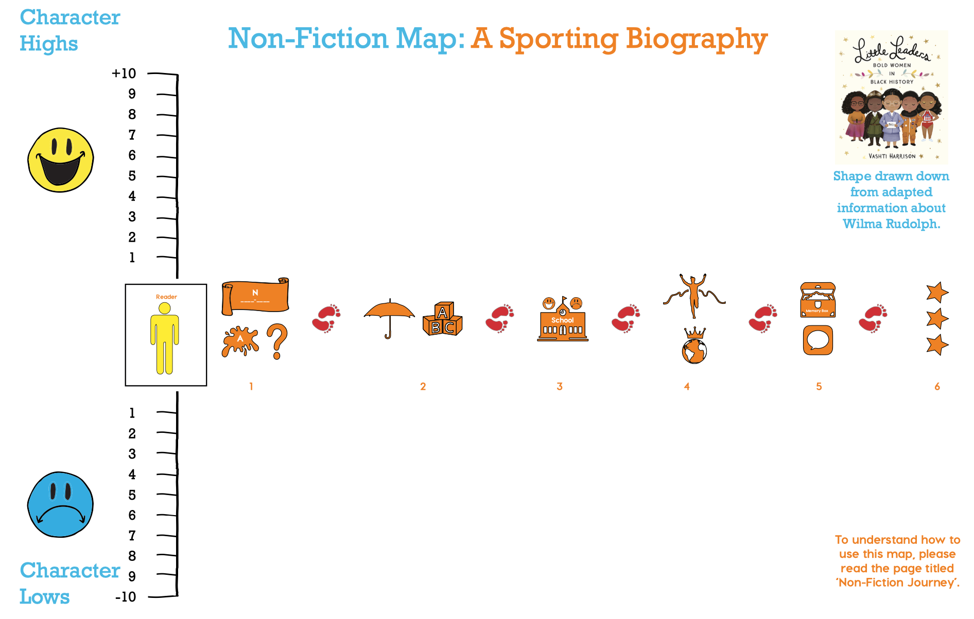

Slide 6
Biography
Tuesday 6th October 2020

Slide 7
Find the shape
Can you match the shapes of the text from yesterday to the sentences and paragraphs?
What words in the text would give you clues?

