Slide 1
Can I add and subtract to compose different numbers?

Slide 2
Thursday 8.10.20

Slide 3
Focus task
Do you remember what a numberbond is?
Do you remember the numberbonds to 10?
Write them quickly on a whiteboard

Slide 4
How many ways can you make 100 and 1000?
We can add and subtract different numbers but still get the same answer.
Today we are going to learn to use numberbonds to 10 to help find missing numbers that will make 100 (Y3) or 1000 (Y4).

Slide 5
100 is made up of ten 10s
Digits | What it means
10
1 ten
100
20
2 tens
30
3 tens
10
10
10
10
10
10
10
10
10
10
40
4 tens
50
5 tens
60
6 tens
100 = 10 + 10 + 10 + 10 + 10 + 10 + 10 + 10 + 10 + 10
70
7 tens
100 = 10 × 10
80
8 tens
100 ÷ 10 = 10
90
9 tens
100
10 tens
Notes:
100 is made up of ten tens. This is how we can show it on a barmodel. We can read it in different ways.

Slide 6
100 is made up of two 50s
100
50
50
100 = 50 + 50
100 = 2 × 50
100 = 50 × 2
100 ÷ 2 = 50
100 ÷ 50 = 2

Slide 7
100 is made up of four 25s
100
25
25
25
25
100 = 25 + 25 + 25 +25
100 = 4 × 25
100 = 25 × 4
100 ÷ 4 = 25
100 ÷ 25 = 4

Slide 8
100 is made up of five 20s
100
20
20
20
20
20
100 = 20 + 20 + 20 +20 + 20
100 = 5 × 20
100 = 20 × 5
100 ÷ 5 = 20
100 ÷ 20 = 5

Slide 9
We don’t always have to use equal parts

Slide 10
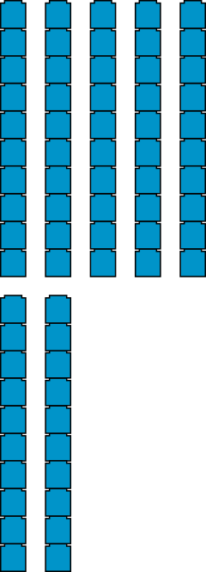
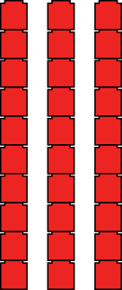
Remember numberbonds?
10
7
3
10 tens
7 tens
3 tens

Slide 11
Which numberbonds did I use?
60
+
40
=
100
?

Slide 12
Which numberbond did I use?
100 = 10 +
90
?
100 – 10 =
90
?
100
10
90
?

Slide 13
Short task
Use the blank 100 square to find 3 pairs of numbers that add up to 100.
Use the 1000 square to find 3 pairs of numbers that add up to 1000.

Slide 14
What do you notice?
+ 3
7 + 3
= 10
+ 3
97 + 3
= 100

Slide 15
What do you notice?
− 4
10 – 4
= 6
− 4
100 – 4
= 96

Slide 16
Model using the square to find pairs
100 =
97 + 3
90
7
10
90
10

Slide 17
Your turn: 24 + ? = 100
24
+
76
=
100
20
10
70

Slide 18
Independent task
Year 3
Use the numbersquare to find the missing number to make 100
35 + ? = 100
47 + ? = 100
84 + ? = 100
73 + ? = 100
Year 4
Use the numbersquare to find the missing number to 1000
350 + ? = 100
424 + ? = 100
573 + ? = 100
706 + ? = 100

Slide 19
Reasoning
A year 3/4 class needs to earn 100 dojo points in a week for a treat.
They have 62 already.
Sienna says they need 48 more.
Jasleen says they need 38 more.
Who is correct?
Explain why.

Slide 20
Reasoning
100
=
62
+
38
?
60
10
30

Slide 21
Reasoning
100
100
62
48
62
38
Sienna
Jasleen
✗
100 = 62 + 48
100 = 62 + 38
Notes:
Year 3 need to earn 100 class points for a treat. They have 62 already. Sienna says they need 48 more. Jasleen says they need 38 more. Who is right?

Slide 22
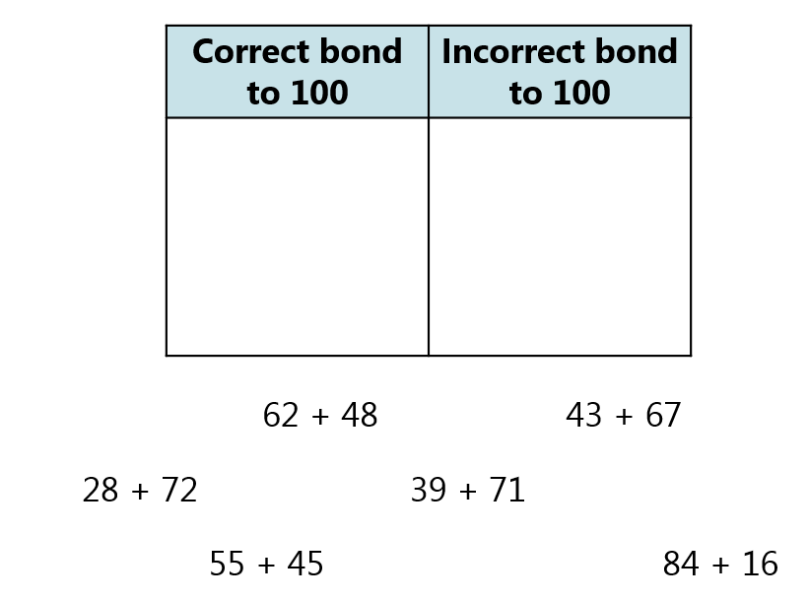
Lightbulb challenge
Year 3: Year 4:
Correct bond to 1000 | Incorrect bond to 1000
250 + 750 924 + 186
320 + 780 677 + 333
545 + 455 489 + 511

