Slide 1
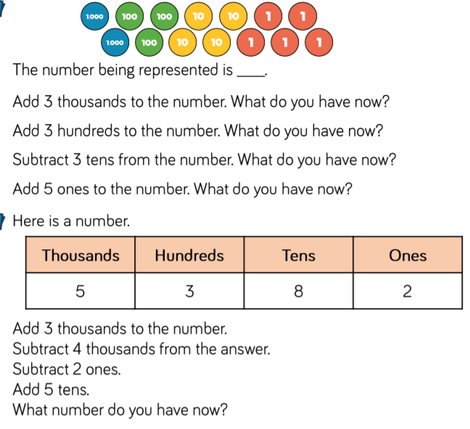
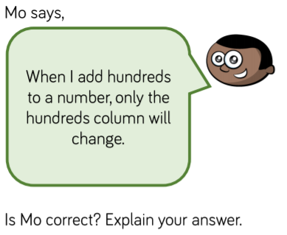
fluency
fluency
1.
1.
2.
2.
reasoning
reasoning

