Slide 2
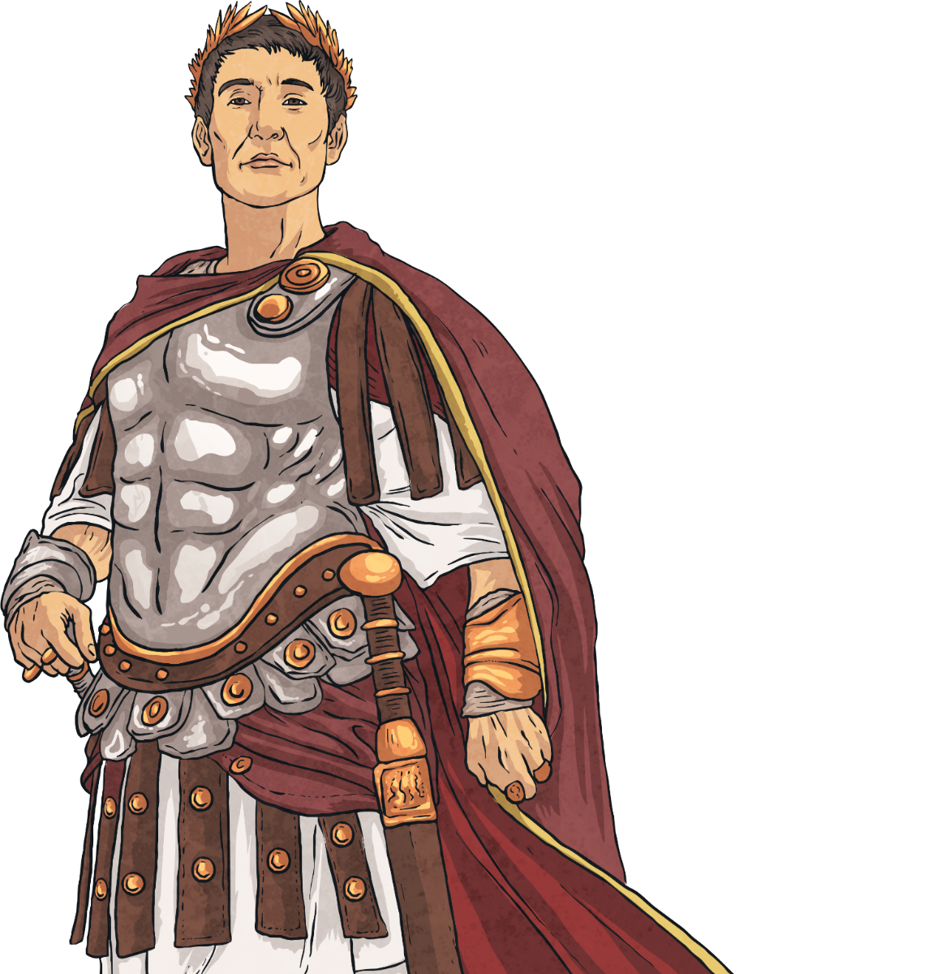
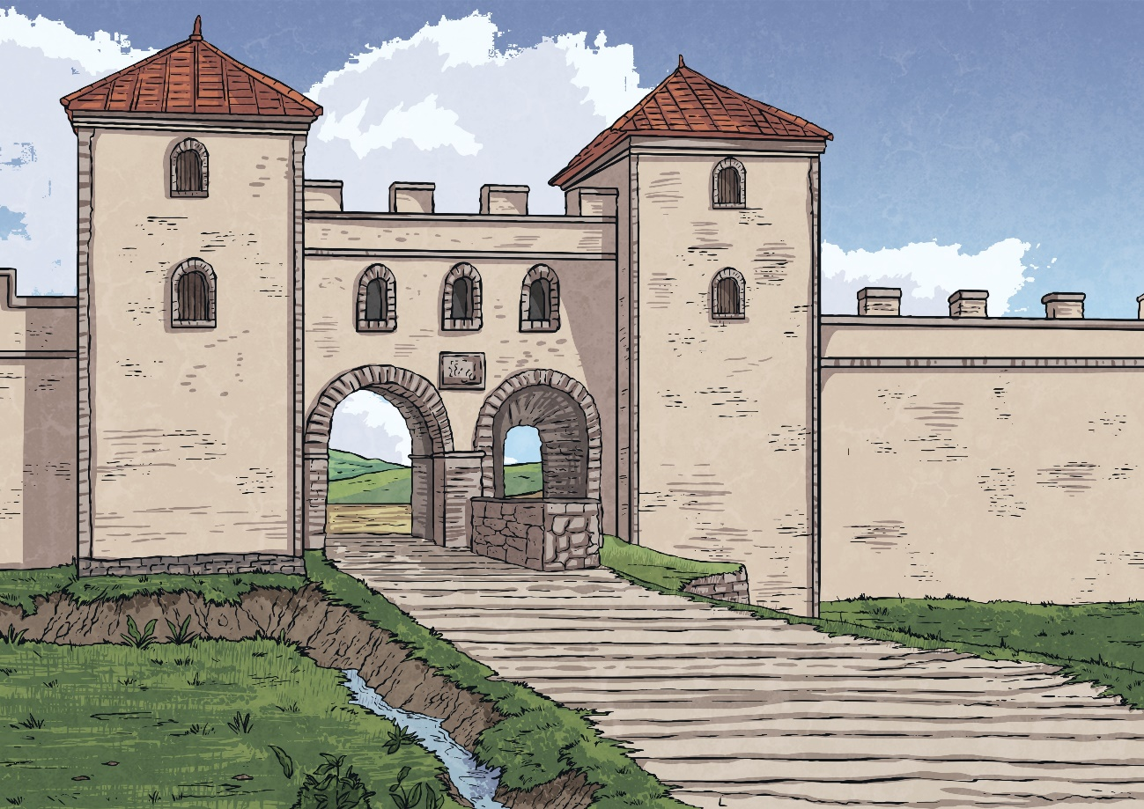
Julius Caesar
Gaius Julius Caesar was a general in the Roman army who eventually became ruler of the Roman Empire. He was also a poet.
Although he lived nearly two thousand years ago, many of our sayings come from the life of Julius Caesar. Even our calendar is derived from the one he invented!

Slide 3
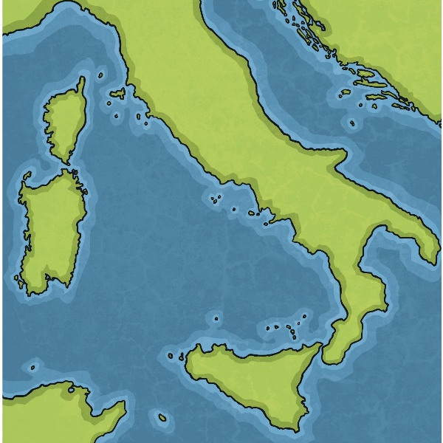
Julius Caesar’s Early Life
Julius Caesar was born in Subura, Rome on 13th July 100 BC. He was born into an important Roman family known as the Julian Clan. The Julian Clan could trace their family right back to the origins of Rome.
When Julius Caesar was 16 years old, his father died and he became the head of the family.
Rome
Do you know any 16 year-olds? Do you think they’d do a good job as the head of an important family?
Talk about it

Slide 4
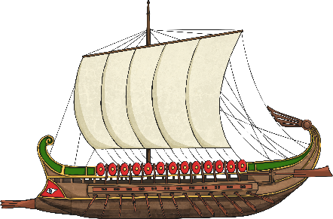
Kidnapped!
In 75 BC, Caesar was kidnapped by pirates in the Mediterranean Sea.
When they told him they would be asking for a ransom of 20 talents, Caesar burst out laughing and suggested they ask for 50!
Caesar was a hostage for 38 days. During his time in captivity, he joined in all the pirates’ games and activities and read them his poetry.
After the ransom had been paid and Caesar had been freed, he immediately set sail after the pirates and captured them. He put the pirates in prison and took all their treasure.

Slide 5
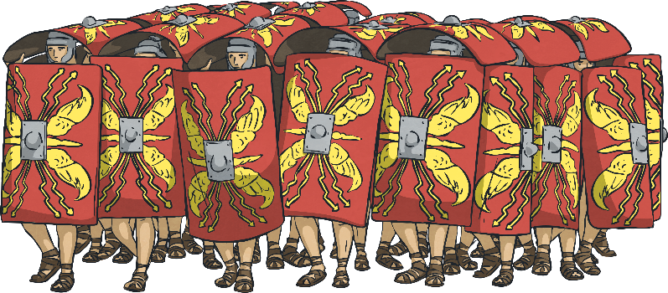
Military Leader
He quickly rose through the ranks and became a general. His military tactics meant that the Roman Empire spread through much of France, Germany and Spain.
In 55 BC, Caesar defeated a Germanic tribe. He had a huge bridge built for him and his army to cross the Rhine river. The tribe was defeated, Caesar and his army crossed back over the bridge and then Caesar had the bridge destroyed.
By 52 BC, Caesar had conquered all of France.
Caesar's uncle, Gaius Marius, was involved in a war with another leader Lucius Cornelius Sulla. Sulla defeated Gaius Marius and became leader of Rome. To avoid the political tension, Julius Caesar joined the Roman army and left Rome.

Slide 6
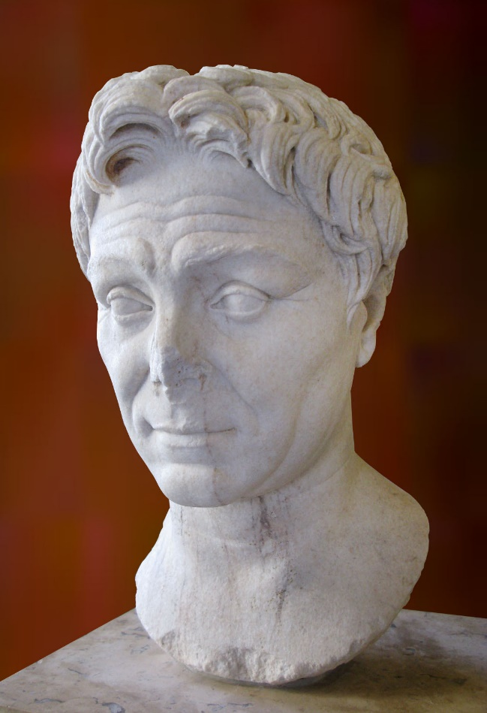
Civil War
Following his military successes, Caesar returned to Rome to run again for a political position. However, Caesar angered the Senate (the rulers of Rome) by bringing his army with him. This was against the rules as Caesar was supposed to break up his army before entering the city. Caesar was labelled a traitor.
For the next 18 months, Caesar fought a war against Pompey the Great, another Roman leader, for control of Rome.
Did you know…?
Pompey the Great was married to Caesar’s daughter, Julia!

Slide 7
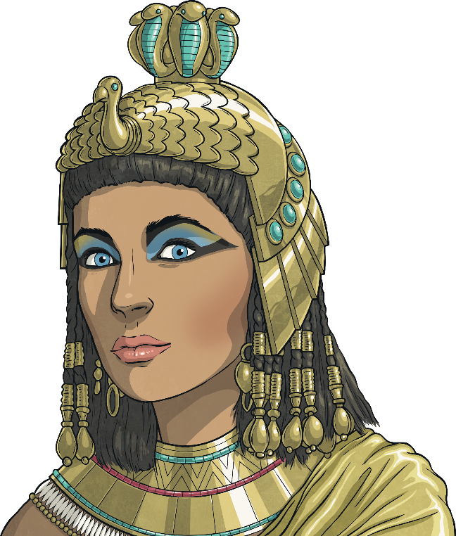
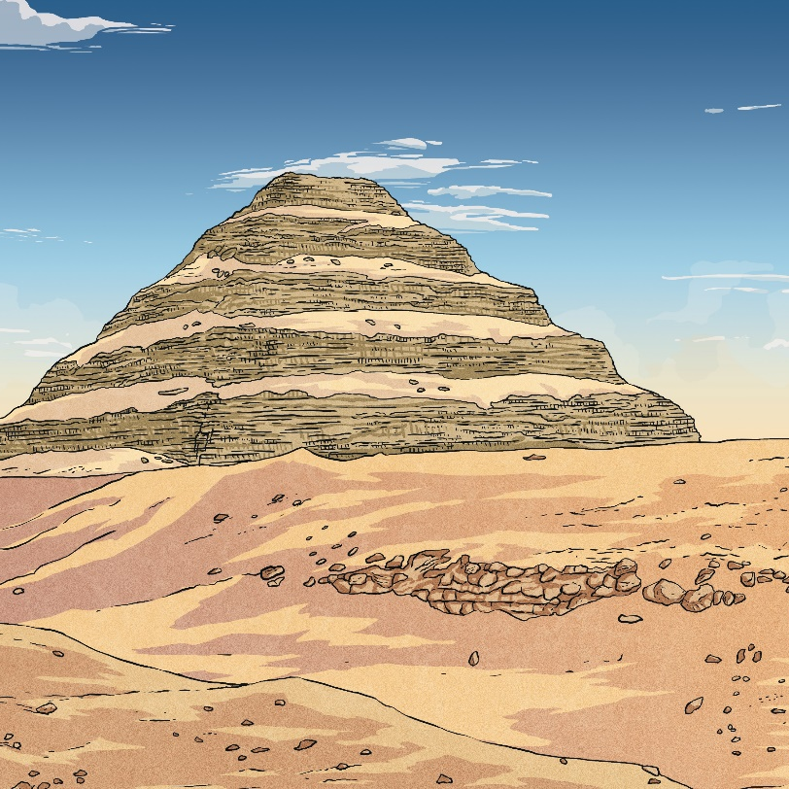
Cleopatra
While in Egypt, Caesar began a political and romantic relationship with Cleopatra, the Pharoah’s sister. Caesar’s army fought to make Cleopatra ruler of Egypt instead of her brother while Cleopatra used her great wealth to fund Caesar’s army.
Cleopatra later had a son whom she named Caesarion. Most historians think Caesar was his father.
Losing the war, Pompey fled to Egypt. Caesar pursued Pompey to Egypt, where the Pharoah had Pompey killed.
The Pharoah, Ptolemy VIII, gave Pompey’s severed head to Caesar as a gift!
Did you know…?

Slide 8
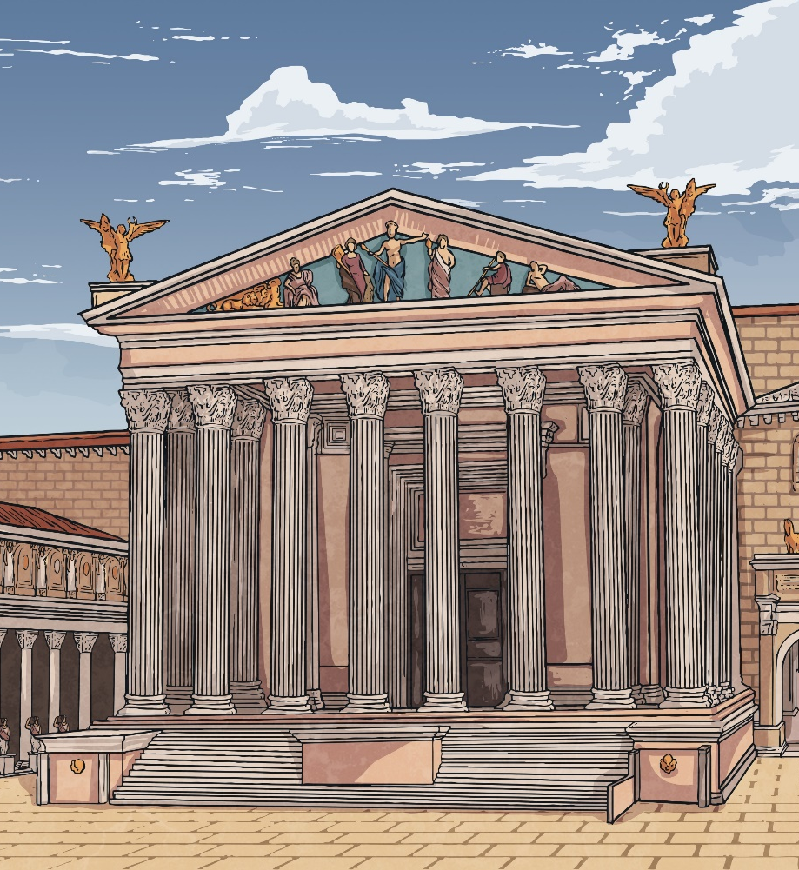
Ruler of Rome
Caesar returned to Rome in 46 BC.
He made himself consul and dictator of Rome.
During his rule, Caesar made many reforms to Rome. He ordered a census, had many public buildings erected and passed a law to give land to people who had served in the Roman army.

Slide 9
The Julian Calendar
There are 365 days in a year plus an extra day every leap year, yes? Well until Caesar’s reform of the calendar, the answer was actually no.
Prior to the introduction of what became known as the Julian calendar, there were 355 normal days in the Roman year and then an extra month whose length changed each year.
Caesar’s calendar is almost identical to the one we use today.

Slide 10
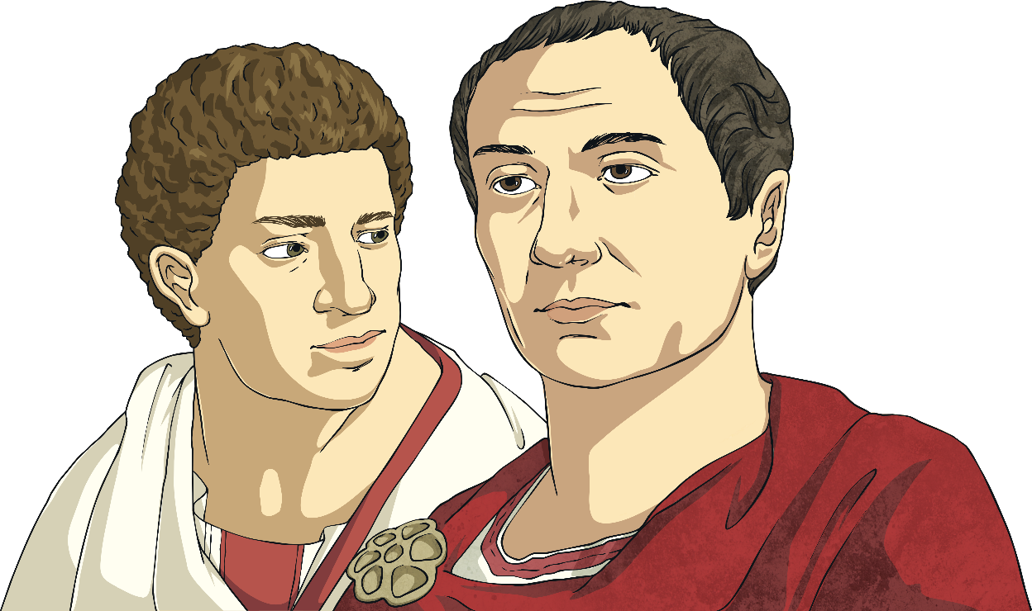
Caesar’s Death
Before Caesar took power, Rome had been a republic. This meant it was ruled by a group of elected leaders with no leader being in power for life.
In February 44 BC, Caesar was appointed dictator of Rome for life. Unbeknown to him, many senators were unhappy with this. They were concerned that Caesar would close the senate and declare himself King of Rome. Lead by Cassius and Brutus, the senators devised a plot to assassinate Caesar at the senate.

Slide 11
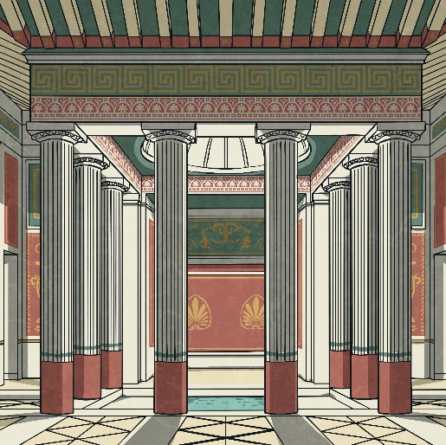
Caesar’s Death
On 13th March 44 BC (known in the Julian Calendar as the ‘Ides of March), Caesar attended the senate.
His wife Calpurnia had warned Caesar not to go as she had dreamt that something bad was going to happen.
Have you ever had a dream that came true?
Talk about it
On his arrival at the senate, Caesar was attacked by over 60 senators. When he saw his supposed good friend Brutus among the attackers, legend has it that he said, ‘You too, my son?’. Caesar then died.

Slide 12
Sayings
Many modern day sayings come from the life of Julius Caesar:
‘Crossing the Rubicon’ – When Caesar went against the senate and brought his army to Rome, he had to cross the Rubicon river. We now use this phrase to mean when someone has made a major decision or taken action that they can’t ever go back on.
‘Et tu, Brute?’ – This is actually from a play that Shakespeare wrote about Julius Caesar. In the play, when Caesar sees his friend Brutus coming towards him to kill him, Caesar says these words. This phrase is used to signify that someone has betrayed a friend.
‘Beware the Ides of March’ – This phrase is also in Shakespeare’s play and it is spoken by a fortune teller to Caesar. People sometimes use it to refer to something being bad luck.
‘I came, I saw, I conquered’ – Caesar wrote this in a letter to the senate after his victory in the Battle of Zela in 47 BC. People use it today to describe any type of success.

Slide 13
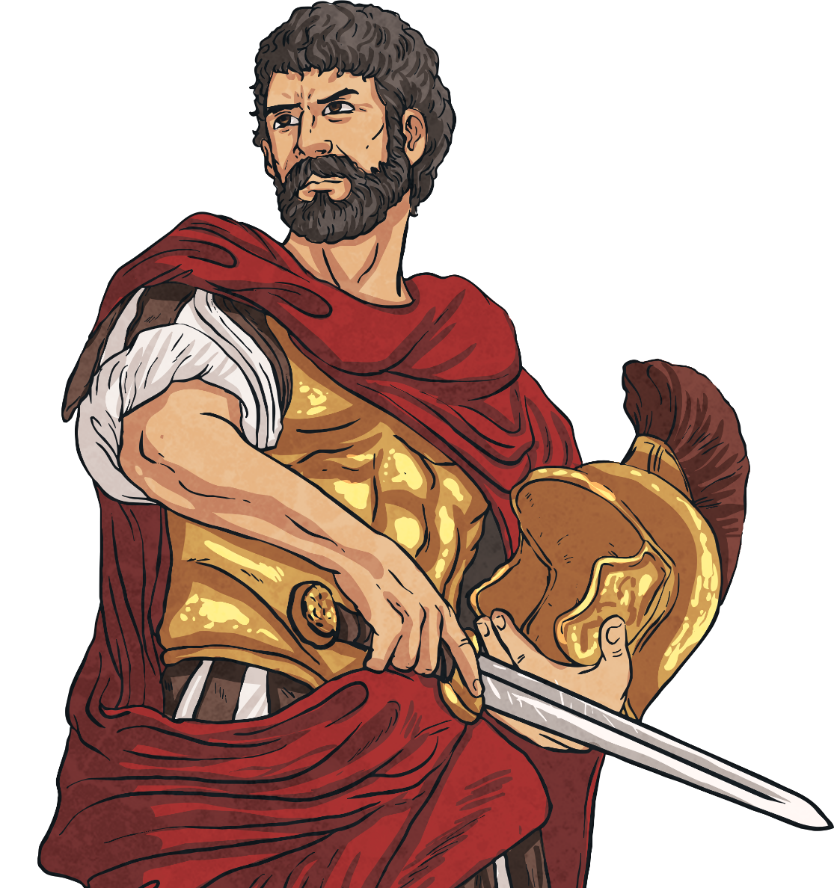
Glossary
assassinate – To murder a political figure.
consul – The highest political position in Rome.
dictator – A ruler with complete power over a country. Once in power, a dictator will try to remain in control by banning elections and trying to get rid of political opponents.
talents – The currency used during the Roman Empire.

