Slide 1
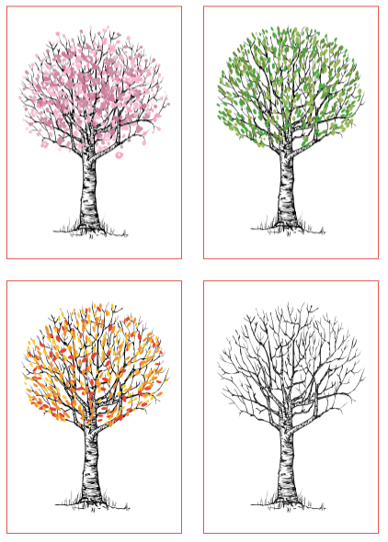
Changes
Look at the four pictures. What has changed?
What started the process of change?
What happened in each stage of the change?
What is your favourite/least favourite period of change?
Did the tree have any control over the changes that were happening to it?

Slide 2
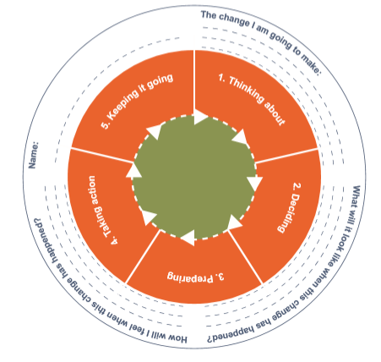
Changes - discussion
Changes can be quite scary, especially if you do not have any control over the changes. Learning from home or moving house for example are big changes.
What changes have happened in your life?
When did you or your family start thinking about this change? When was the decision to make the change taken? What preparations needed to be taken to make this change happen?
How did the change take place?
How did you manage to keep going?
Your task
How are you feeling about returning to school shortly or in September?
Can you complete the circle of change?

