Slide 1
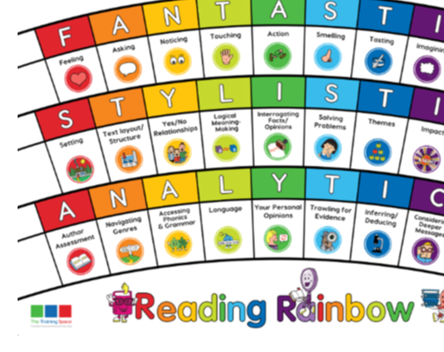
Monday 16th November
Lesson 1:
BOOK TALK

Slide 2
Lesson 1 - Book Talk
Using chapter 2 we are focusing on these 3 lenses:
Feeling
Characters
Stating Predictions

Slide 3
In your books, write down the following sentence starters for each of the lenses. These will help us when we write our answers this week.

Slide 4
Sentence starters:
Feeling:
Mrs Jarvis seems particularly ______ when…
Characters:
The character Mrs Jarvis seems to be…
Stating Predictions:
At this stage in the story, I can predict that…

Slide 5
Feeling lens
How do you think Mrs Jarvis is feeling about having to move her family again?
Can you verbally answer the question using a sentence starter? (2 points)
Write down some ideas about how she feels under your LI.

Slide 6
Character lens
What words would you use to describe Mrs Jarvis in this section of the story?
Can you verbally answer the question using a sentence starter? (2 points)
Write down some adjectives to describe Mrs Jarvis.

Slide 7
Stating Predictions lens
What do you predict will happen next to Jim and his family?
Can you verbally answer the question using a sentence starter? (2 points)

Slide 8
Tuesday 17th November
Lesson 2:
MODEL

Slide 9
Lesson 2 – Model
We are going to create some sentences together today using the same 3 lenses:
Feeling
Characters
Stating Predictions
We will write the answers together, but you can add in extra information if you would like to.

Slide 10
Feeling lens
How do you think Mrs Jarvis is feeling about having to move her family again?
Mrs Jarvis seems particularly __________...
OR
The impression we get of Mrs Jarvis’ feelings towards moving her family is…
2) Character Lens
What words would you use to describe Mrs Jarvis in this section of the story?
The character Mrs Jarvis seems to be…
OR
In this chapter, the character of Mrs Jarvis can be described as…
3) Prediction Lens
What do you predict will happen next to Jim and his family?
At this stage in the story I predict that…
OR
It is easy to predict what will happen next because…

Slide 11
Thursday 19th November
Lesson 3:
ENABLE

Slide 12
Lesson 3 - Enable
Today is your turn to answer questions on your own.
Please use the sentence starters from this week to help you.
Feeling
Characters
Stating Predictions

Slide 13
Session 3 – Enable (Independent comprehension)
Year 5
How do you think Mrs Jarvis is feeling on the journey from their old house to the place that she used to work?
The impression we get of how Mrs Jarvis is feeling in this chapter is…
2) What clues are there in this chapter to show us that Emily is a sensible young girl?
In this chapter, we can see that Emily is sensible where it says…
3) What do you predict will happen to Jim and his family next?
At this stage in the story, I predict that…
Bonus question
4 ) How do you think Jim feels about the iron boot scraper?
Year 6
How do you think Mrs Jarvis is feeling on the journey from their old house to the place that she used to work? What makes you think this?
The impression we get of how Mrs Jarvis is feeling in this chapter is… because…
2) What are the differences between Jim and his sister Emily? What makes you think this after reading Chapter 3?
In this chapter, we can see the clear differences between Jim and Emily are…
3) What do you predict will happen to Jim and his family next? Has your prediction changed from when we first started reading Street Child?
At this stage in the story, I predict that…
When we first started reading, my prediction was…
4 ) How do you think Jim feels about the iron boot?
5)What clues are there that Rosie, Mrs Jarvis’ friend, is a good person?
We get the idea that Rosie is a going to be a good person due to…

Slide 14
Friday 20th November
Lesson 4:
COMPREHENSION

