Slide 1
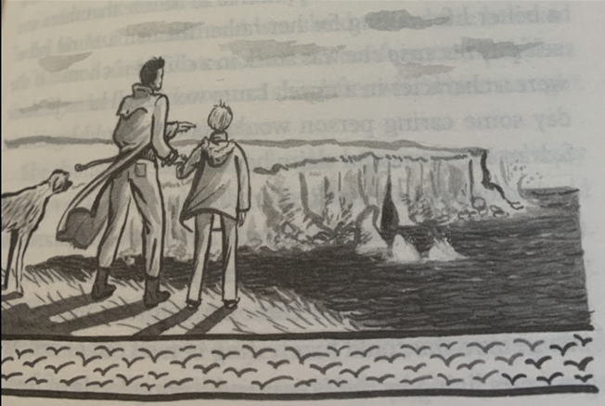
Dead Man’s Cove
Plot point 5
Visiting Dead Man’s Cove

Slide 2
Learning chunk 1
Initiate Uncle Calvin realises how upset Laura is and wants to spend some time with her. They go for a walk with Lottie along the forbidden coast path past Porthmeor beach, where Laura slips and stumbles on the narrow path.
Using the ‘checking’ lens Chot down and create a list of sounds that Laura notices when walking along the coastal path.
Listen: https://www.pond5.com/sound-effects/item/117402925-walking-rough-sea-beach-loop
Challenge: Use the noticing lens.

Slide 3
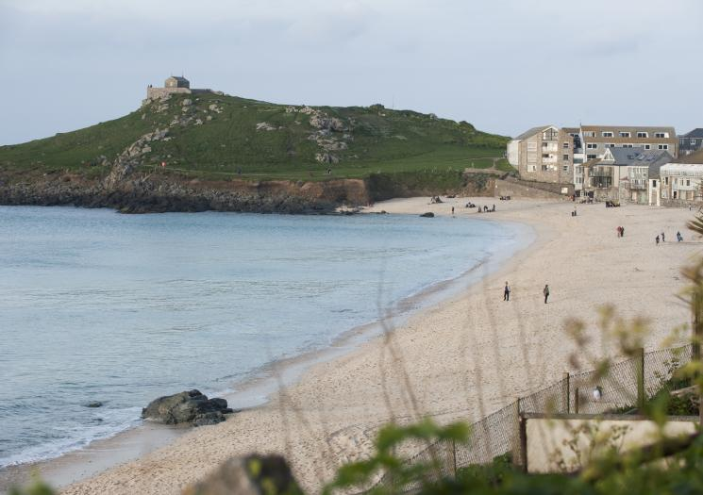
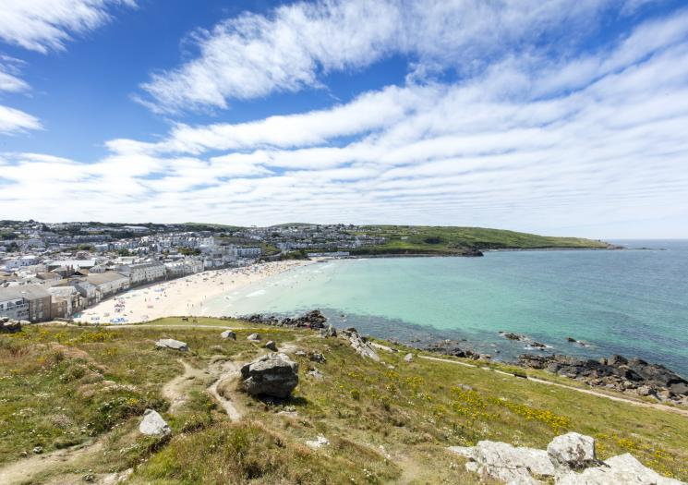
Learning chunk 1
Model Share write a sentence using the checking lens. https://www.pond5.com/sound-effects/item/117402925-walking-rough-sea-beach-loop
Challenge: Use the noticing lens.

Slide 4
Example Model sentence
Stumbling cautiously along the narrow, rocky cliff path, sand crunching beneath her feet with every step, Laura grabbed on tightly to the rocky outcrops for added safety. Gulls wheeled and screeched above the cliffs as the waves sucked and crashed against the cliffs far below and the distant laughter and chatter of children playing on the beach below drifted lazily along the coastal path.

Slide 5
Learning chunk 1
Enable Children to write a sentence (or two) using the imagining lens to describe the sounds she hears as she walks along the coastal path.
Challenge: Use the noticing lens.

Slide 6
Learning chunk 2
Initiate
A:The cliffs looked starkly black against the clear, blue sky.
P:Laura noticed how starkly black the cliffs were against the clear, blue sky.
A:Cliffs surrounded the beach the entire way.
P:The entire stretch of beach was surrounded by cliffs.
In your chotting books, change the sentences to passive voice.

Slide 7
Learning chunk 2
Model Share write a sentence describing a part of their walk using the passive voice.
The entire stretch of beach was surrounded by stark, black cliffs which towered precariously towards the bright, blue sky in stark contrast.

Slide 8
Learning chunk 2
Enable Children to write a sentence using the model sentence structure to help.
Use the sentence structure lens
Challenge: use the noticing lens.

Slide 9
Learning chunk 3
Initiate As Laura looks down on the infamous Deadman’s Cove she hears lots of sounds. Use onomatopoeia to describe them.
See the next slide for examples of onomatopoeia.
Then chot down as many examples as possible in your books of onamaopeia that Laura may hear.

Slide 10
Onamaopoeia

Slide 11
Learning chunk 3
Model Share write a sentence describing Laura standing at the top of the cliffs looking down onto the rocks and beach below.
Use the onomatopoeia lens to describe.
Laura shuddered as she looked down onto the crashing waves below, she couldn’t imagine a worse fate than being trapped in the tunnel with the gush of rising water. Lottie whined as she pulled on her lead, desperate to leave the terrifying place where so many had lost their lives.

Slide 12
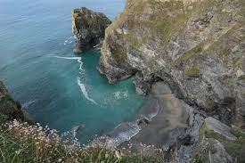
Learning chunk 3
Enable Children to write a sentence describing Laura walking along the coastal path. Use the onomatopoeia lens to describe.
Challenge: include the imagining lens (what Laura thought).

Slide 13
Dead Man’s Cove
Plot point 6 (chp 12)
Message in a bottle
.

Slide 14
Learning chunk 1
Initiate
Laura was walking along the beach to school, she came across an ordinary glass bottle(the type used for syrups) but with the label removed and the glass scrubbed clean. Laura could see there was a note inside. Laura picked up the bottle and attempts to remove the note.
Chot down words to describe things Laura has ‘felt’ E.G. the sand, waves, the bottle, the lid, pulling out the note. What words and phrases describe these actions?

Slide 15
Learning chunk 1
Model: Share write a sentence or two describing Laura finding the bottle and what she does.
Today the path along the beach had an eerie feel. The violent waves crashed against the rocks and Laura frequently needed to jump out of the way to avoid becoming wet. It was as she jumped that she felt something hit against her leg. A smooth, clear bottle bobbed up and down in the waves, with what appeared to be a rolled up note inside. Laura stooped to pick it up, and noticing how cold it felt she unscrewed the lid, poking her finger in to try to release the note.

Slide 16
Learning chunk 1
Enable
Now write your own sentence (or two) describing Laura finding the bottle and picking it up to see what is inside.
Use the Touching lens to write using adjectives and adverbs.

Slide 17
Learning Chunk 2
Initiate
Laura is intrigued by the bottle with the message in. She finally pulls the rolled up note out and reads it. ‘Can I trust you?’ reads the message. Who has written it? Who was it meant for? What does it mean? Laura thinks back to Sylvan Meadows when she read a book by her favourite detective, Mat Walker, to help solve a mysterious case where he received a message in a bottle too.
Split your chotting section in two. On one side, write in present tense some questions and notes about the mysterious bottle and note.
On the other side, write in past tense about the Mat Walker mystery when he too received a message in a bottle.

Slide 18
Learning Chunk 2
Model

Slide 19
Learning Chunk 2
Enable

