Slide 1
LI:Year 5 & 6
Subtract proper fractions from mixed numbers
Number: Fractions
Spr2

Slide 2
In Focus Task:
Success Criteria: I can subtract a proper fraction from a mixed number using partitioning I know when I need to break one of the wholes up to make it possible to subtract
Which one is different?

Slide 3
In Focus Task:
Success Criteria: I can subtract a proper fraction from a mixed number using partitioning I know when I need to break one of the wholes up to make it possible to subtract
Which one is different?
This calculation is the odd one out. All the other calculations give answers that are equivalent to 2 ½. This one does not.

Slide 4
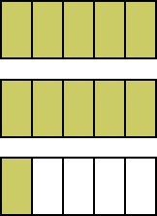
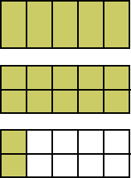
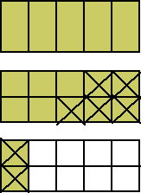
Talking time:
Drew is working out the answer to .
He uses this method:
STEP 1: STEP 2: STEP 3:
ANSWER:
Explain the method Drew has used.

Slide 5
Talking time:
Drew is working out the answer to .
He uses this method:
STEP 1: STEP 2: STEP 3:
ANSWER:
Explain the method Drew has used.
Drew has used the area method, but he needs to partition the mixed number
into 1 and 1 12/10 so that he can then subtract 7/10. If he partitioned it into 1
and 2/10, he would find that he is unable to subtract 7/10.

Slide 6
Talking time:
How would you use Drew’s method to calculate the answer to
?
Remember to partition the whole if you need to.
STEP 1: STEP 2: STEP 3:

Slide 7
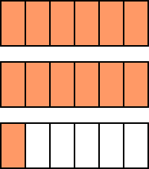
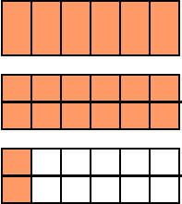
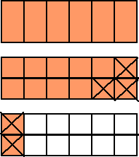
Talking time:
How would you use Drew’s method to calculate the answer to
?
Remember to partition the whole if you need to.
STEP 1: STEP 2: STEP 3:

Slide 8
Activity 1:
Use the three-step method you have practised to find the
answer to this calculation.

Slide 9
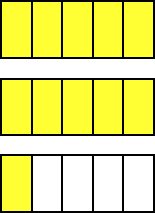
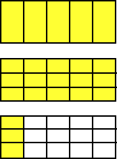
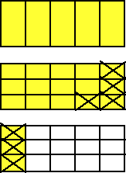
Activity 1:
Use the three-step method you have practised to find the
answer to this calculation.

Slide 10
Activity 2:
Use the three-step method you have practised to find the
answer to this calculation.

Slide 11
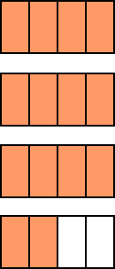
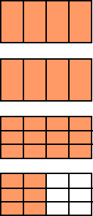
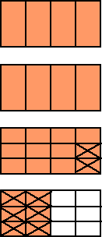
Activity 2:
Use the three-step method you have practised to find the
answer to this calculation.

Slide 12
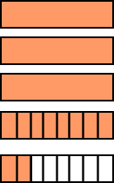
Talking time:
Becky uses a written method to find the answer to
Here is what she does:
Explain the method Becky has used.

Slide 13
Talking time:
Becky uses a written method to find the answer to
Here is what she does:
Explain the method Becky has used.
Becky has partitioned 4 and 2/8 into 3 and 10/8 because she knows she cannot subtract the equivalent of ¾ from 2/8.
Next, Becky has converted ¾ into eighths so that both fractions now have the same denominator.
Finally, Becky has subtracted to find the answer.

Slide 14
Activity 2:
Use the written method to partition, convert and then calculate.
2
3
5
6
4 – 2

Slide 15
Activity 2:
Use the written method to partition, convert and then calculate.
2
3
5
6
5
3
5
6
4 – 2 =
3 – 2
=
10
6
5
6
3 – 2
= 1
5
6

Slide 16
Evaluation:
Success Criteria: I can subtract a proper fraction from a mixed number using partitioning I know when I need to break one of the wholes up to make it possible to subtract
True or False?
To calculate , we need to partition
one of the wholes in the first mixed number
to help us.
is the same as
d)

Slide 17
Evaluation:
Success Criteria: I can subtract a proper fraction from a mixed number using partitioning I know when I need to break one of the wholes up to make it possible to subtract
True or False?
To calculate , we need to partition
one of the wholes in the first mixed number
to help us. TRUE
is the same as
TRUE
FALSE
d) FALSE

